Slide 1

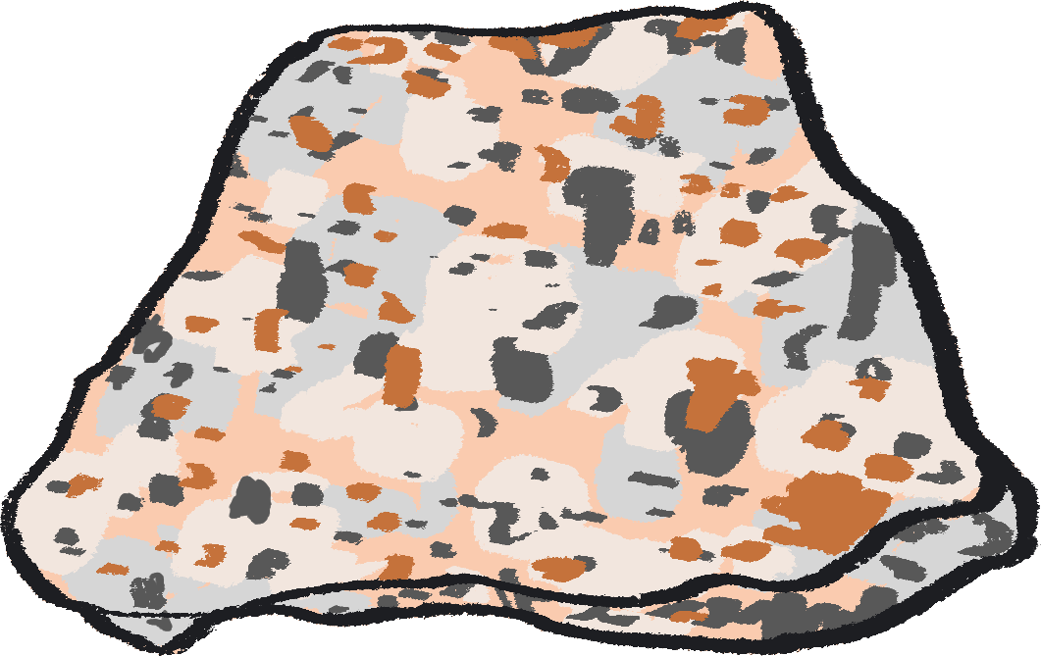



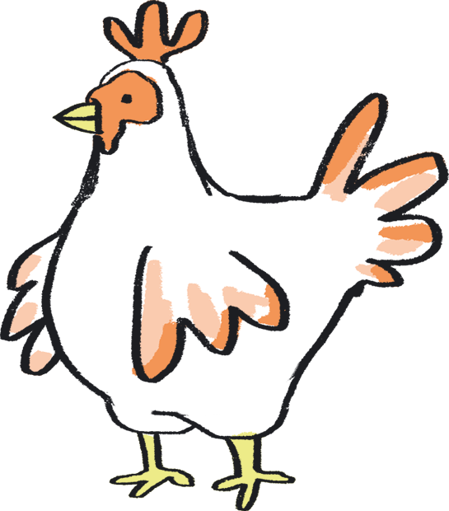
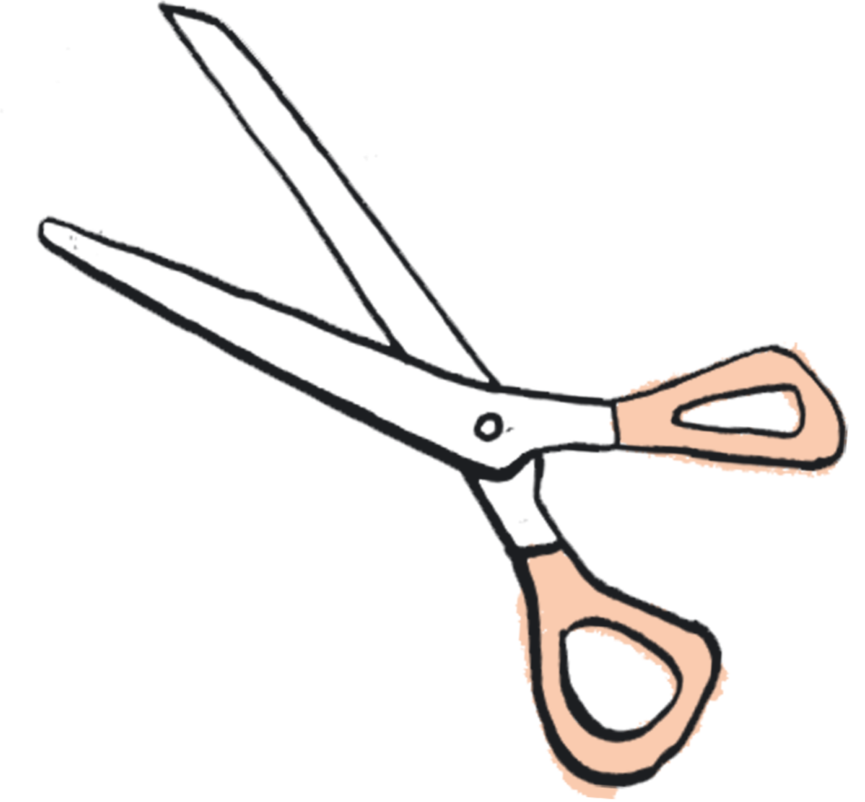
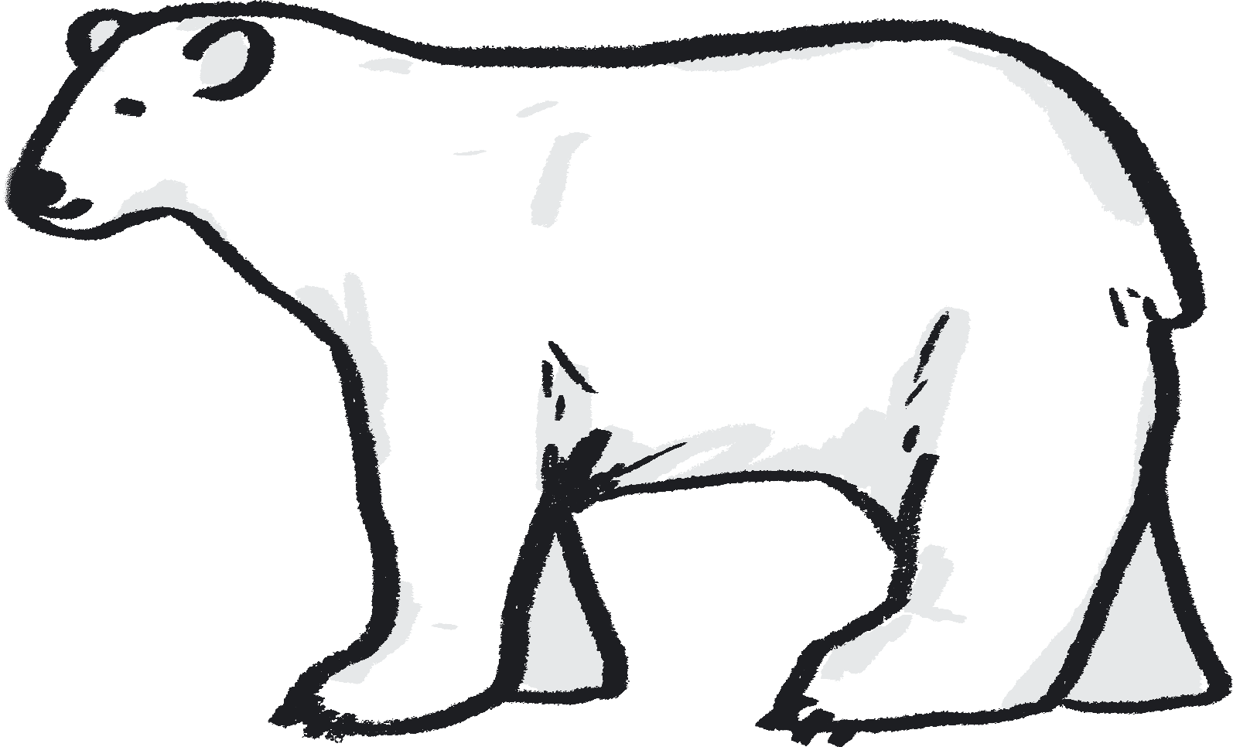
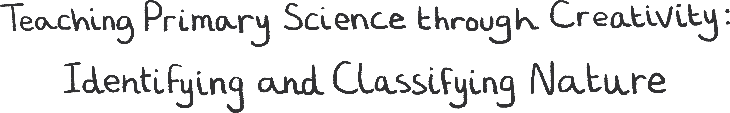
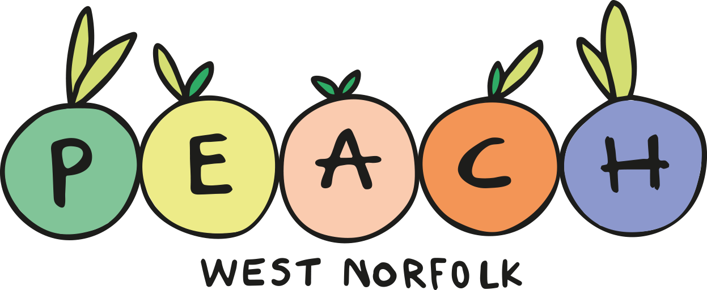



Teacher Lab
YEAR FIVE Teaching Resource – Slides and Notes

Slide 2
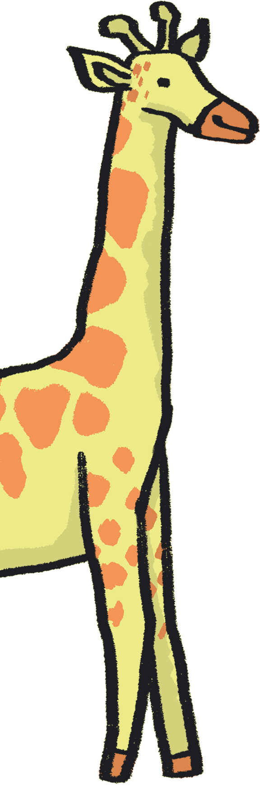
Contents
About Teacher Lab
How to use this resource
About this resource
Author statements
Lesson plans:
  Year 5 – Life Cycles
Credits
References

Slide 3
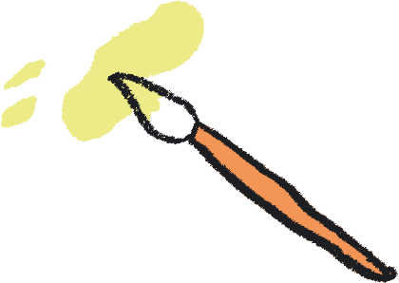
About Teacher Lab
The Teacher Lab project promotes creative practice in the classroom by supporting cross-curricular teacher and artist exchanges in the UK. It offers teachers direct access to a variety of artists, in order to re-imagine the curriculum and develop practical tools for learning through the arts.
You can access the previous Teacher Lab resource (exploring Push and Pull forces) created by teacher Christina Paul and actor and mathematician Victoria Gould, here: https://sites.barbican.org.uk/teacherslab/
……………………………………………………………………………………………………………………………………………………………………………..
This Teacher Lab was a collaboration between Barbican Creative Learning, Creative Arts East for PEACH West Norfolk, and involved teachers Gill Sekatawa and Sarah Melia from Nelson Academy in Downham Market, Norfolk, and Norwich based artist Kaitlin Ferguson.
Through a series of planning, testing and reflection sessions, Gill, Sarah and Kaitlin co-designed a range of creative activities to support the delivery of the primary science curriculum. These were then developed into a resource pack, in the form of a set of PowerPoint Slides which can be used directly in a lesson, with supportive guidance notes to assist your teaching.

Slide 4
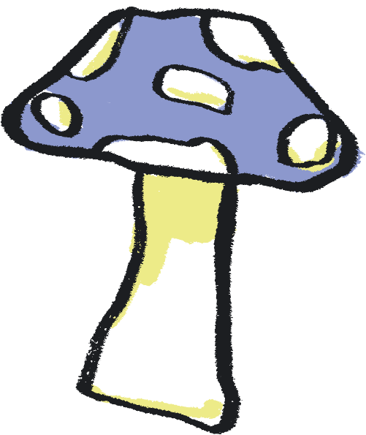
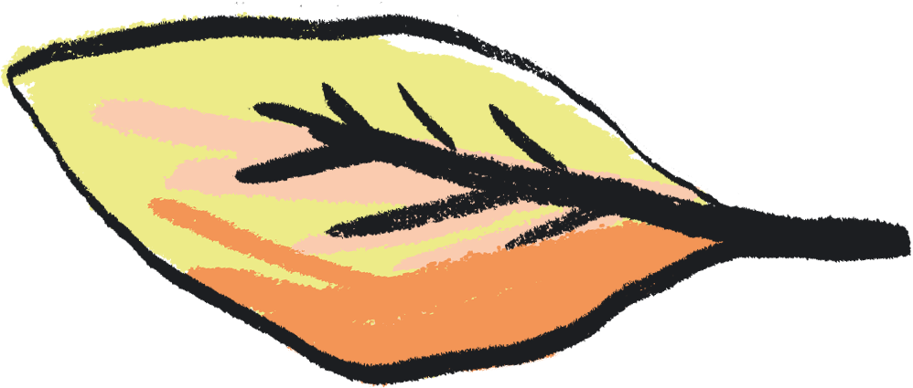
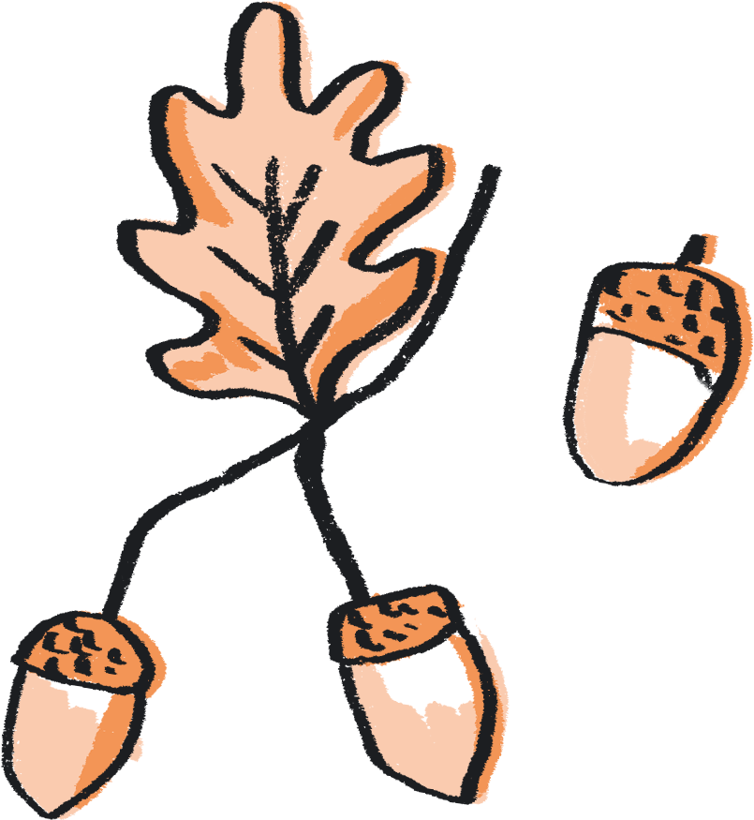
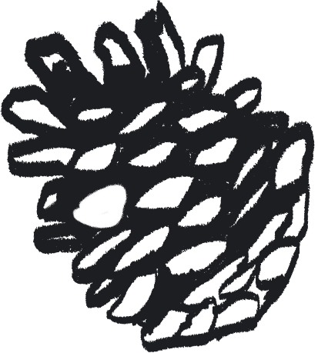
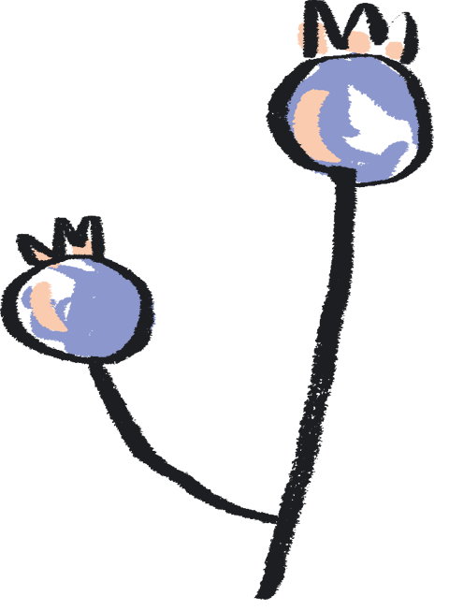
How to use this resource
You can use this resource in two ways:
As a live PowerPoint presentation for the whole class to view
As a printed pdf
Each year group has a dedicated set of slides.
The main content of each slide is directed at the pupils.
This content is animated to ensure that the teacher is in control of the pace of the lesson.
Each slide also has a corresponding set of ‘notes’, which are directed at the teacher.
To use the resource in PowerPoint Slide Show mode:
Go to the slide you wish to begin from
Click ‘Slide Show’ tab in the top navigation bar
Click ‘From Current Slide’ in the menu bar
To see the notes in this mode, click on the ‘…’ in the lefthand corner and select Presenter View
To view the notes:
Click on the View tab in the top navigation bar
Select ‘Notes’ to see these at the bottom of each slide

Slide 5
About this Resource…
Our Teacher Lab resource pack supports both creative practice and scientific enquiry in the classroom. We aim to offer teachers access to a variety of art experiences, aligned to each year group’s science curriculum. Through these activities, we hope to introduce exciting ways to combine the deepening of scientific knowledge and skills with the development of creative practice. Each activity also aims to embed scientific understanding and help children to ‘know more and remember more’ about the chosen topic.
We chose the working scientifically skills of ‘identifying and classifying’, as these are skills which run throughout the primary curriculum. We have chosen ‘Nature’ as a theme across all of the activities, offering ways to broaden children’s experience and understanding of nature and their place within it. Each nature-based topic has been selected from the National Curriculum and for reception the Early Learning Goals, to ensure each is as relevant as possible.
With reference to this knowledge base, we demonstrate how arts practice can be used to reinforce the skills and processes of identifying and classifying. For each year group, we have chosen a different art-based skill to provide teachers with a wide repertoire of creative ideas. We hope that these might be a starting point to enable teachers to use these creative practices to reinforce learning in other curriculum areas.

Slide 6
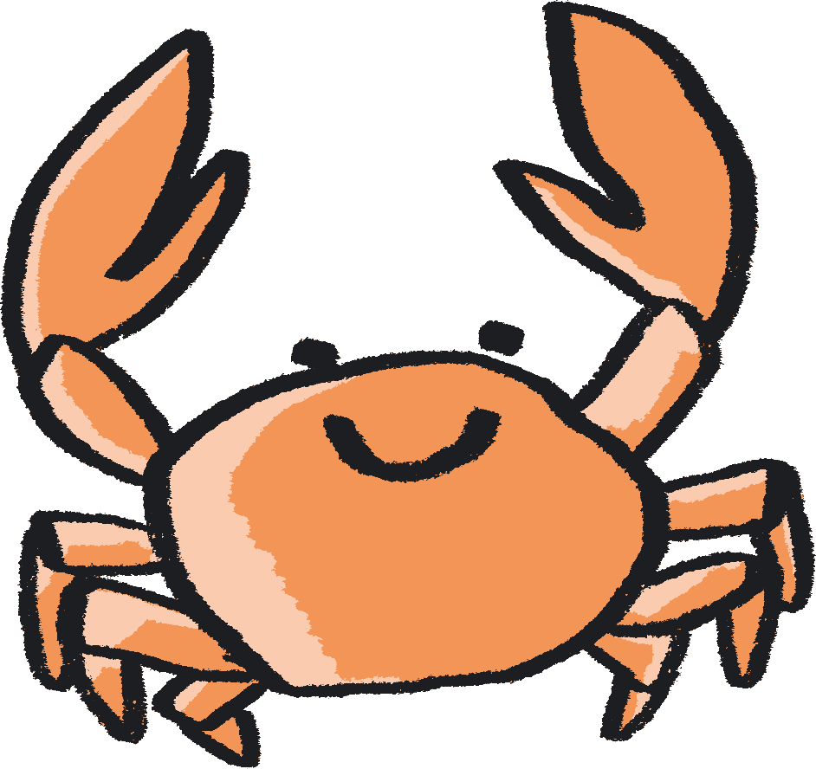
Each activity is designed as a mini project brief for your class, they are jumping off points to take in whichever direction best suits you. We encourage you to follow the natural curiosity of the children you’re working with and adapt the activity how best you see fit.
In terms of work with SEND children - each child is of course different, so when working with this resource, feel free to pick and choose activities which feel most suitable for them, depending on how they feel that day. Feel free to get creative with the activities and adapt them to your child's needs to create the best experience possible.

Slide 7
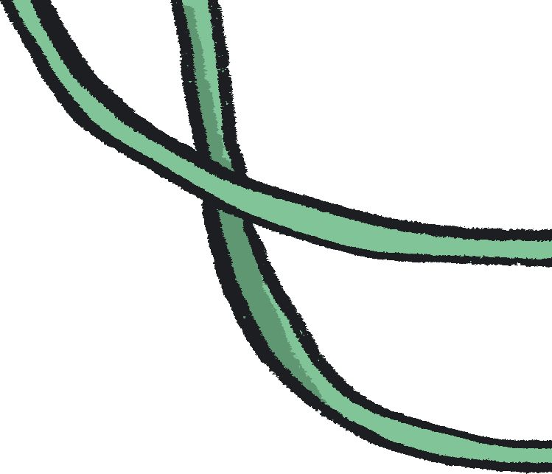
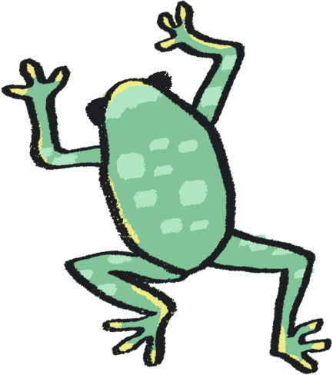
Author Statements
Gill Sekatawa, Art and Design Lead, Nelson Academy:
My aim for the resource was to provide a range of activities and experiences which will not only allow students to soak up the knowledge but also that allowed all involved to acquire transferable skills in art and problem solving to use in their future learning.
Prior to this Teacher Lab project, we had recently explored art and poetry with Kaitlin as part of Barbican Box in West Norfolk, which was an amazing experience. When the Barbican and Creative Arts East approached us about working together again, but this time in the suggested area of Science, it became immediately clear that we should involve Sarah, my teaching team colleague. As Science lead for our school, she is tasked with ensuring that, working scientifically, children will know and remember more. From my experience, there is no better way of making knowledge 'stick’ than using art and creativity to make learning engaging.
Sarah Melia, Science Lead, Nelson Academy:
I came at this project as a novice artist, intrigued to learn how art and science could mix and how creative practice could help children to enjoy working scientifically as well as know and remember more about a chosen topic. I wanted to choose a working scientifically thread which would run through all year groups in the hope that we would reach as wide a teacher and pupil audience as possible. By having this common thread link all the year groups’ activities together, the aim is that teachers will be able to adapt art activities from other year groups to use with other knowledge areas in their own year group, thereby creating a bank of resources whose application is potentially much wider than that originally written. As a science lead, I wanted not only to improve my own creative practice, but also to introduce a range of activities that could be adapted and used in different contexts, so that they could support the teaching of schools’ individual science curriculums, no matter what the unit’s knowledge base.

Slide 8
Author Statements continued…
Kaitlin Ferguson, Artist:
It has been really inspiring to work on this collaboration with both Gill and Sarah, and to create a resource which draws upon areas of the curriculum which we each feel very passionate about. It has been a fascinating process, which has allowed us to find inspiration from each other's passions and knowledge.
When we began creating the resource, we agreed it was really important that each set of activities felt truly balanced between art and science. We saw science as an inspiration for making art, and creativity as a means to explore science on a more meaningful level.
Art is a dynamic subject which has the ability to work in tandem with any subject in the curriculum, to bring greater depth and understanding. During our initial chats, we realised that classifying and sorting was not only a science skill which is relevant to each year group, but it also is a skill found in art. For example, curation is simply the sorting and organising of artworks. Therefore we designed the activities to have identifying and classification at the heart of them.
It’s been really enlightening to learn about the curriculum in greater detail, from those who are actively teaching it. This has allowed me to absorb and learn from the amazing teaching of Gill and Sarah. Like most teachers, Gill and Sarah have to come up with infinite new ideas and activities for their pupils regularly, under pressure of time constraints. Therefore, it has been really rewarding to create a resource which is designed both for ease of use for the teacher but also full of excitement and wonder for the children.
We hope that the resource offers teachers an exciting and ambitious set of ideas, rooted in the curriculum, to help grow the confidence, knowledge, and creativity of children.

Slide 9
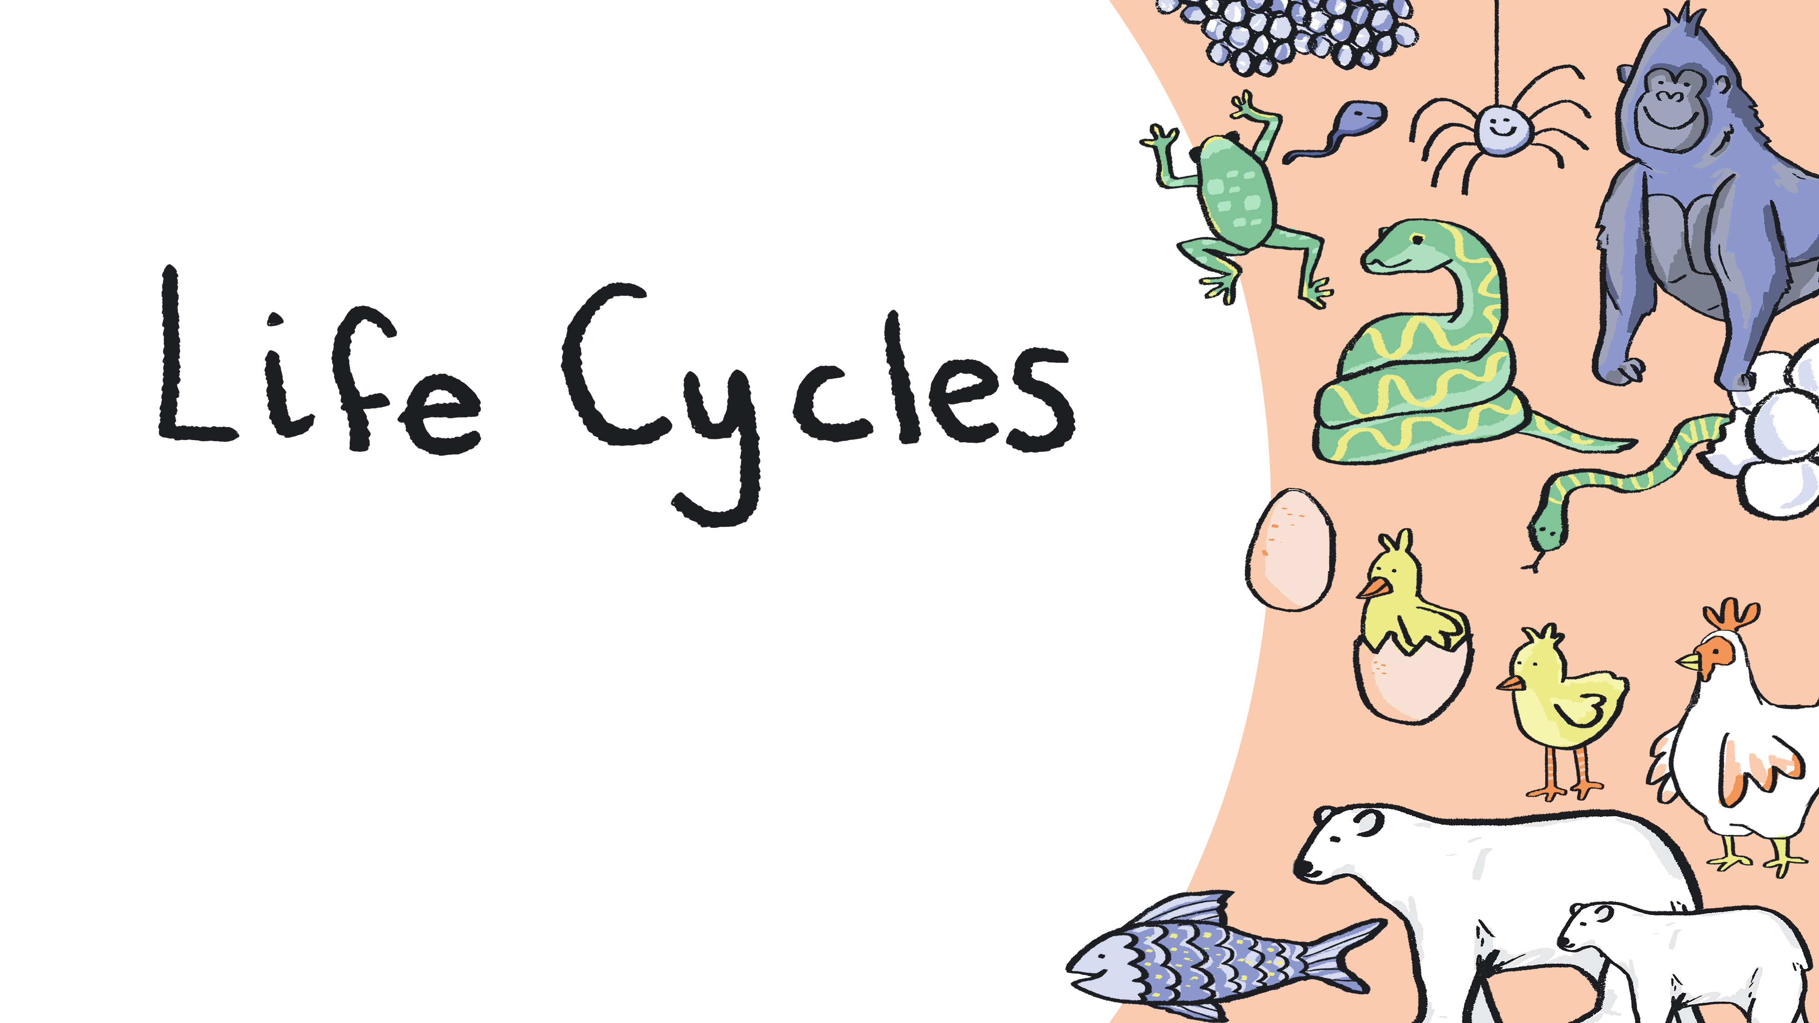
With Year 5
Notes:
Curriculum Links: Being able to describe the differences in the life cycles of a mammal, an amphibian, an insect and a bird
Curriculum Links: Practical scientific methods, processes and skills: recording data and results of increasing complexity using scientific diagrams and labels, classification keys, tables, scatter graphs, bar and line graphs.
Non statutory - They should use and develop keys and other information records to identify, classify and describe living things and materials, and identify patterns that might be found in the natural environment.

Slide 10
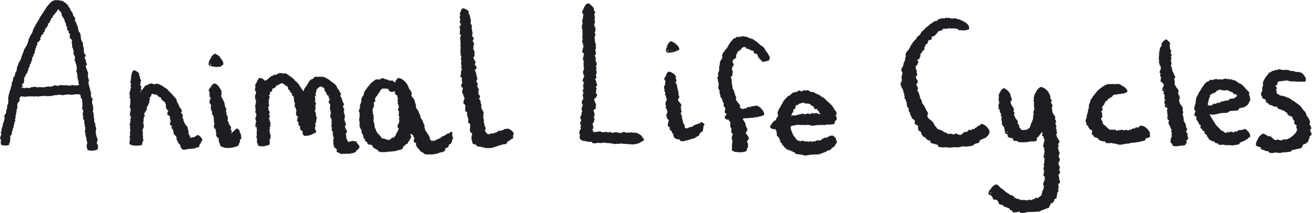
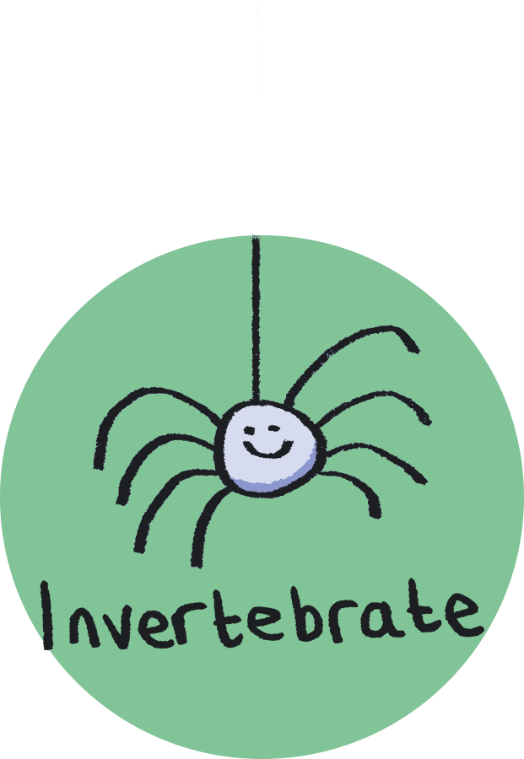
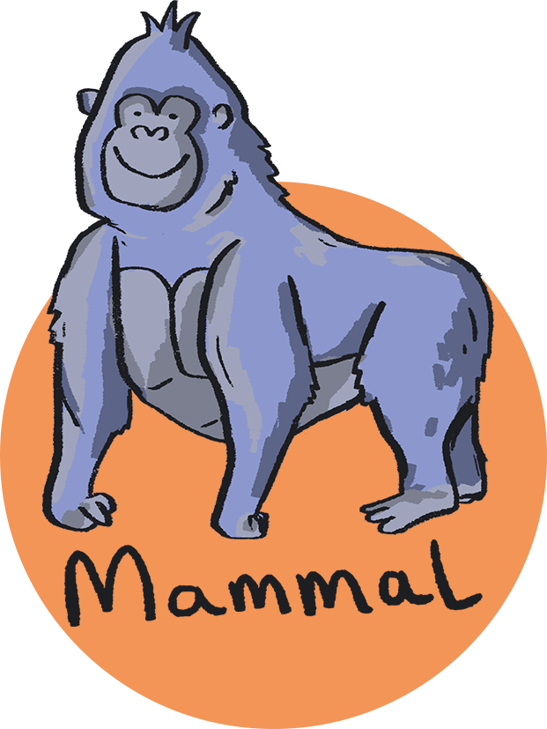
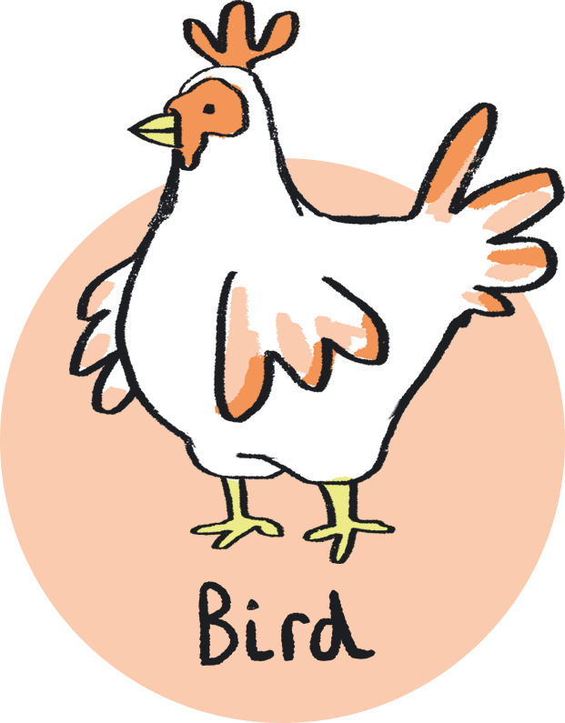
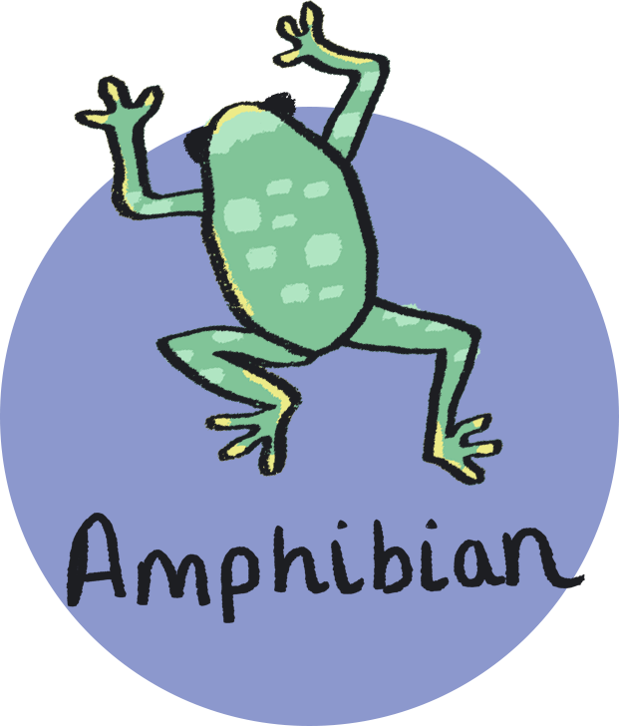
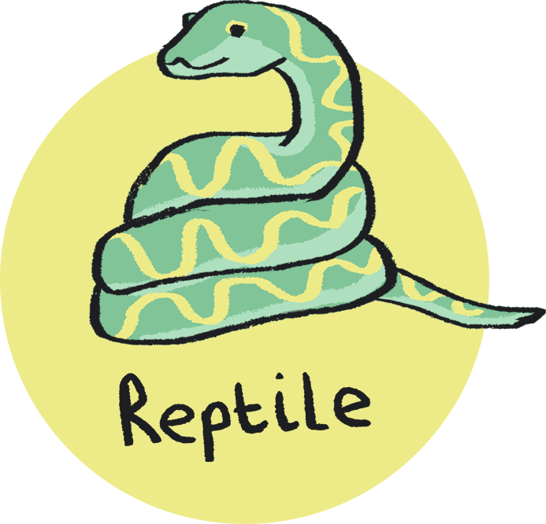
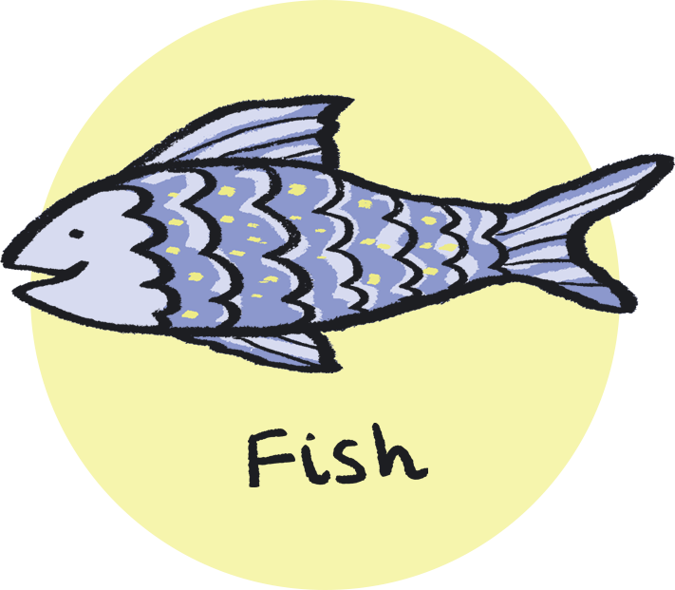
Classification activity
Describe the differences in the life cycles of a mammal, an amphibian, an insect and a bird.
You will need:
Pencil and paper
Images of TWO different animals from TWO different animal classes.
Quiz: Can you remember what the six different animal classes are?
Notes:
Please note - Prior knowledge of basic life cycle of bird/mammal/insect/amphibian required - you may wish to have the resources you used printed off for reference. A popular subscription education website has some great life cycle resources!

Slide 11


Have a careful look at images of two different animals’ lifecycles, from two different classes.
Think carefully about the similarities and differences between their life cycles.
Try drawing a Venn diagram to explore the similarities and differences you have thought about.
Top Tip: Look at an example Venn diagram on the next slide…
Write down the reasons for your decisions.

Slide 12
Frog
Chicken
Both Frog & Chicken
Eggs are fertilised after they are laid
Adults mate
Lays eggs
Recently hatched young have gills and breathe through them
Adults breathe through lungs
Recently hatched young have lungs and breathe air
Young are not directly fed by their parents
Body structure does not fundamentally change as they grow
Also breathe through moist skin
Go through metamorphosis – a change in the animal’s body structure

Slide 13
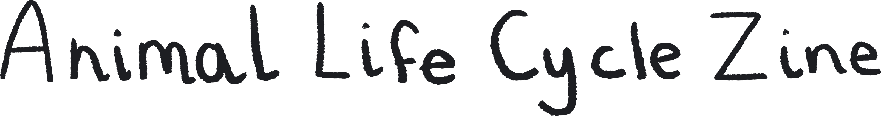
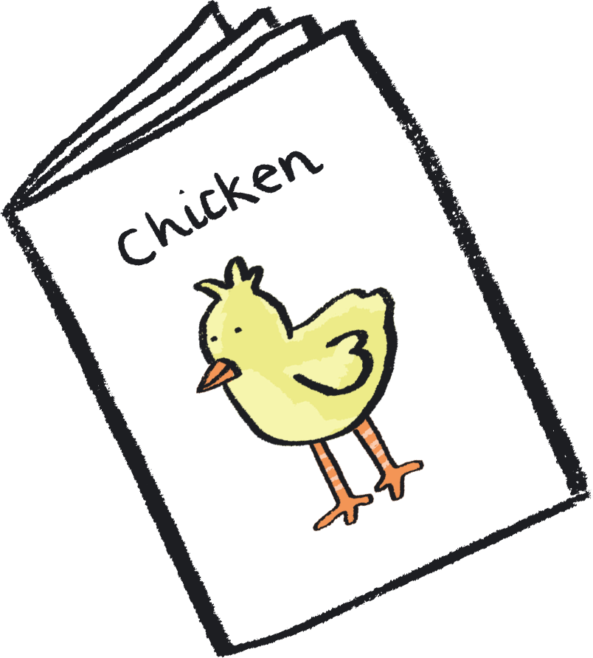
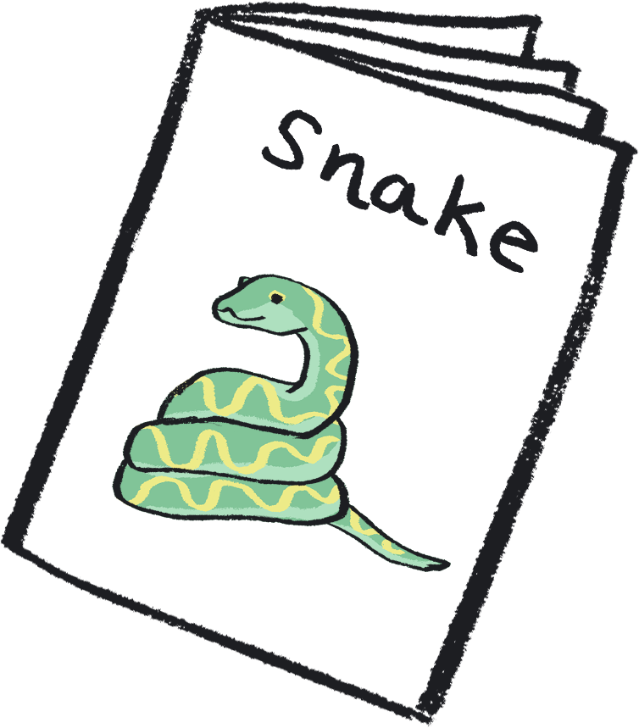
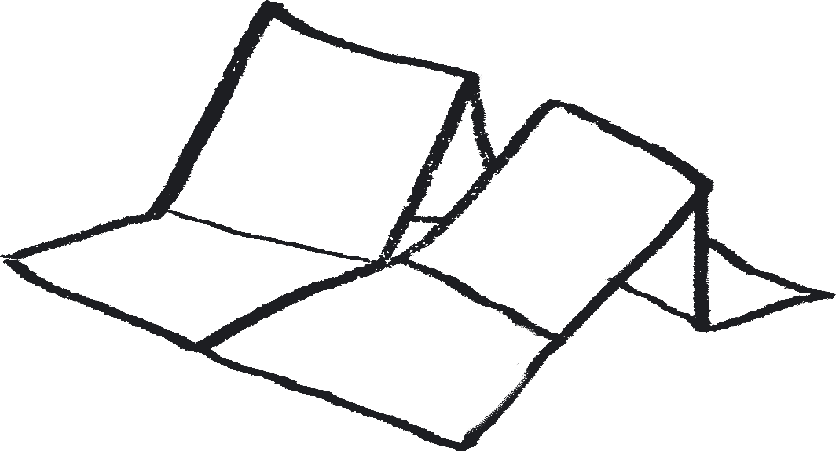

Art activity
Medium: Zine Making and Mono printing
A zine is a magazine hand-made by artists.
For this activity, have a go at making a zine inspired by the lifecycle of an animal.
Create artwork to go inside by trying a type of printmaking called 'mono-printing'.

Slide 14
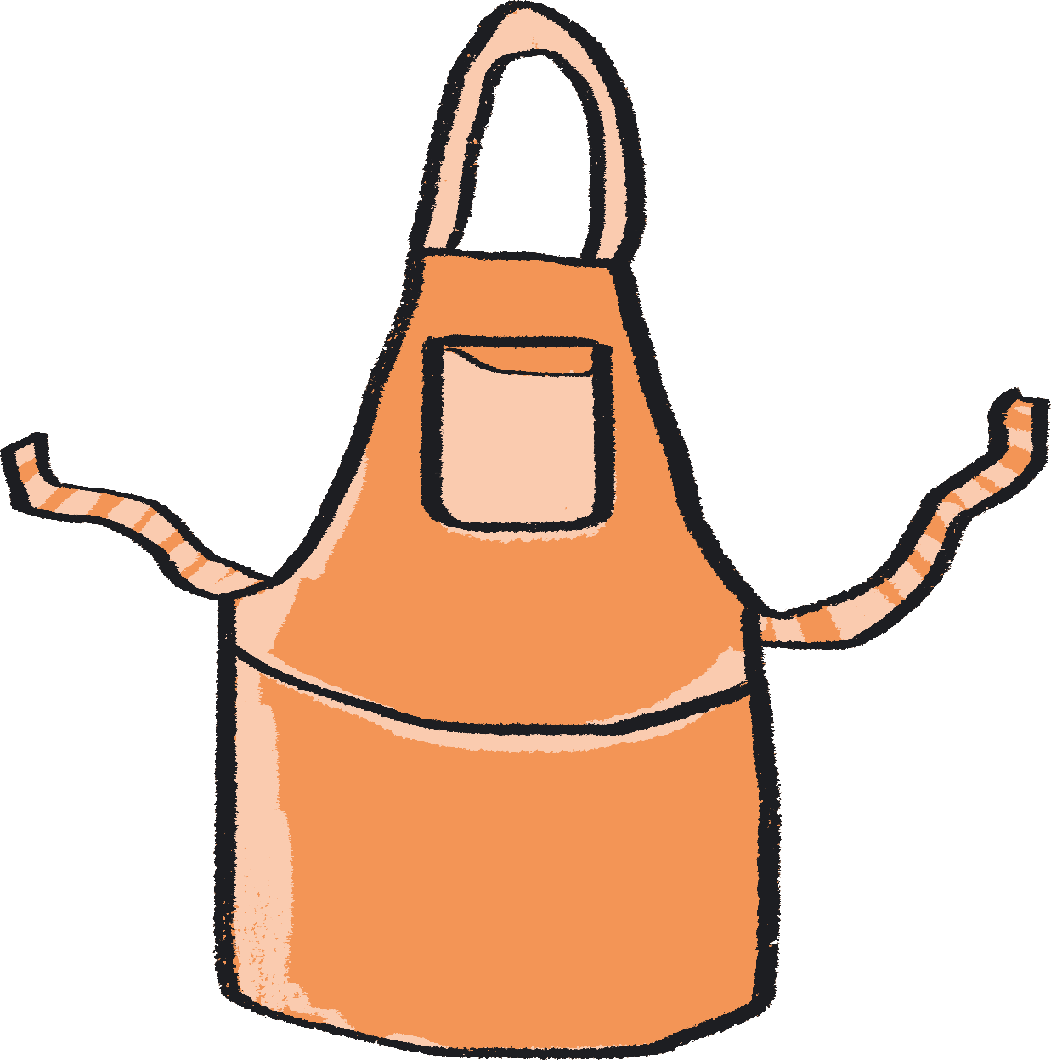
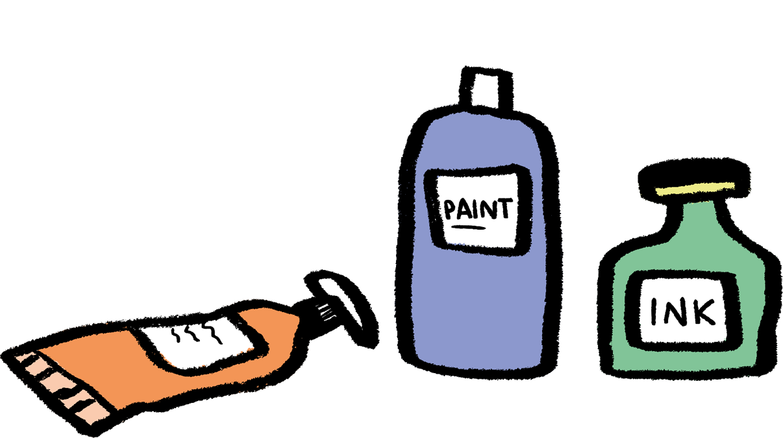

You will need:
A3 paper (1 per person)
A6 paper sheets (multiple sheets per person)
Scissors
Table coverings
Aprons
Reference images of animals during different stages of their lifecycle
Acetate sheets (1 per person)
Printing rollers
Printing ink
Arts and craft tray for rolling ink out
Pencils
Glue
Notes:
Resource notes:
A6 Paper sheets - An easy way to make these is to cut A4 pieces of paper into four rectangles
Printing ink – Use block printing ink which is water based (you could substitute this for acrylic paint)
Acetate Sheets - Used for OHP projectors. These will be your printing 'plates’ You could use another flat surface to roll printing ink out on to, such as a Perspex sheet or a picture frame

Slide 15
Stage 1: How to Fold a Zine
Click here to watch Kaitlin on YouTube…

Slide 16
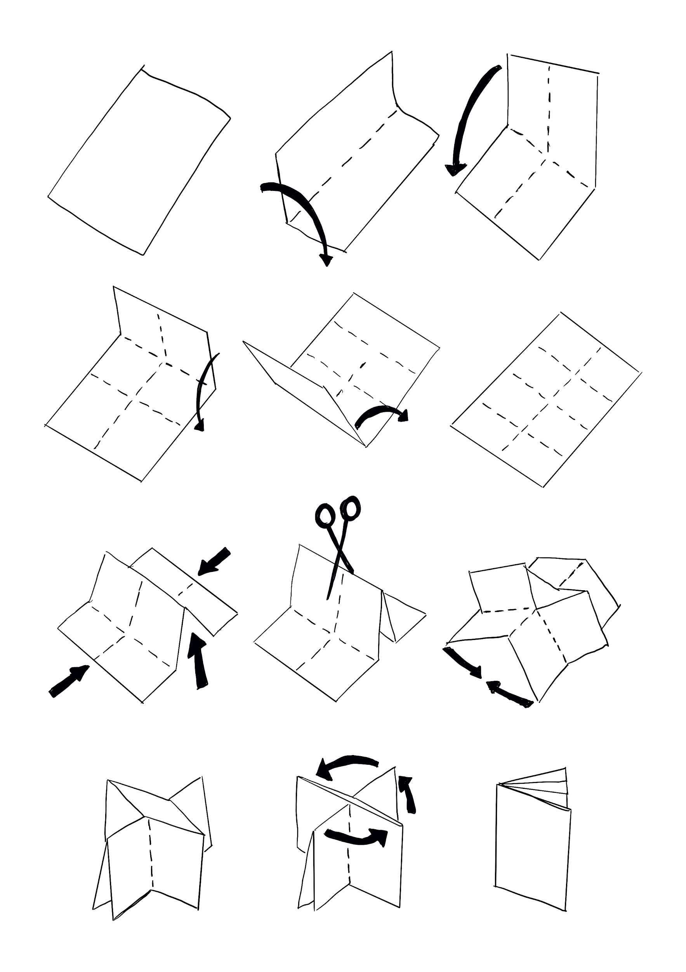
Take A3 piece of paper.
Fold your piece of paper in half lengthways.
Fold your piece of paper in half width ways.
Unfold the piece of paper.
Take one of the shorter sides and fold it in to meet the middle crease.
Open the piece of paper back out.
Repeat the last fold again on the other side.
Unfold your piece of paper so that it is flat. You should be able to see eight boxes.
Turn the paper over.
Push the shorter ends of the piece of paper towards each other. This will lift the central fold upright.
Cut along the side where the crease is. Be sure to only cut half-way down the piece of paper.
Open your zine up by bringing the corners on the long sides together.
This should create a booklet shape.
Then fold each one of the pages down to create a folded zine.
Stage 1: How to Fold a Zine – the steps…

Slide 17
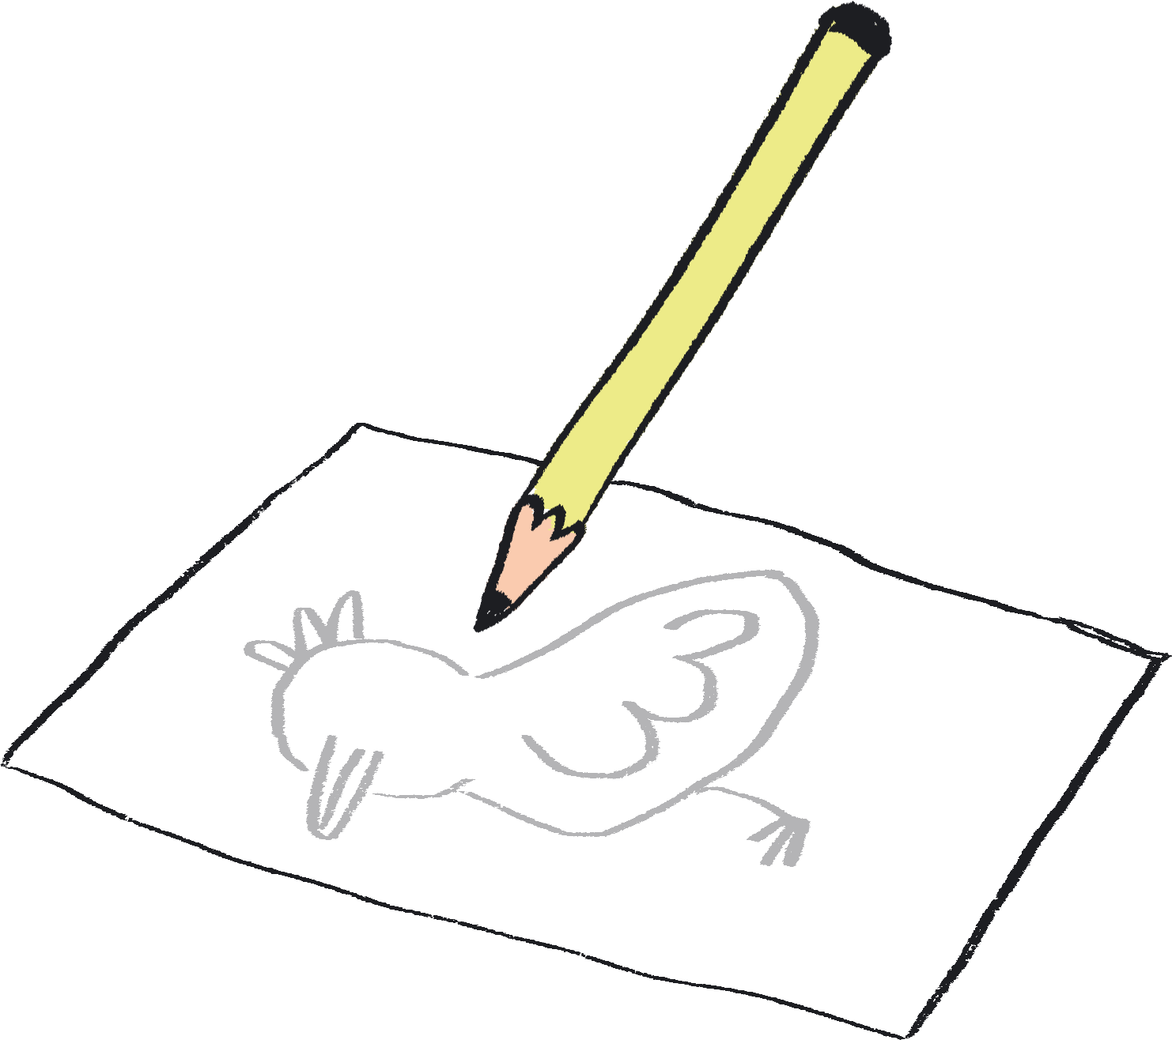
To create the artwork in your zine we are going to try
positive
monoprinting
It’s a really easy
printmaking
process!
Stage 2 - Design the Artwork for Your Zine
You are going to be making a different monoprint for each stage of the lifecycle of your chosen animal.
You’ll be printing these on smaller pieces of paper.
When they are dry, you will cut these prints up and stick them in your zine so make sure they are the right size!
But first:
Choose an animal lifecycle you would like to focus on.
Research the different stages of its life.
With a pencil, lightly sketch each stage on a different page in your zine.
Notes:
Drawing the lifecycle can develop children’s observation and recording skills, and help them to notice the ways in which the animal changes.
Children can be encouraged to try to notice the details of the animal. This can also lead to other science conversations about the physical attributes of animals – about camouflage, means of locomotion (do they hop, walk, fly or undulate?), and more.

Slide 18
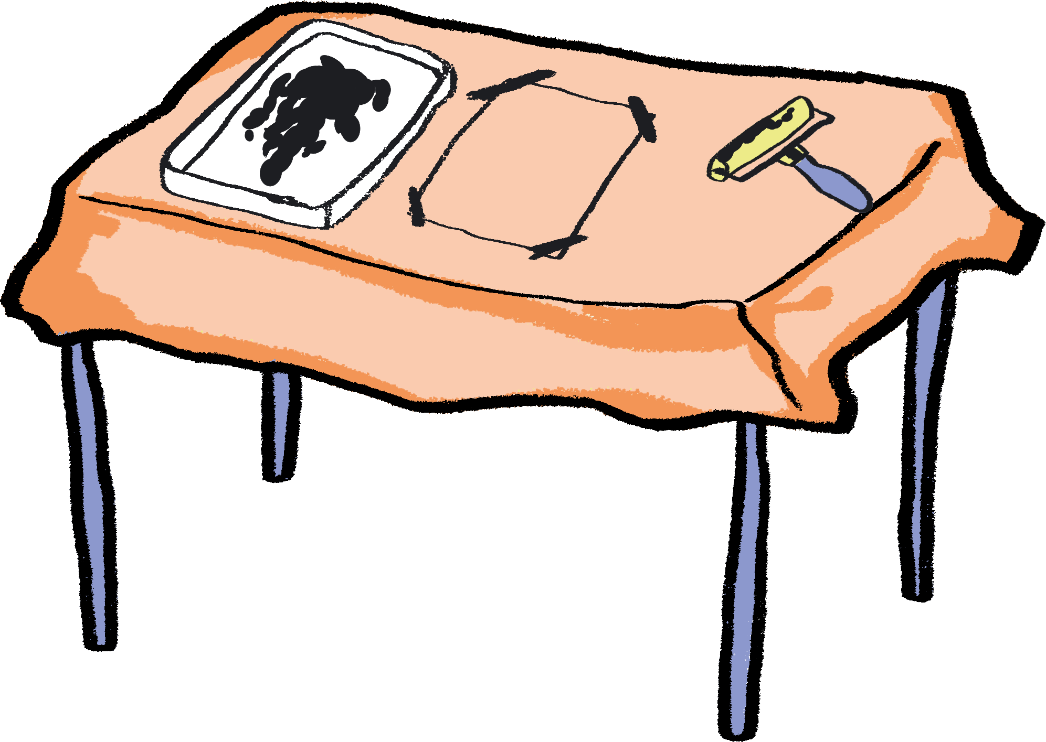
Stage 3 - How to Monoprint
Cover the table you are printing on with newspaper or an old tablecloth, to protect it from stains.
Put a small blob of ink (the size of a 1p coin) on your printing tray and roll out the ink.
  Top Tip - When you hear a sticky sound, you know the ink is evenly applied to the roller!
Take a sheet of acetate and either tape or hold down on the table.
Notes:
Notes to teacher: Try to get the children to create monoprints which are roughly the size of a postcard or A6 piece of paper, in order to fit on the different pages of the zine booklet.

Slide 19
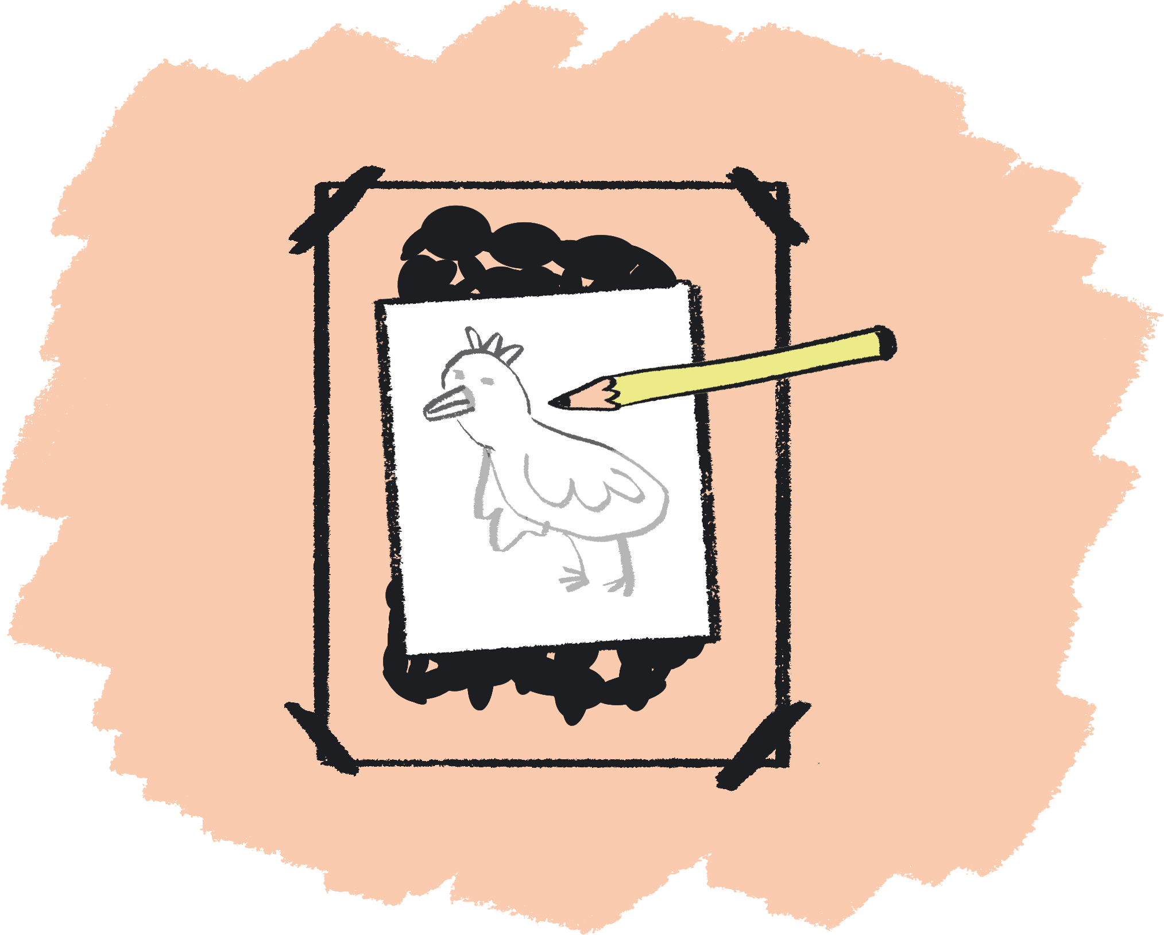
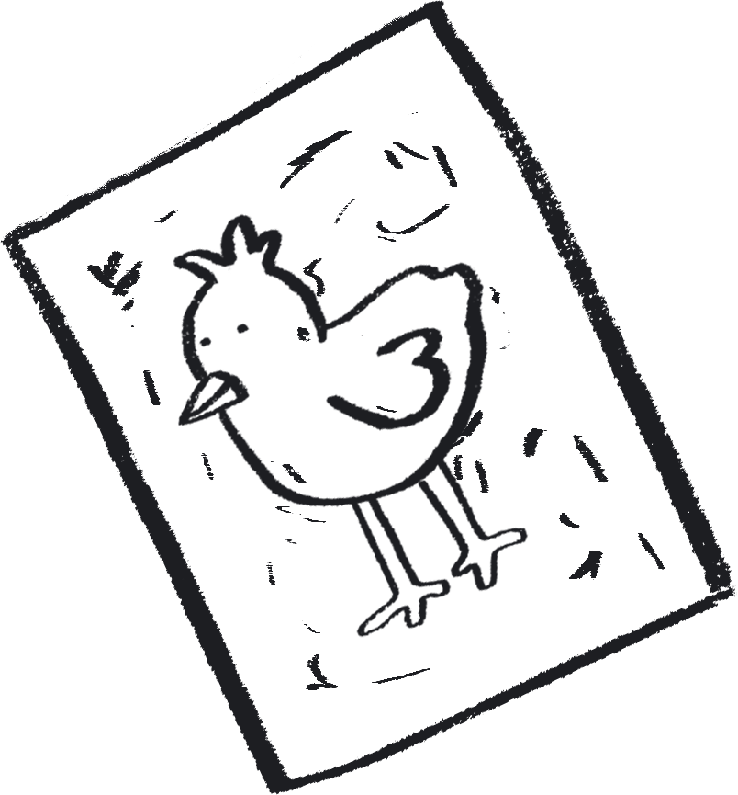
Stage 3 - How to Monoprint
Roll the ink out on the acetate for a minute in different directions to make sure the ink is evenly distributed.
Very gently place the piece of paper on top of the acetate with the ink on.
Using a pencil, draw your design on the back of the paper, being careful not to press with your hand on the paper.
When you are done, gently peel the paper off to reveal your print!
Notes:
PROMPTS FOR CREATIVE THINKING
Before they create their print, students might like to look at examples – there are some examples of print artists on the last slide of this section. Do any of these inspire them? What it is about these designs that they like? How do they think the artist might have made these? Can they check this through research?
Students can reflect on the outcome of their print - is there anything they would do differently next time? More / less ink, different pencil pressure, a more simple / more complex design? They can try this when creating the print for the next stage.

Slide 20
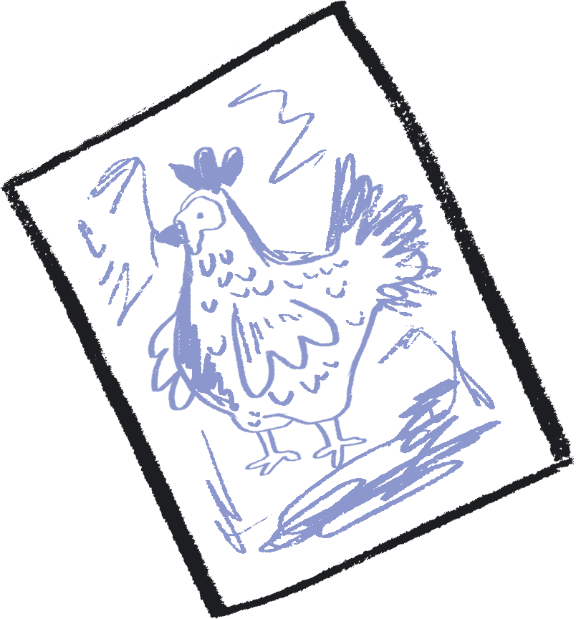
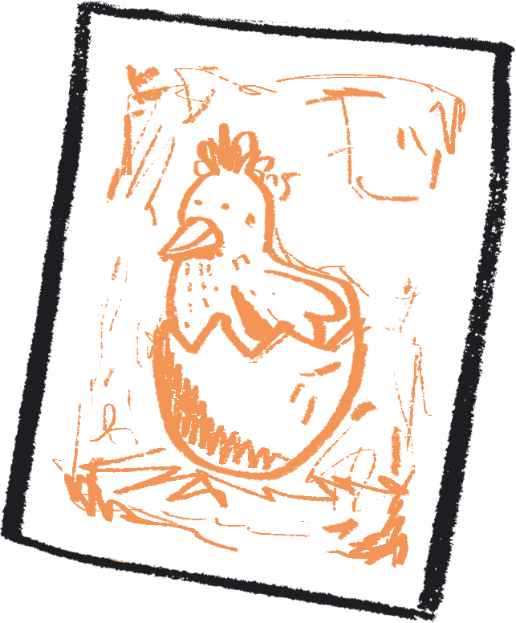
Stage 3 - How to Monoprint
To make another print, either re-roll the ink to go again or wash the acetate off and add a new colour.
Try experimenting with different pressures for different thicknesses in your lines.
Once your prints are fully dry, cut them up and stick them into the different pages of your zine.
Add a title page to your zine and annotations (explanatory notes) which explain the lifecycle stages of your animal.
Notes:
Possible Extension:
When making their lifecycle zine, you could get children to include a page comparing the chosen animal class with another (maybe even including their Venn diagram).

Slide 21
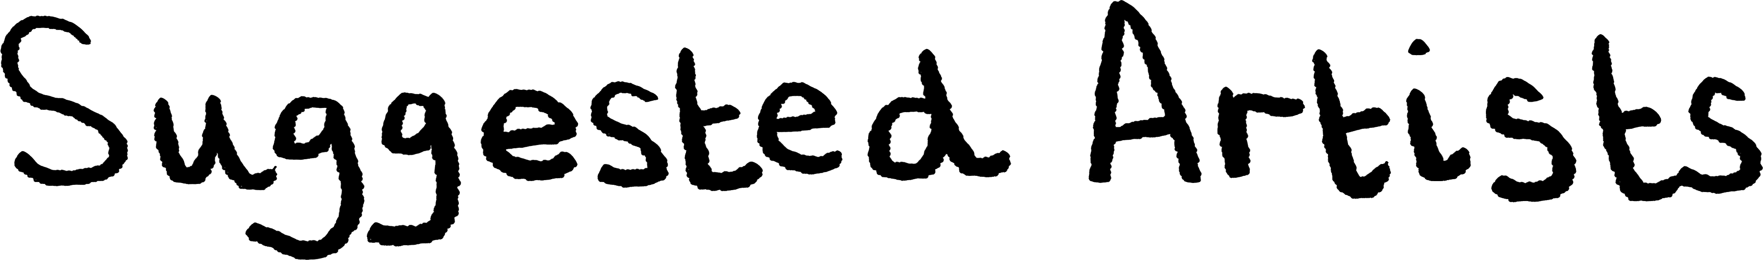
Sangeeta Gupta
“Look at Sangeeta's abstract prints. Look at ways of creating backgrounds for prints'' Gill
“For detail in drawings into ink. Create layered monoprints using the two techniques - perhaps using some of the animals and fossils studied in the science investigations'' Gill
“I have always really loved Gabo's monoprint series, and how he draws so carefully directly into the ink'' Kaitlin
Georgina Brown
Naum Gabo

Slide 22

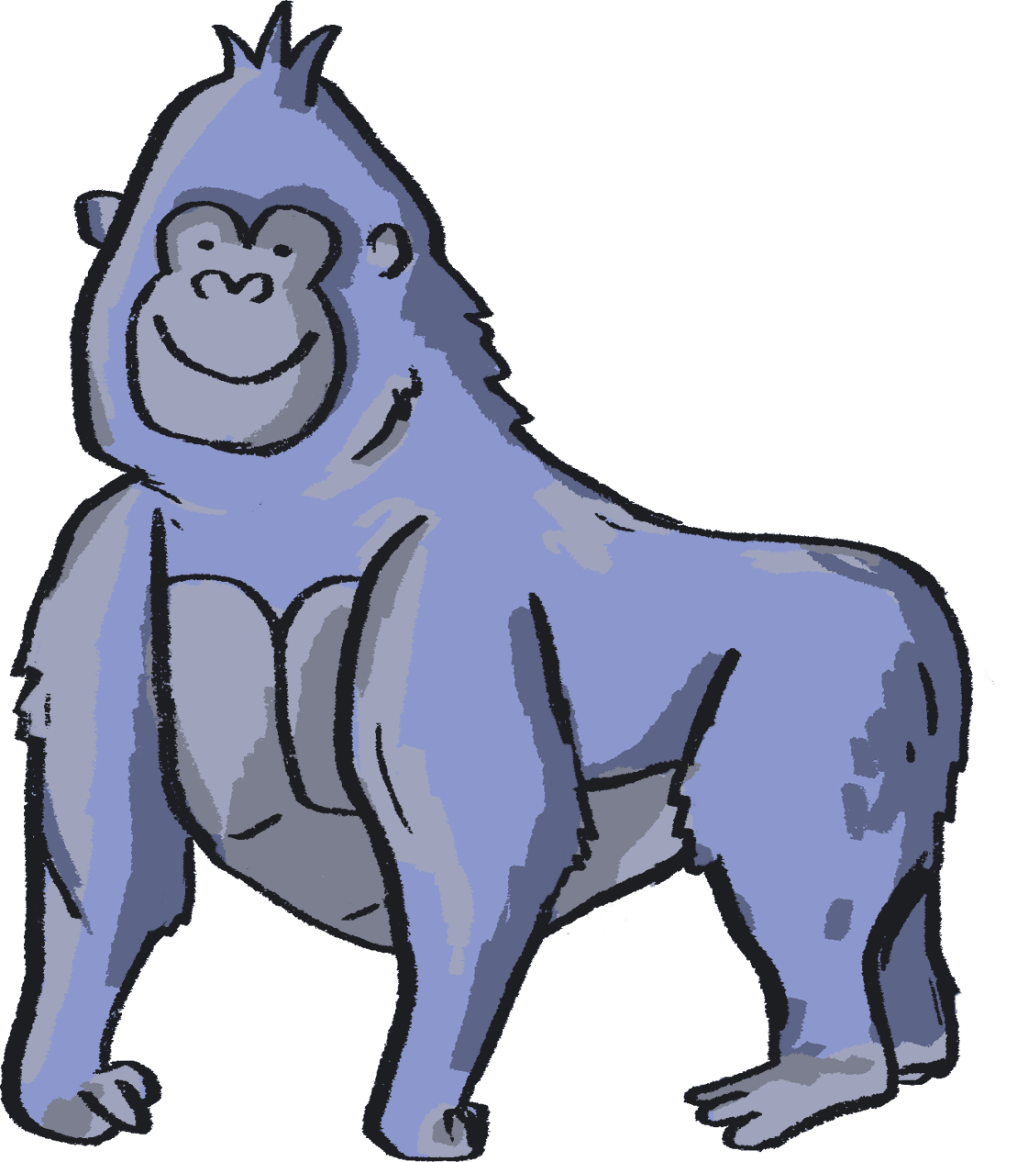

Authors:
Kaitlin Ferguson, Artist
Gill Sekatawa, Art and Design Lead, Nelson Academy
Sarah Melia, Science Lead, Nelson Academy
Illustrator:
Sophie Clouston, Creative Arts East
Commissioned and produced in 2021 by:
Barbican Creative Learning
Creative Arts East for PEACH West Norfolk
With thanks to:
Staff and students at Nelson Academy, Downham Market
Norfolk and Norwich Festival Bridge
Attribution:
You are welcome to share this resource with colleagues and adapt it as you see fit. Please note that if you do so, the following credit line must be used:
Taken from Teacher Lab: Teaching Primary Science through Creativity, written by Kaitlin Ferguson, Gill Sekatawa and Sarah Melia. Illustrations by Sophie Clouston. Commissioned by Barbican Creative Learning and Creative Arts East. With support from the Esmée Fairbairn Foundation and Nelson Academy, Downham Market. Teacher Lab is a Barbican Creative Learning programme

Slide 23

Below are some links to more resources for supporting creativity in learners:
https://www.researchgate.net/publication/305218451_A_Five_Dimensional_Model_of_Creativity_and_its_Assessment_in_Schools
https://www.thomastallisschool.com/tallis-habits.html
https://nnfestival.org.uk/festival-bridge/schools-education/resource-bank/
https://www.groundworkgallery.com/exhibitions-about-environment/virtual-tour/

