Slide 1

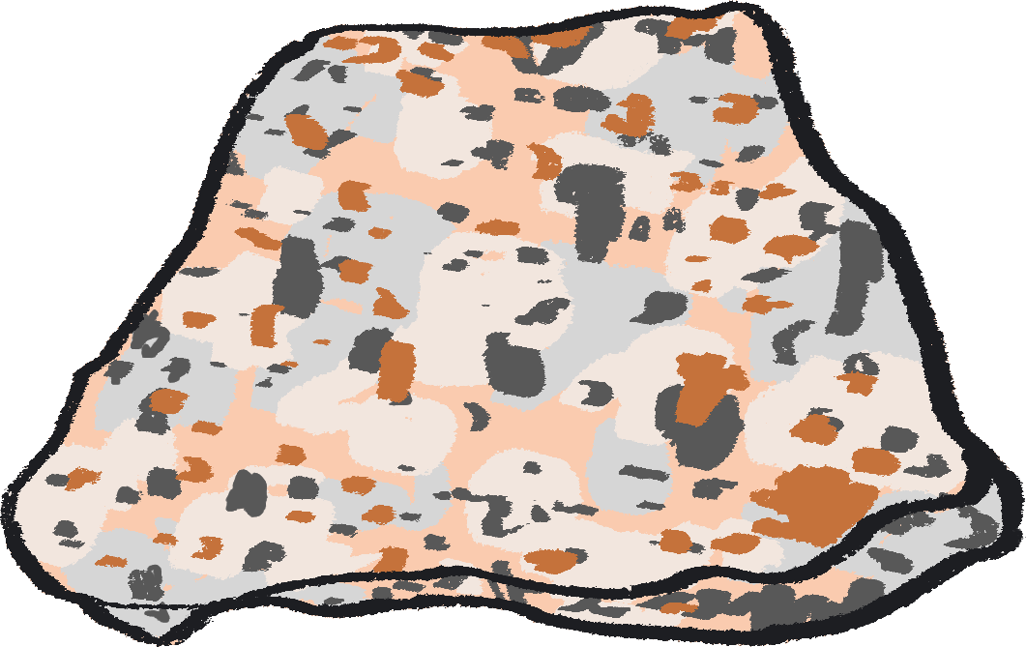



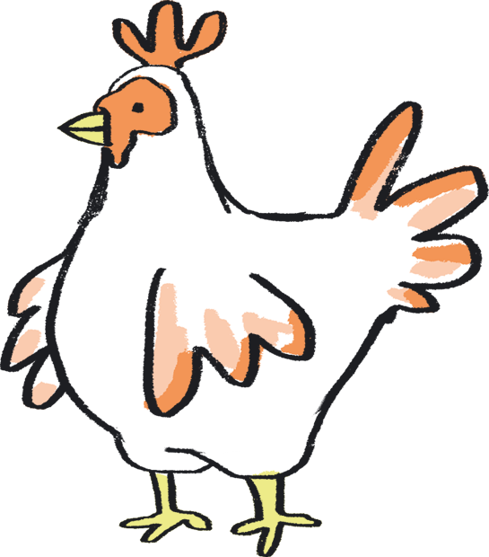
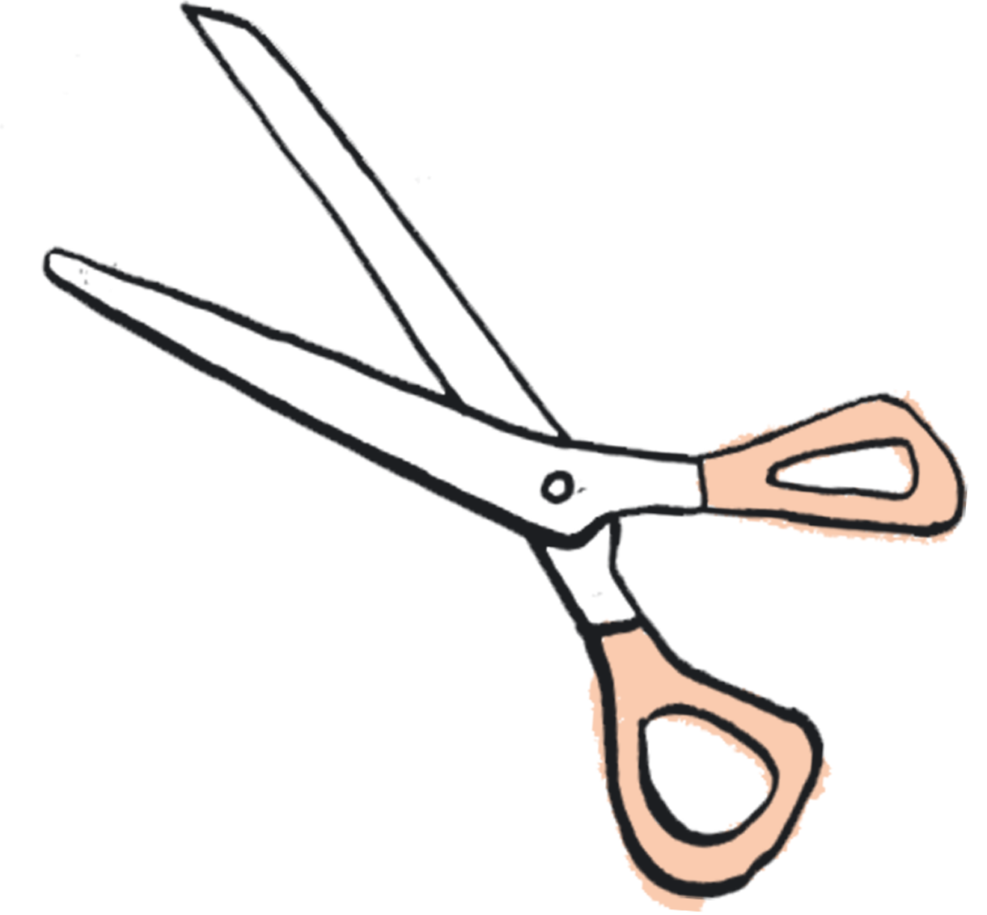

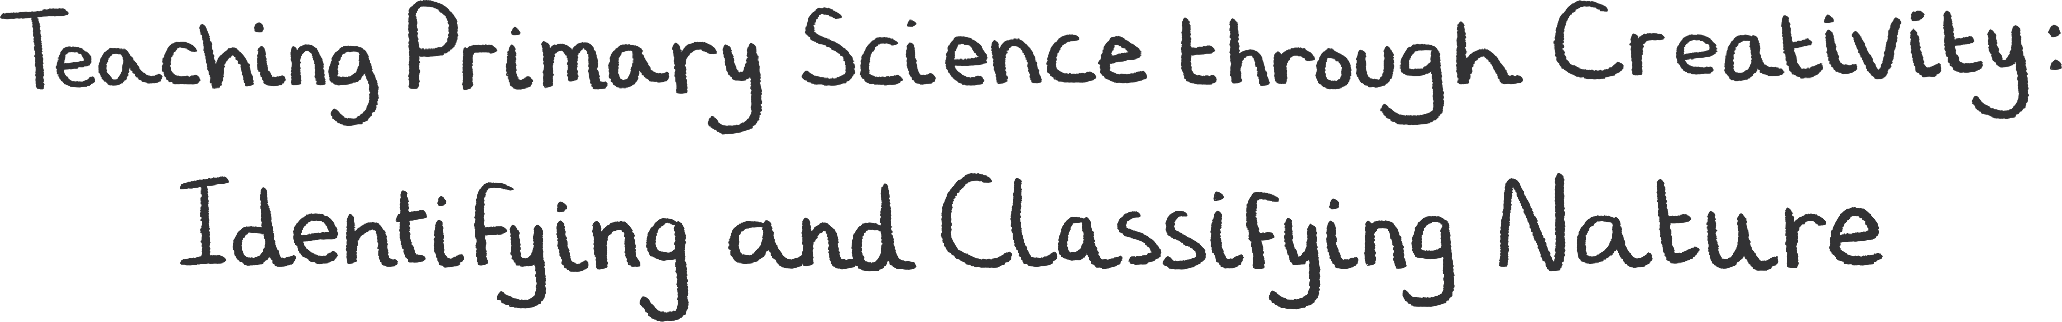
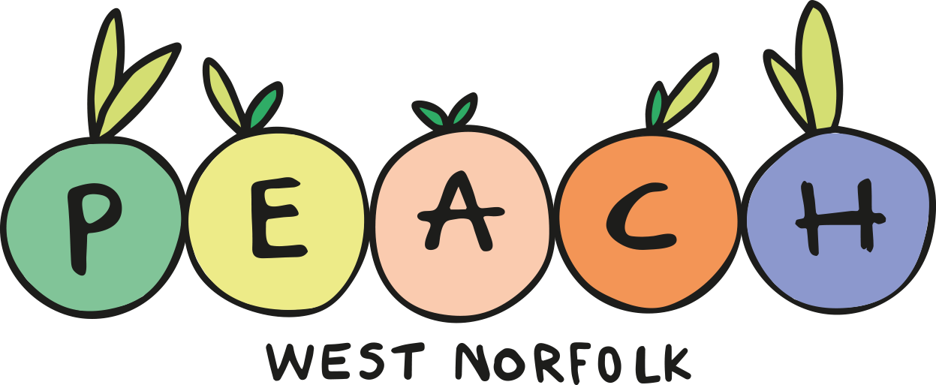



Teacher Lab
YEAR FOUR Teaching Resource – Slides and Notes

Slide 2
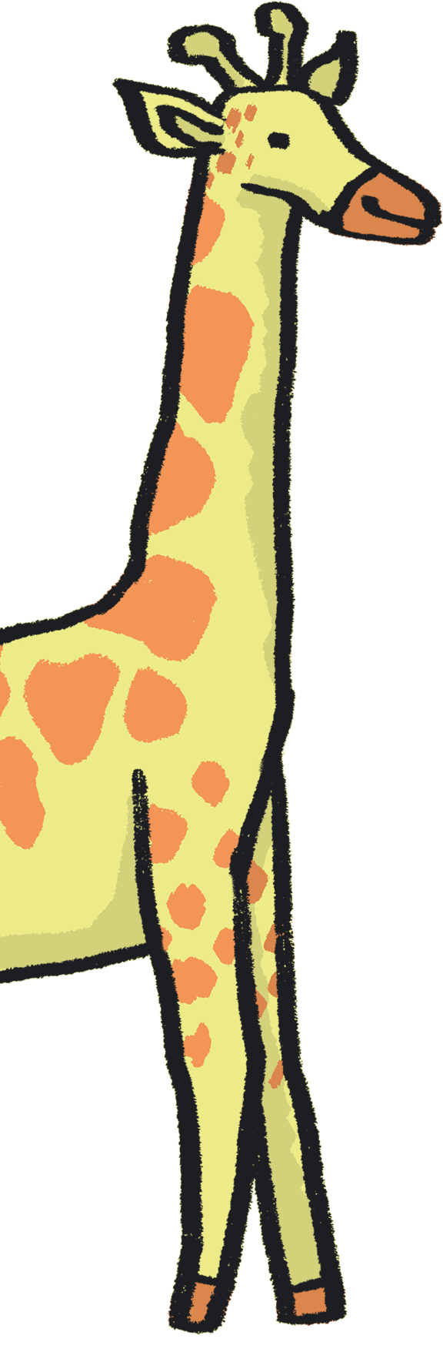
Contents
About Teacher Lab
How to use this resource
About this resource
Author statements
Lesson plans:
  Year 4 – Teeth
Credits
References

Slide 3

About Teacher Lab
The Teacher Lab project promotes creative practice in the classroom by supporting cross-curricular teacher and artist exchanges in the UK. It offers teachers direct access to a variety of artists, in order to re-imagine the curriculum and develop practical tools for learning through the arts.
You can access the previous Teacher Lab resource (exploring Push and Pull forces) created by teacher Christina Paul and actor and mathematician Victoria Gould, here: https://sites.barbican.org.uk/teacherslab/
……………………………………………………………………………………………………………………………………………………………………………..
This Teacher Lab was a collaboration between Barbican Creative Learning, Creative Arts East for PEACH West Norfolk, and involved teachers Gill Sekatawa and Sarah Melia from Nelson Academy in Downham Market, Norfolk, and Norwich based artist Kaitlin Ferguson.
Through a series of planning, testing and reflection sessions, Gill, Sarah and Kaitlin co-designed a range of creative activities to support the delivery of the primary science curriculum. These were then developed into a resource pack, in the form of a set of PowerPoint Slides which can be used directly in a lesson, with supportive guidance notes to assist your teaching.

Slide 4
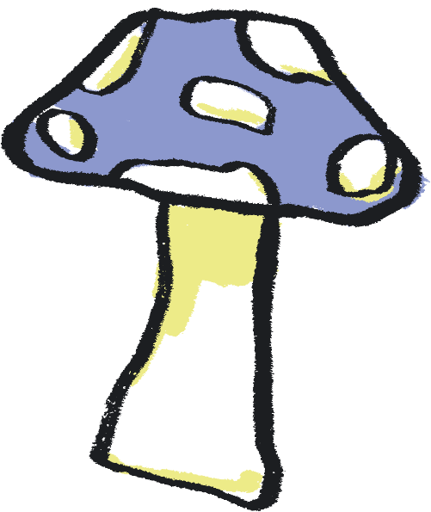
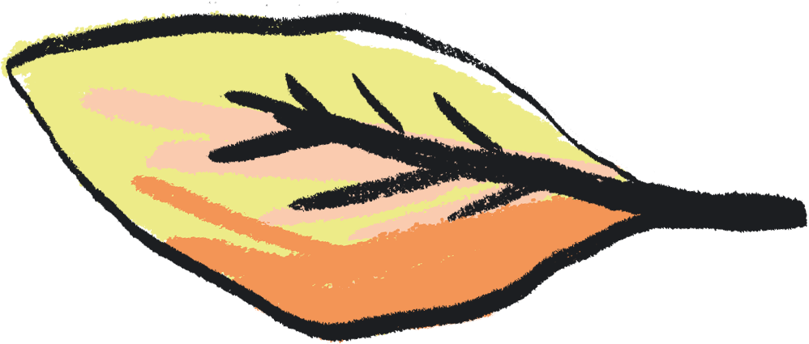
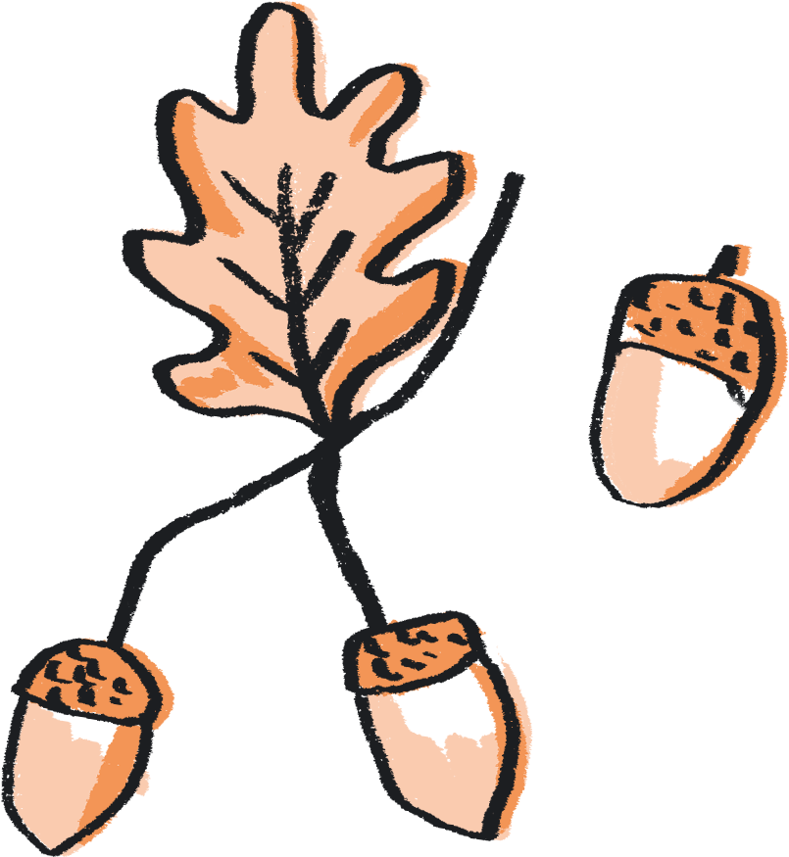
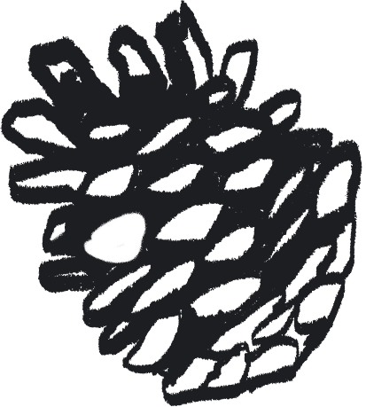
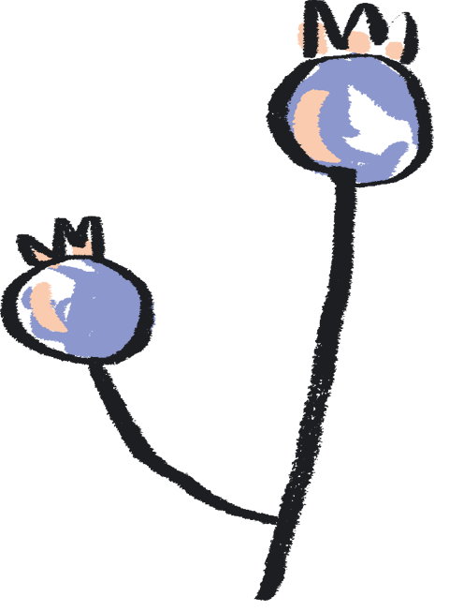
How to use this resource
You can use this resource in two ways:
As a live PowerPoint presentation for the whole class to view
As a printed pdf
Each year group has a dedicated set of slides.
The main content of each slide is directed at the pupils.
This content is animated to ensure that the teacher is in control of the pace of the lesson.
Each slide also has a corresponding set of ‘notes’, which are directed at the teacher.
To use the resource in PowerPoint Slide Show mode:
Go to the slide you wish to begin from
Click ‘Slide Show’ tab in the top navigation bar
Click ‘From Current Slide’ in the menu bar
To see the notes in this mode, click on the ‘…’ in the lefthand corner and select Presenter View
To view the notes:
Click on the View tab in the top navigation bar
Select ‘Notes’ to see these at the bottom of each slide

Slide 5
About this Resource…
Our Teacher Lab resource pack supports both creative practice and scientific enquiry in the classroom. We aim to offer teachers access to a variety of art experiences, aligned to each year group’s science curriculum. Through these activities, we hope to introduce exciting ways to combine the deepening of scientific knowledge and skills with the development of creative practice. Each activity also aims to embed scientific understanding and help children to ‘know more and remember more’ about the chosen topic.
We chose the working scientifically skills of ‘identifying and classifying’, as these are skills which run throughout the primary curriculum. We have chosen ‘Nature’ as a theme across all of the activities, offering ways to broaden children’s experience and understanding of nature and their place within it. Each nature-based topic has been selected from the National Curriculum and for reception the Early Learning Goals, to ensure each is as relevant as possible.
With reference to this knowledge base, we demonstrate how arts practice can be used to reinforce the skills and processes of identifying and classifying. For each year group, we have chosen a different art-based skill to provide teachers with a wide repertoire of creative ideas. We hope that these might be a starting point to enable teachers to use these creative practices to reinforce learning in other curriculum areas.

Slide 6
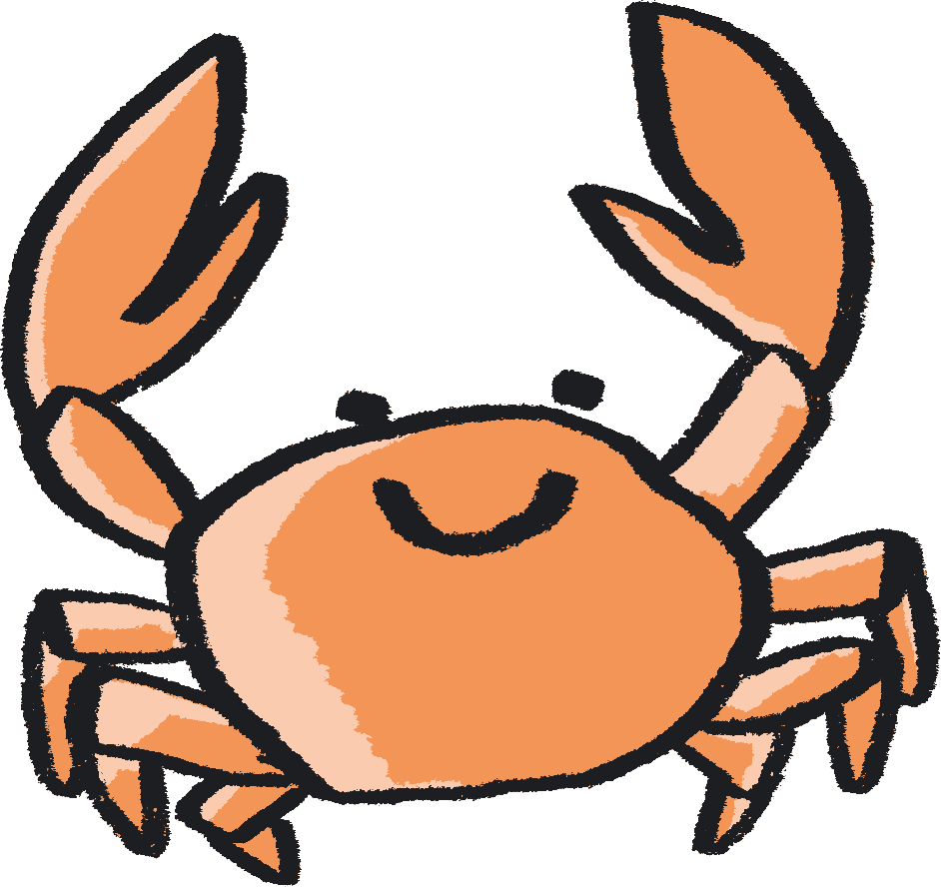
Each activity is designed as a mini project brief for your class, they are jumping off points to take in whichever direction best suits you. We encourage you to follow the natural curiosity of the children you’re working with and adapt the activity how best you see fit.
In terms of work with SEND children - each child is of course different, so when working with this resource, feel free to pick and choose activities which feel most suitable for them, depending on how they feel that day. Feel free to get creative with the activities and adapt them to your child's needs to create the best experience possible.

Slide 7

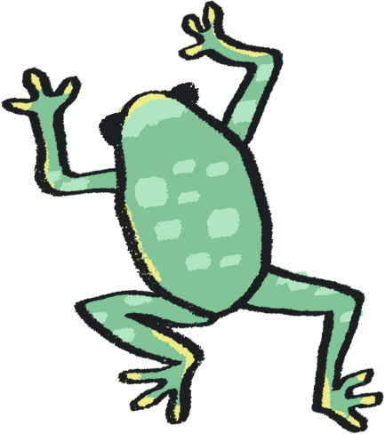
Author Statements
Gill Sekatawa, Art and Design Lead, Nelson Academy:
My aim for the resource was to provide a range of activities and experiences which will not only allow students to soak up the knowledge but also that allowed all involved to acquire transferable skills in art and problem solving to use in their future learning.
Prior to this Teacher Lab project, we had recently explored art and poetry with Kaitlin as part of Barbican Box in West Norfolk, which was an amazing experience. When the Barbican and Creative Arts East approached us about working together again, but this time in the suggested area of Science, it became immediately clear that we should involve Sarah, my teaching team colleague. As Science lead for our school, she is tasked with ensuring that, working scientifically, children will know and remember more. From my experience, there is no better way of making knowledge 'stick’ than using art and creativity to make learning engaging.
Sarah Melia, Science Lead, Nelson Academy:
I came at this project as a novice artist, intrigued to learn how art and science could mix and how creative practice could help children to enjoy working scientifically as well as know and remember more about a chosen topic. I wanted to choose a working scientifically thread which would run through all year groups in the hope that we would reach as wide a teacher and pupil audience as possible. By having this common thread link all the year groups’ activities together, the aim is that teachers will be able to adapt art activities from other year groups to use with other knowledge areas in their own year group, thereby creating a bank of resources whose application is potentially much wider than that originally written. As a science lead, I wanted not only to improve my own creative practice, but also to introduce a range of activities that could be adapted and used in different contexts, so that they could support the teaching of schools’ individual science curriculums, no matter what the unit’s knowledge base.

Slide 8
Author Statements continued…
Kaitlin Ferguson, Artist:
It has been really inspiring to work on this collaboration with both Gill and Sarah, and to create a resource which draws upon areas of the curriculum which we each feel very passionate about. It has been a fascinating process, which has allowed us to find inspiration from each other's passions and knowledge.
When we began creating the resource, we agreed it was really important that each set of activities felt truly balanced between art and science. We saw science as an inspiration for making art, and creativity as a means to explore science on a more meaningful level.
Art is a dynamic subject which has the ability to work in tandem with any subject in the curriculum, to bring greater depth and understanding. During our initial chats, we realised that classifying and sorting was not only a science skill which is relevant to each year group, but it also is a skill found in art. For example, curation is simply the sorting and organising of artworks. Therefore we designed the activities to have identifying and classification at the heart of them.
It’s been really enlightening to learn about the curriculum in greater detail, from those who are actively teaching it. This has allowed me to absorb and learn from the amazing teaching of Gill and Sarah. Like most teachers, Gill and Sarah have to come up with infinite new ideas and activities for their pupils regularly, under pressure of time constraints. Therefore, it has been really rewarding to create a resource which is designed both for ease of use for the teacher but also full of excitement and wonder for the children.
We hope that the resource offers teachers an exciting and ambitious set of ideas, rooted in the curriculum, to help grow the confidence, knowledge, and creativity of children.

Slide 9
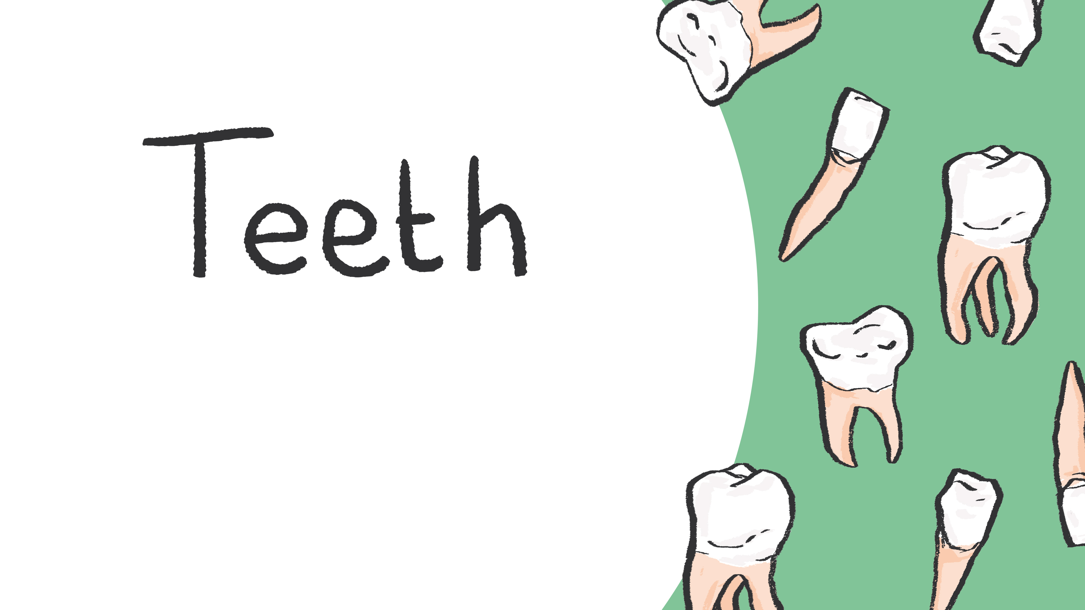
With Year 4
Notes:
Curriculum Links: Comparing teeth and organising into groups (creatures and types of teeth)
Curriculum Links: Construct and interpret a variety of food chains, identifying producers, predators and prey.
Curriculum Links: Practical scientific methods, processes and skills: gathering, recording, classifying and presenting data in a variety of ways to help in answering questions; identifying differences, similarities or changes related to simple scientific ideas and processes.
Non statutory - talk about criteria for grouping, sorting and classifying; and use simple keys.

Slide 10
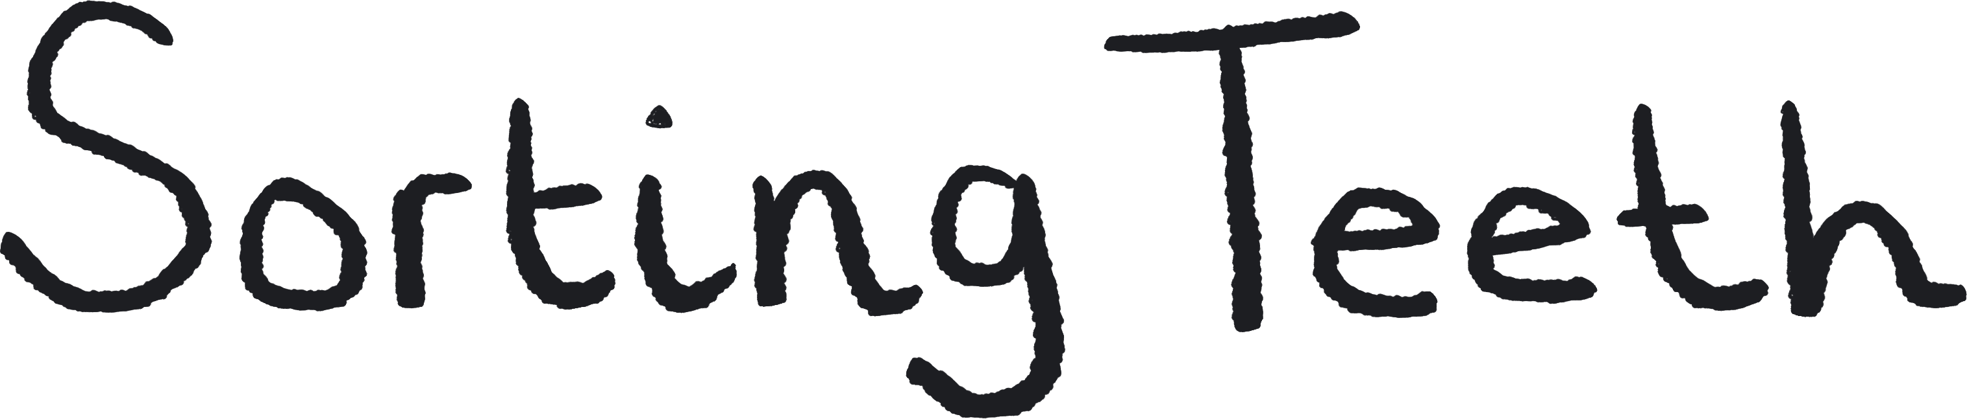
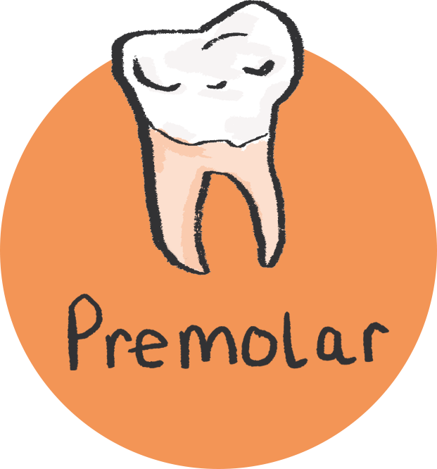

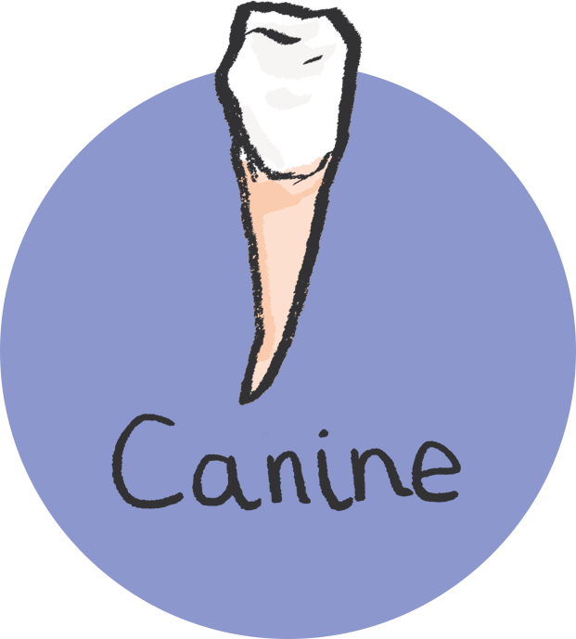
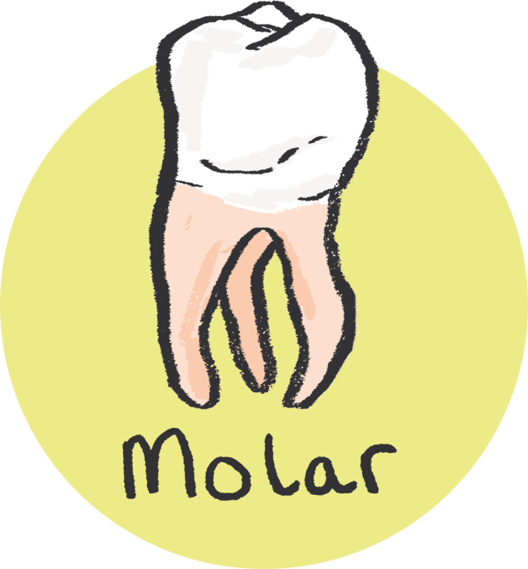
Classification activity
Compare teeth and organise into groups, by either types of teeth or different species.
You will need:
Pictures of different types of human teeth.
Notes:
Resource note:
To source pictures of different types of human teeth, the search term for this would be 'four types of teeth' this should yield appropriate images.

Slide 11

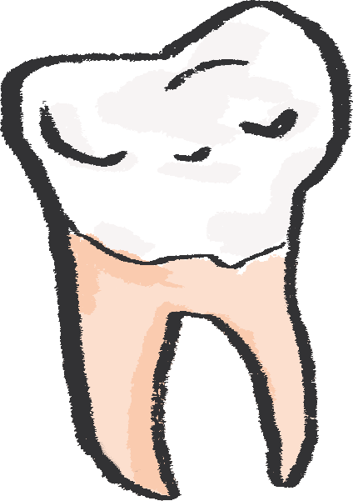
Have a careful look at your selection of teeth images.
Discuss the functions of the different types of teeth.
Sort the teeth pictures into their types.
  Quick Quiz: Can you remember what they are?
  Incisor
  Canine
  Premolar
  Molar
Look carefully at the shapes of the teeth and think about the kinds of marks they make.
Notes:
Possible Extension:
You could also use images of different types of teeth from animals.
PROMPTS FOR CREATIVE THINKING:
What can animal teeth tell us about what those animals eat? What about animals that don't have any teeth at all? Start by imagining, using intuition and existing knowledge, and then checking through research.

Slide 12


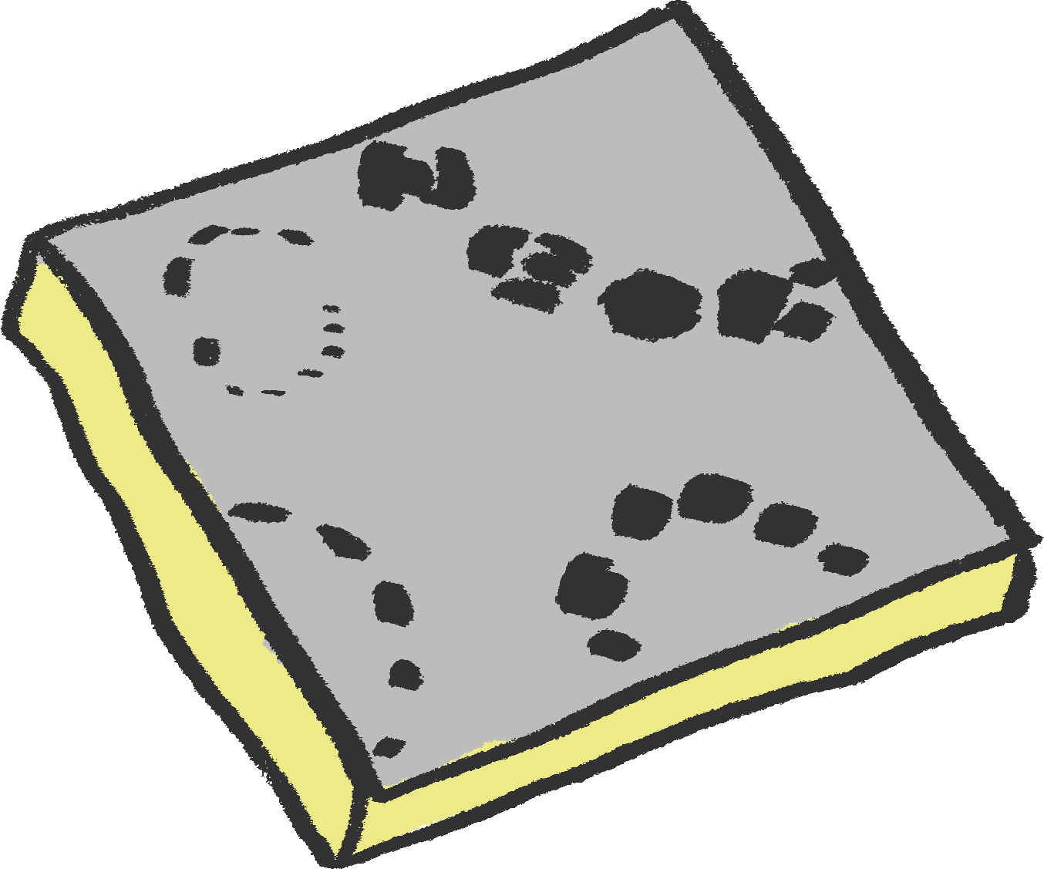
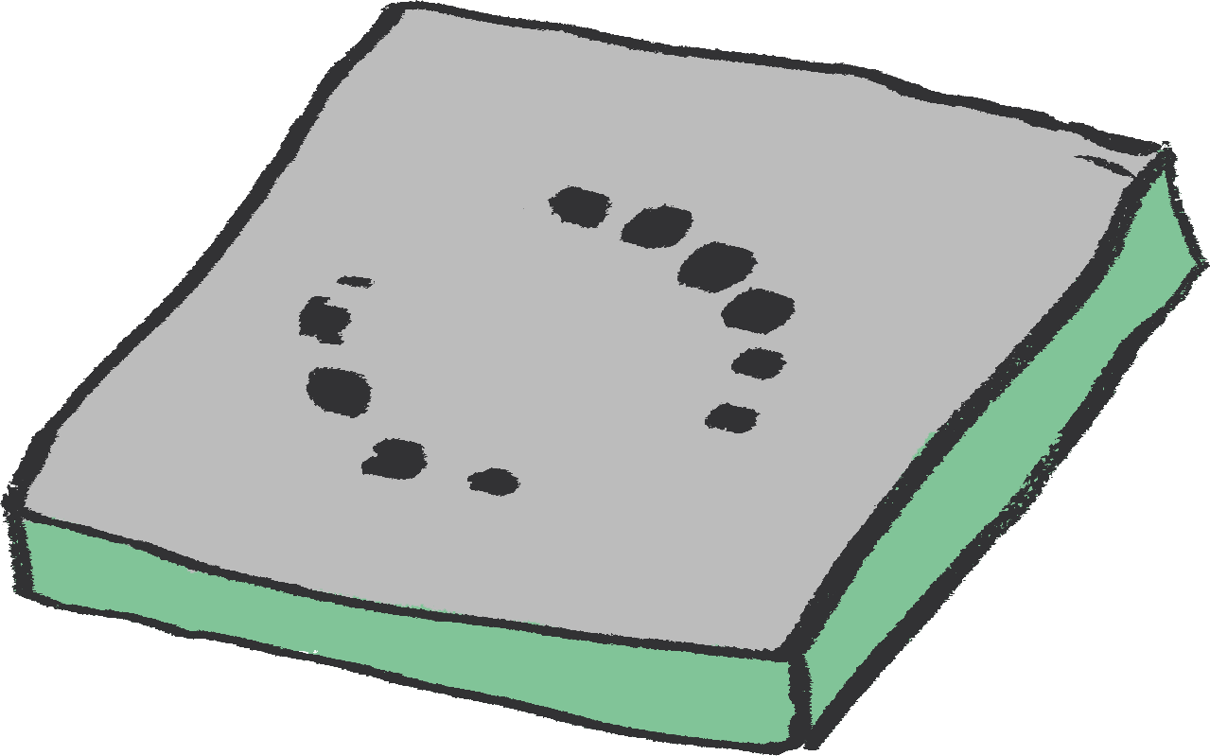
Art activity
Medium: Clay / Sculpture
Explore the imprints and textures created by different types of teeth, using clay to create relief tile sculptures.

Slide 13
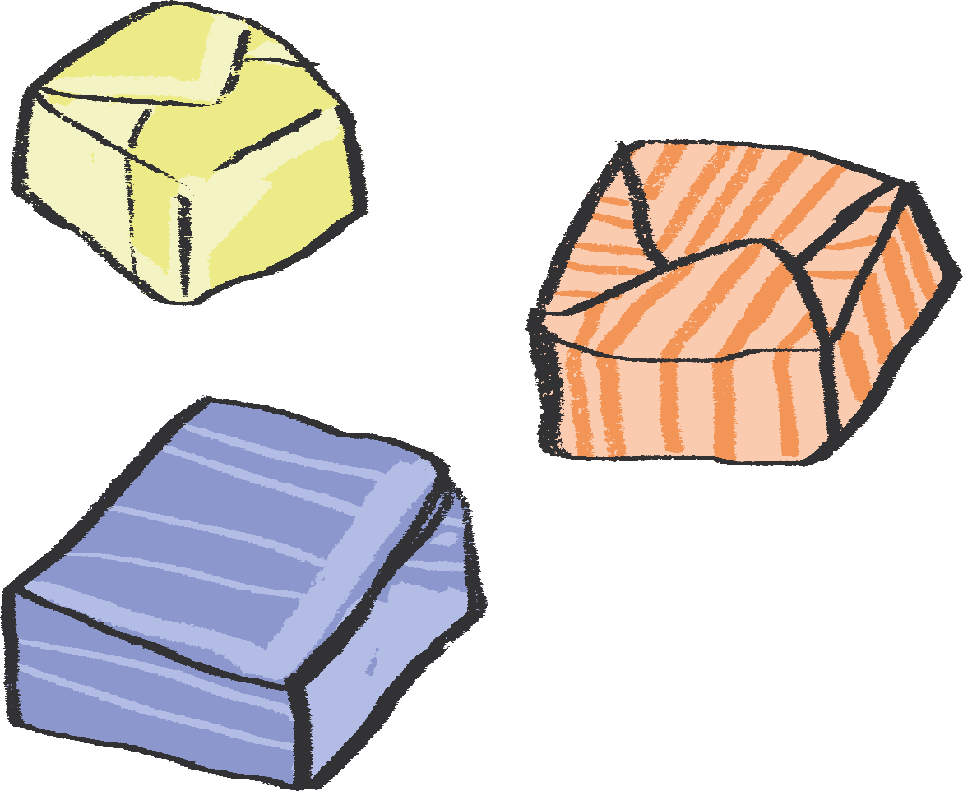
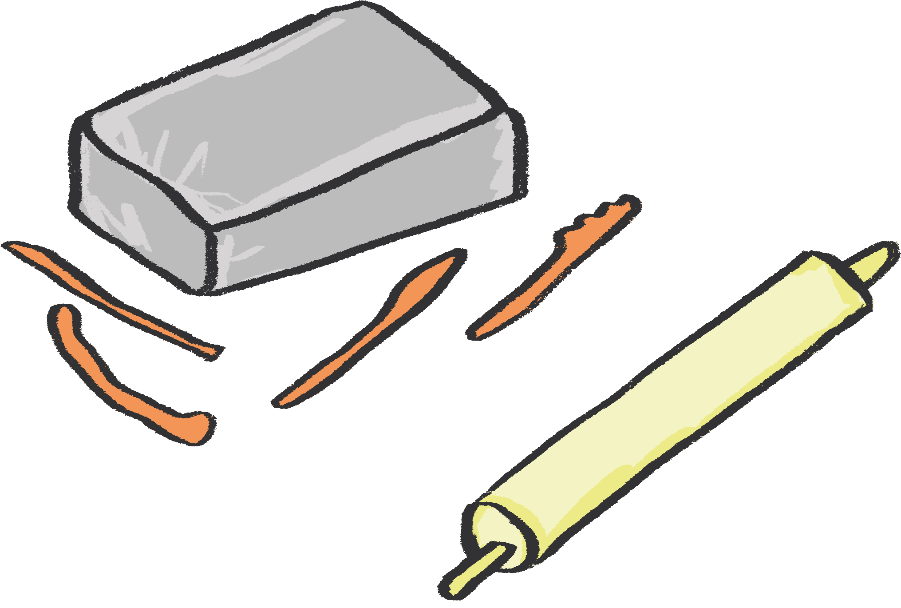
You will need:
Chewy sweets such as Starbursts, Fruitella, etc (few per person)
Air drying clay
Aprons
Ruler
Clay tools
Rolling pins
Table covering or boards to roll clay out on
Paper and pencil
Top tip! For those who do not like the feeling of clay on their hands, try wearing gloves when handling it!

Slide 14
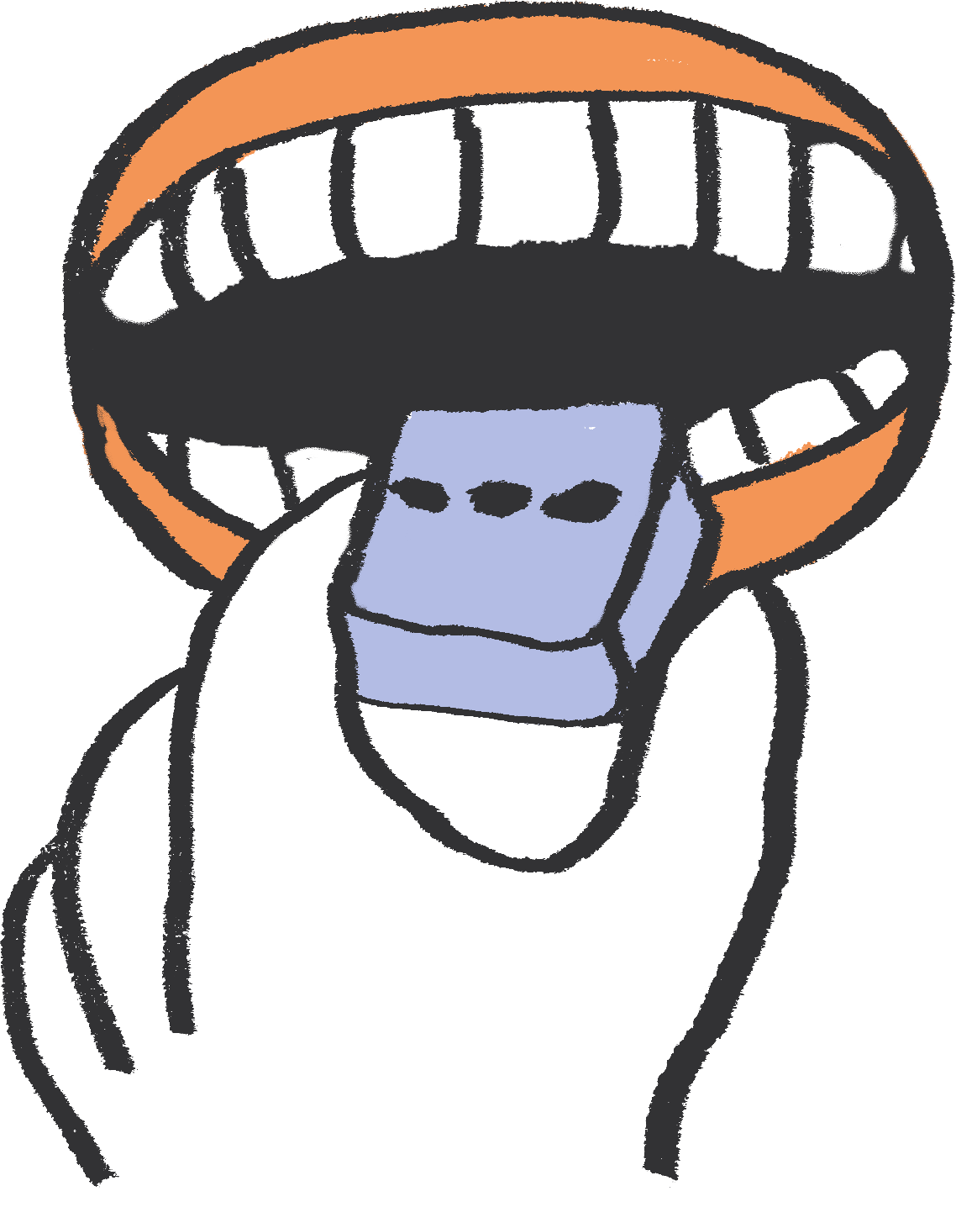
Cover the table you are working on with a table covering or put down a board to work on.
With clean hands, start by carefully pressing your different teeth into the chewy sweets and see what marks they make.
  Be careful not to chew and swallow them as you need to keep them for reference!
Look carefully at the different shapes and marks your teeth make.
Can you match the imprints of your teeth to the different types of teeth you’ve learned about?
Notes:
This activity can help learners connect their theoretical knowledge to their own experience and bodies.

Slide 15
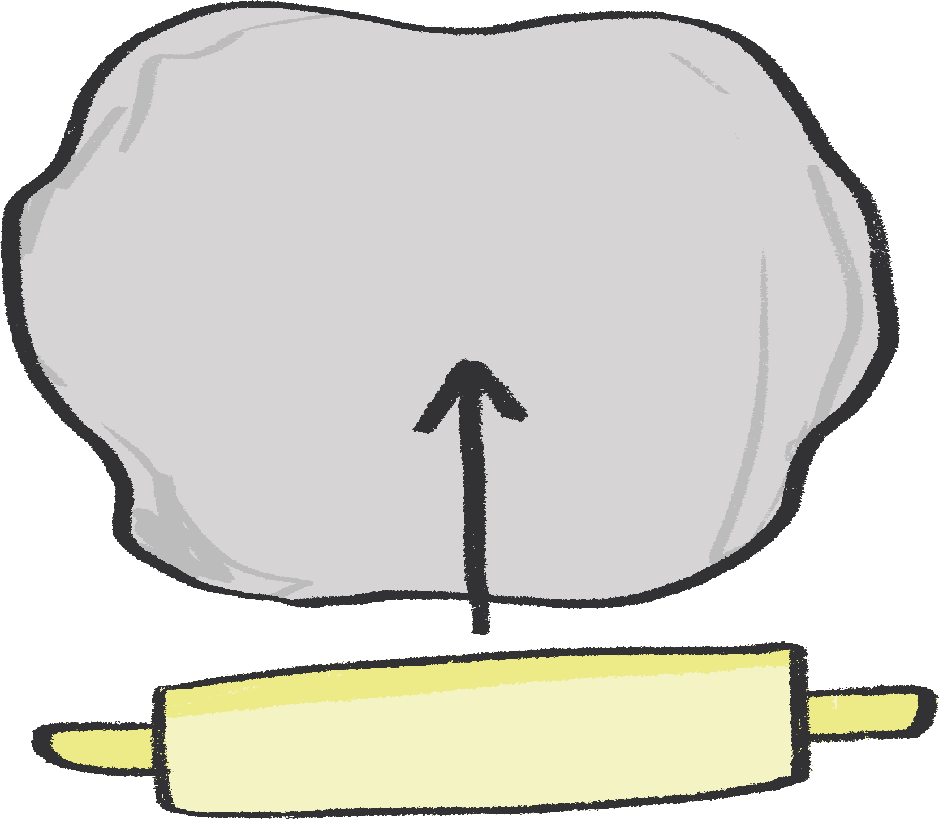
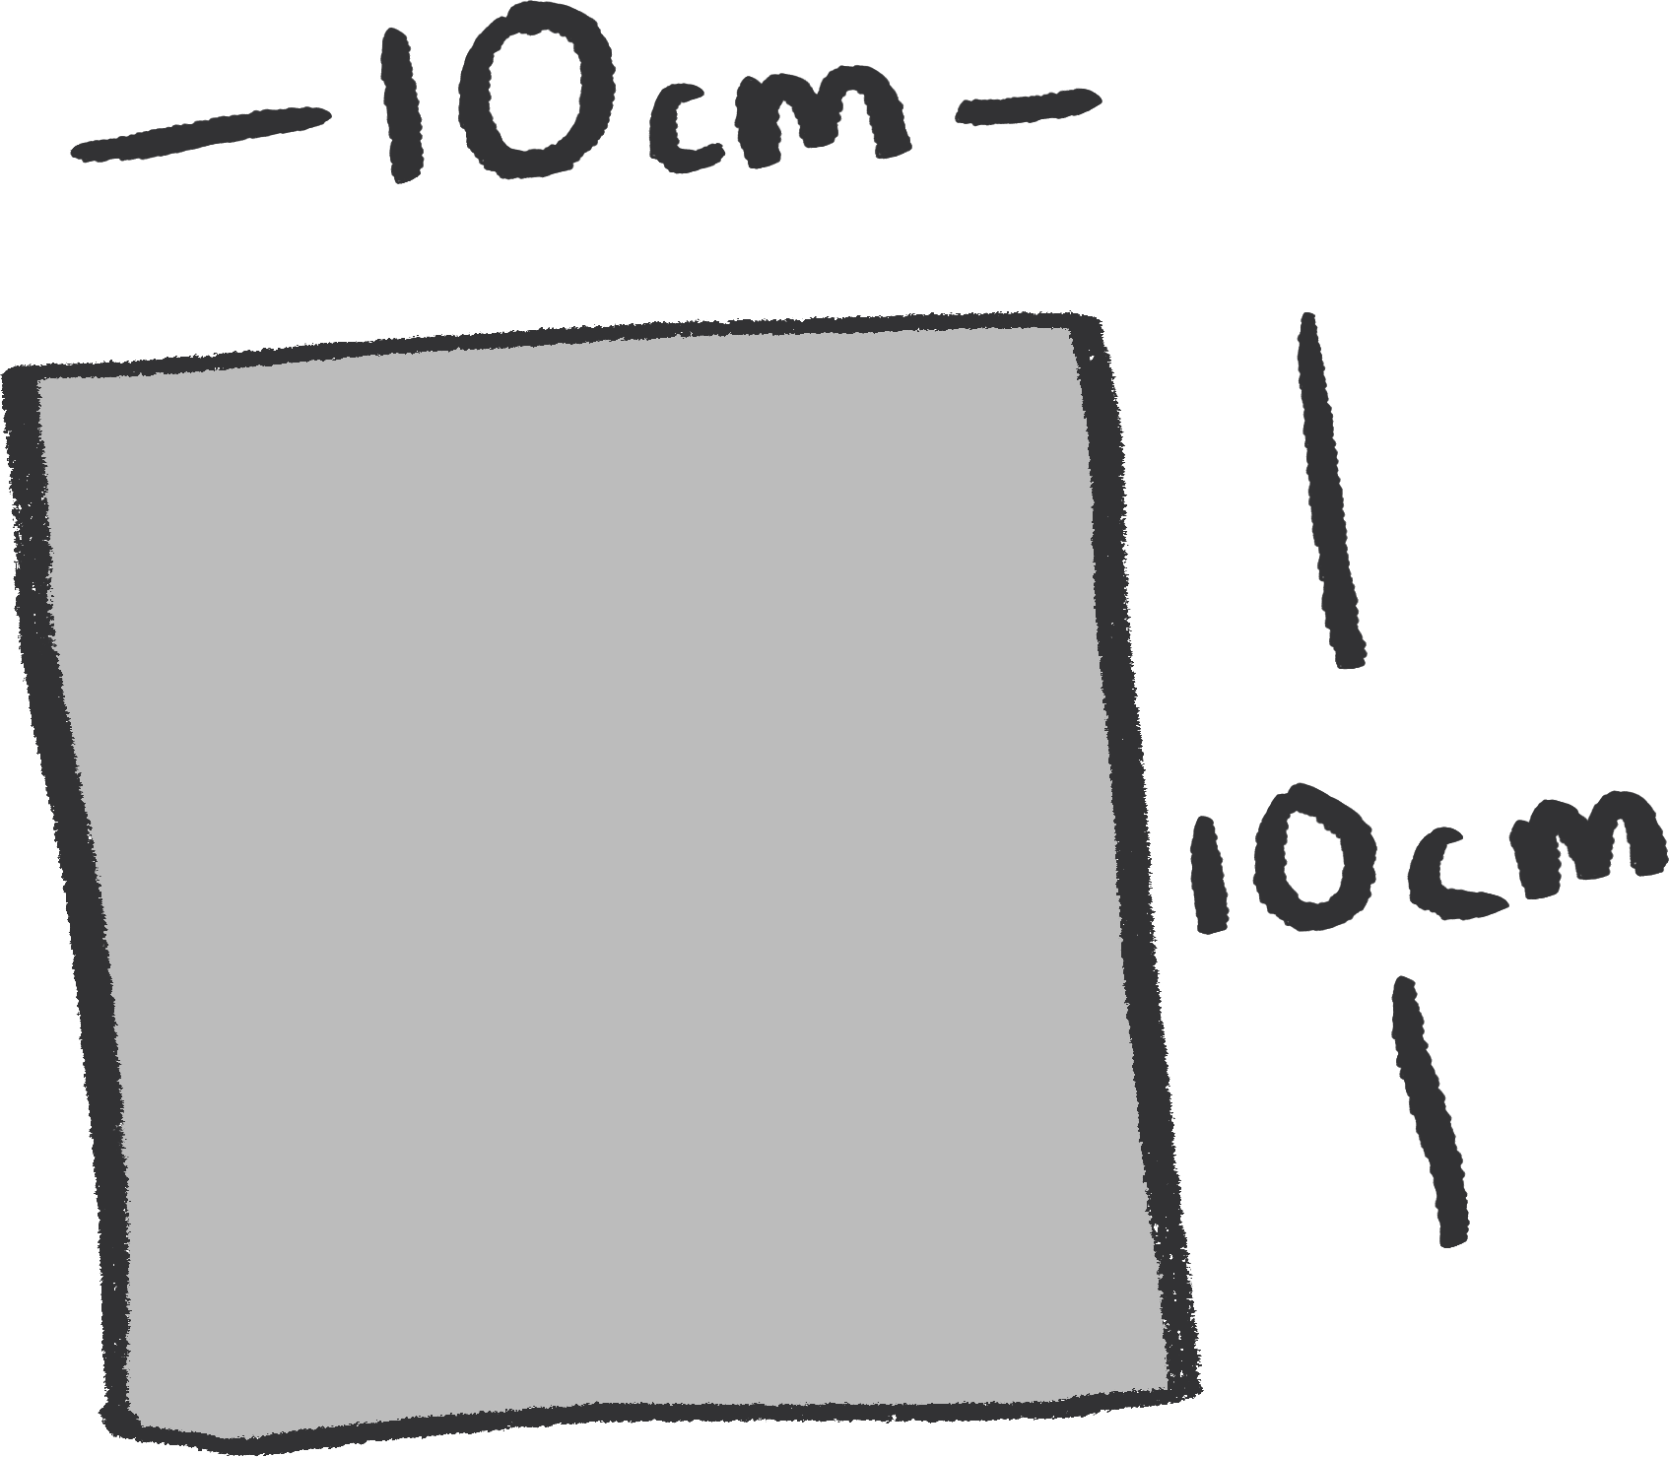
continued…
Take a block of clay which is roughly the size of your fist and roll it out on the table.
Every time you roll the clay, pick it up and turn it over and roll the clay from the other direction.
  Top tip: this will stop the clay sticking to the table!
Roll your tile until it is about 2cm thick all the way across.
Top tip: you can use wooden spacers to help with this.
Using a ruler cut a square that is roughly 10cm by 10cm and trim off any excess clay.
Top tip: you can put this back in the bag and use for later.

Slide 16
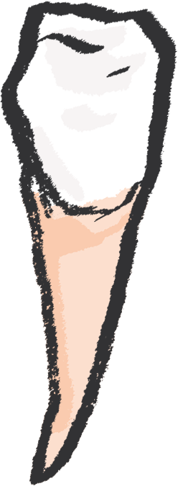
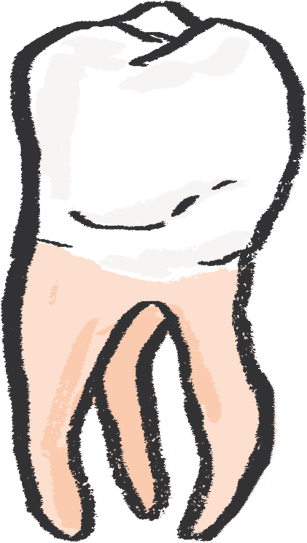

continued…
Look back at the images of the different types of teeth as well as your sweets. Can you remember what all of the different types of imprints of teeth are?
  For example, canines might make sharp pointy lines or molars might make bumpy wobbling marks.
Using your clay and tools, create a pattern drawn into the clay made up of marks made by different types of teeth.
  Alternatively you could follow the layout of teeth in a human or animal.
When carving into the clay, try not to press too deeply as it will pierce a hole in it and might crack when it dries.
Notes:
There may be a temptation here for children to want to create marks that are simply pleasing to them, but they should be encouraged to reference the marks that their teeth made and try to replicate these, although in a pattern of their choosing. This could be supported through a comparison exercise afterwards, using the chewy sweets.
It may also be useful to explain to children that each person’s teeth are unique, so they will be creating a piece of art which is unique to them.

Slide 17
continued…
When you have finished your design, leave your tile somewhere dry and warm for a few days until it is fully dried out.
After you've made your clay tile, lay the final piece onto a sheet of paper and annotate it to explain the different teeth you have represented and their functions.
Notes:
PROMPTS FOR CREATIVE THINKING:
in pairs, students could choose one pattern that the other student has created that they like, and be shown by that student how they achieved it. They can also discuss anything that they felt didn't work as well as they had hoped, and what they learnt from this - seeing this not as a failure but as an opportunity for development.

Slide 18
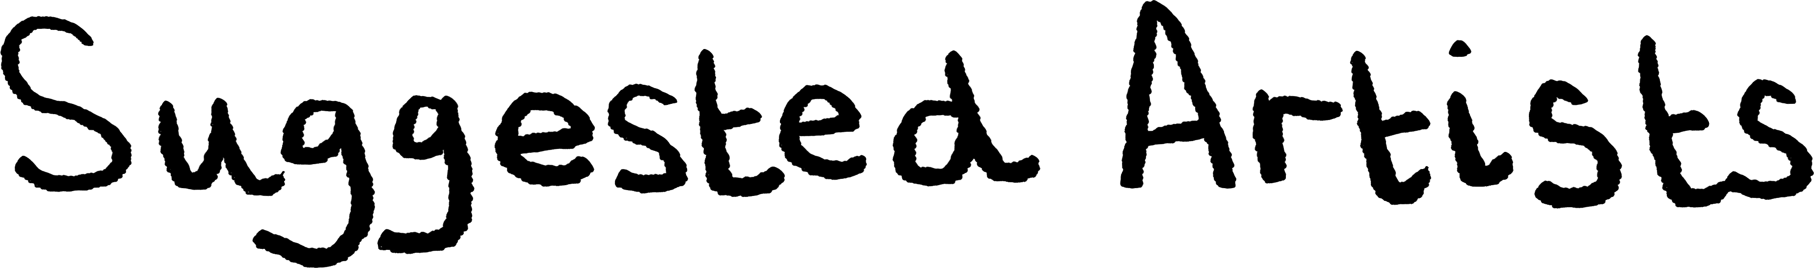
“Holly Hendry is one of my favourite artists, she creates sculptural artworks which often feature different body parts. See you if can spot any teeth!” Kaitlin
Barbara Hepworth was an English artist and sculptor, who took inspiration from the natural landscape. Try having a careful look at the different textures Hepworth created on the surfaces of her sculptures.
“Jacques Lipchitz was a Cubist sculptor who created some fascinating reliefs, they might give you some ideas about how to draw into your clay.” Kaitlin
Holly Hendry
Barbara Hepworth
Jacques Lipchitz

Slide 19

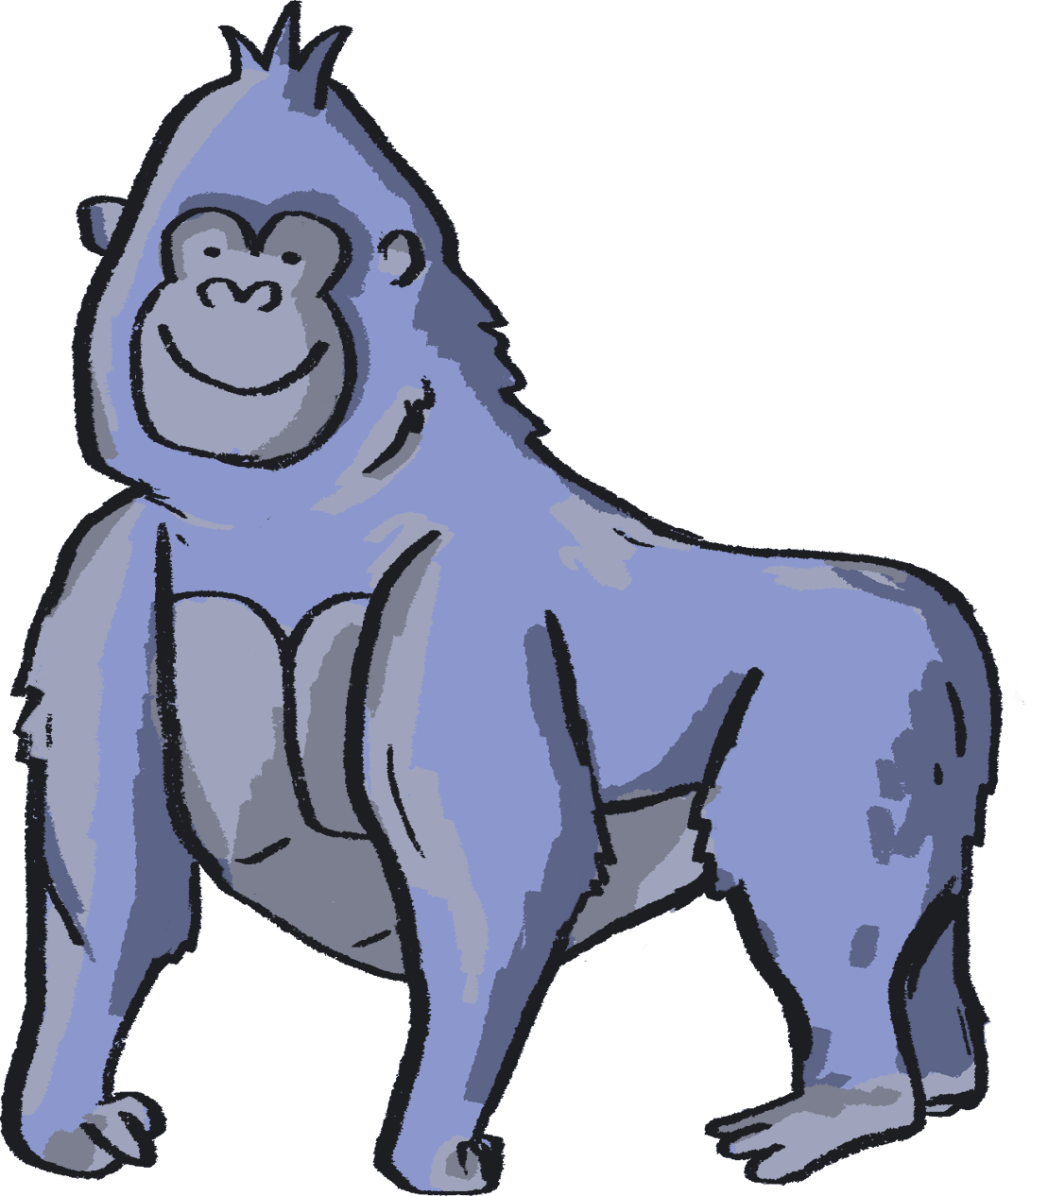

Authors:
Kaitlin Ferguson, Artist
Gill Sekatawa, Art and Design Lead, Nelson Academy
Sarah Melia, Science Lead, Nelson Academy
Illustrator:
Sophie Clouston, Creative Arts East
Commissioned and produced in 2021 by:
Barbican Creative Learning
Creative Arts East for PEACH West Norfolk
With thanks to:
Staff and students at Nelson Academy, Downham Market
Norfolk and Norwich Festival Bridge
Attribution:
You are welcome to share this resource with colleagues and adapt it as you see fit. Please note that if you do so, the following credit line must be used:
Taken from Teacher Lab: Teaching Primary Science through Creativity, written by Kaitlin Ferguson, Gill Sekatawa and Sarah Melia. Illustrations by Sophie Clouston. Commissioned by Barbican Creative Learning and Creative Arts East. With support from the Esmée Fairbairn Foundation and Nelson Academy, Downham Market. Teacher Lab is a Barbican Creative Learning programme

Slide 20

Below are some links to more resources for supporting creativity in learners:
https://www.researchgate.net/publication/305218451_A_Five_Dimensional_Model_of_Creativity_and_its_Assessment_in_Schools
https://www.thomastallisschool.com/tallis-habits.html
https://nnfestival.org.uk/festival-bridge/schools-education/resource-bank/
https://www.groundworkgallery.com/exhibitions-about-environment/virtual-tour/

