Slide 1

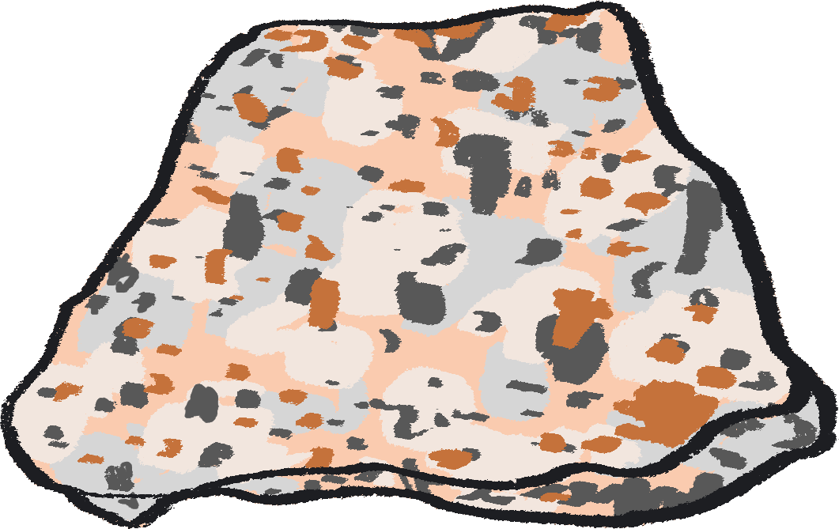



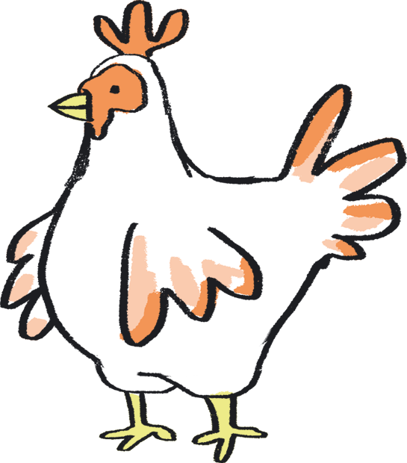
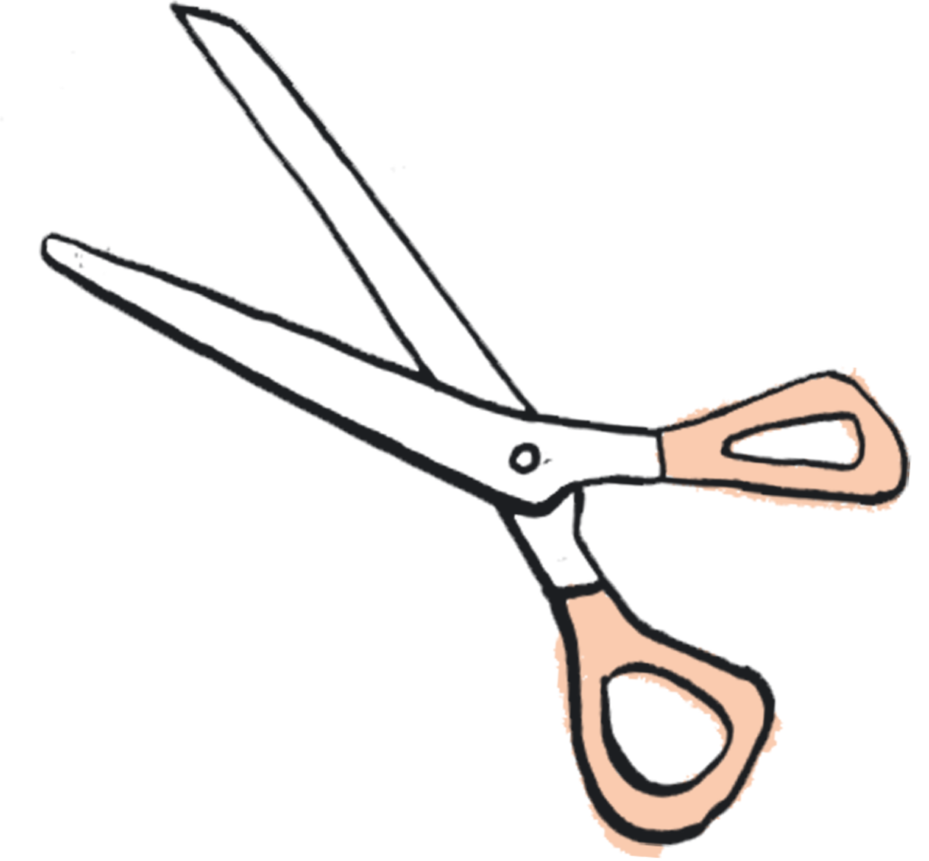
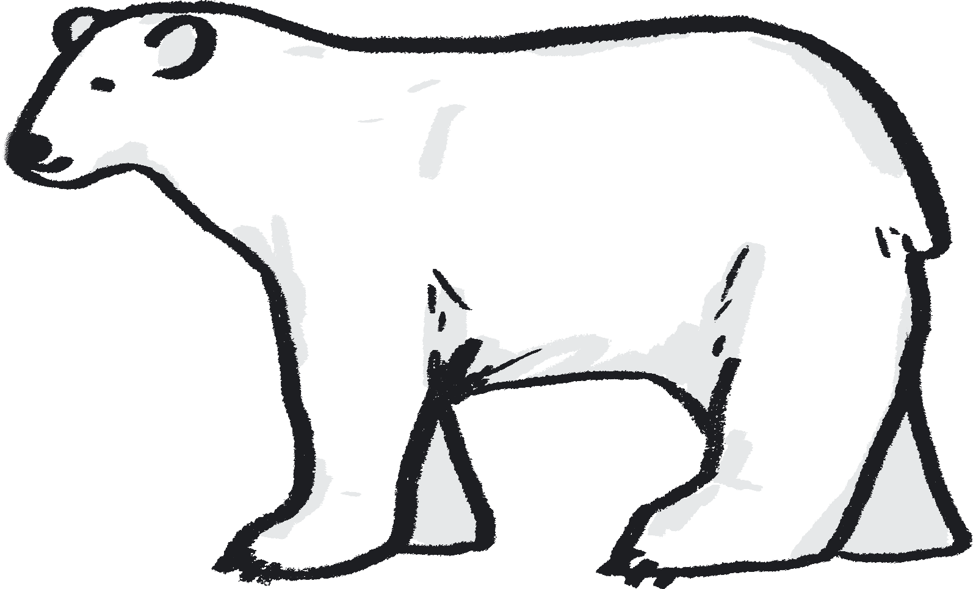
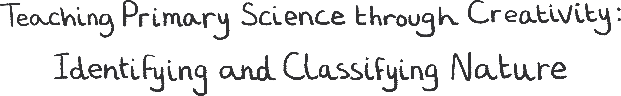
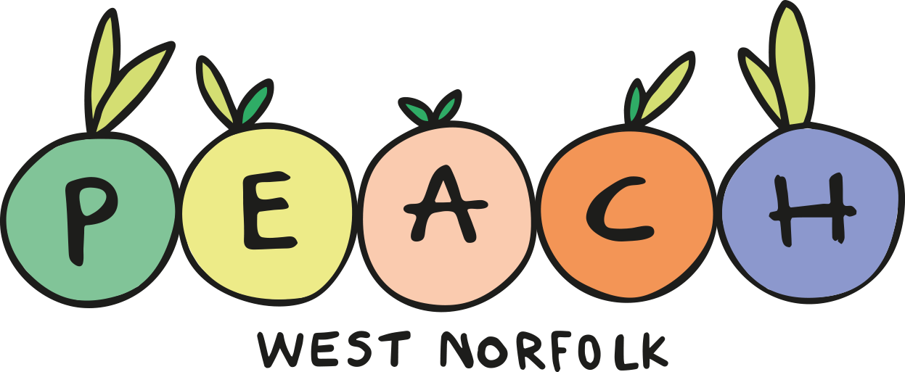



Teacher Lab
YEAR ONE Teaching Resource – Slides and Notes

Slide 2
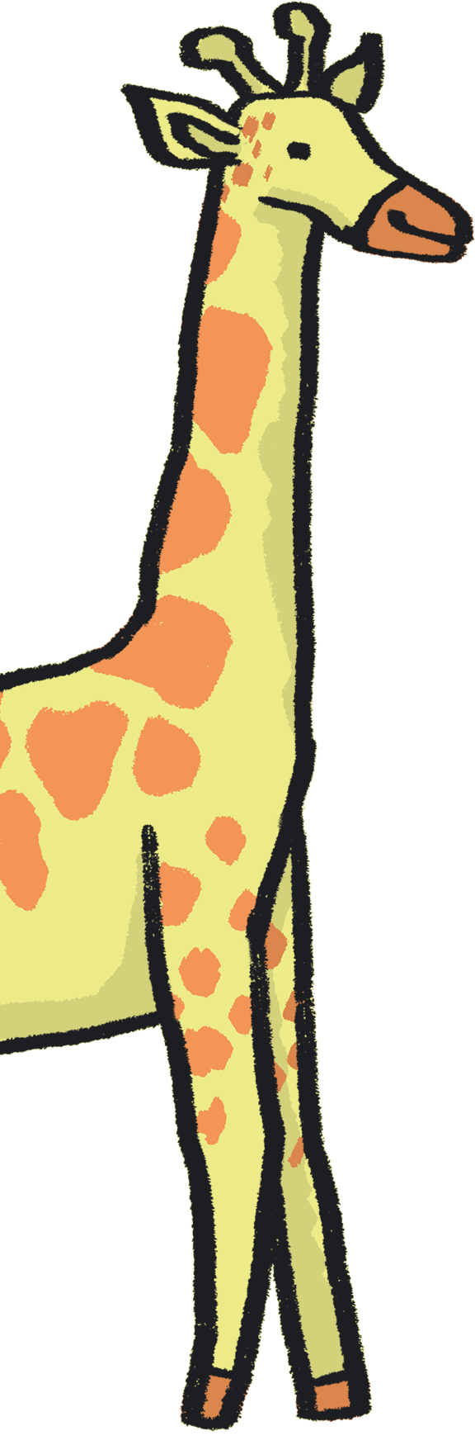
Contents
About Teacher Lab
How to use this resource
About this resource
Author statements
Lesson plans:
  Year 1 – Leaves and Seasons
Credits
References

Slide 3

About Teacher Lab
The Teacher Lab project promotes creative practice in the classroom by supporting cross-curricular teacher and artist exchanges in the UK. It offers teachers direct access to a variety of artists, in order to re-imagine the curriculum and develop practical tools for learning through the arts.
You can access the previous Teacher Lab resource (exploring Push and Pull forces) created by teacher Christina Paul and actor and mathematician Victoria Gould, here: https://sites.barbican.org.uk/teacherslab/
……………………………………………………………………………………………………………………………………………………………………………..
This Teacher Lab was a collaboration between Barbican Creative Learning, Creative Arts East for PEACH West Norfolk, and involved teachers Gill Sekatawa and Sarah Melia from Nelson Academy in Downham Market, Norfolk, and Norwich based artist Kaitlin Ferguson.
Through a series of planning, testing and reflection sessions, Gill, Sarah and Kaitlin co-designed a range of creative activities to support the delivery of the primary science curriculum. These were then developed into a resource pack, in the form of a set of PowerPoint Slides which can be used directly in a lesson, with supportive guidance notes to assist your teaching.

Slide 4
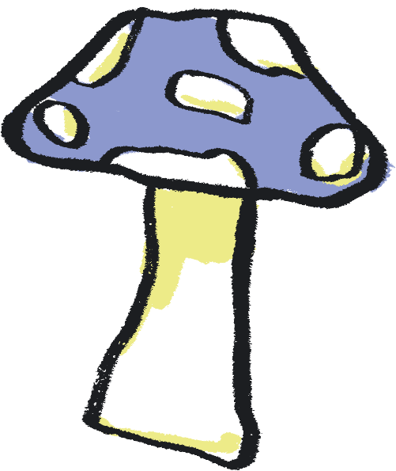
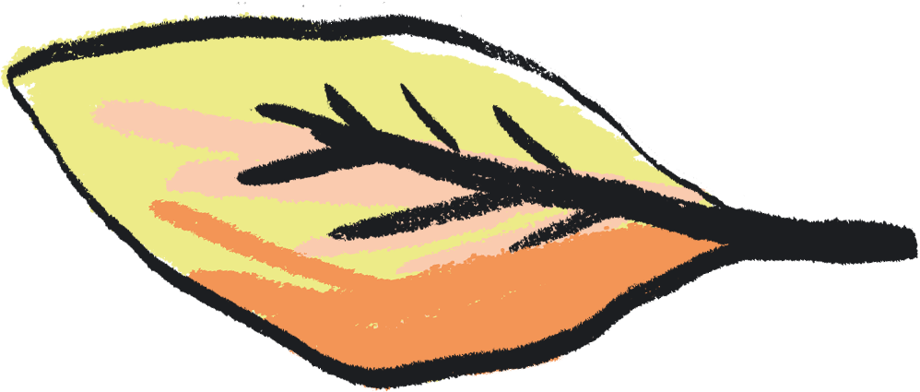
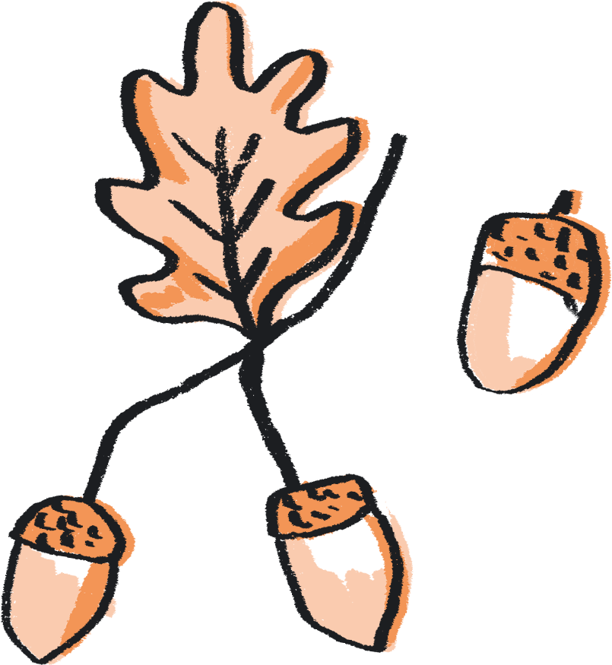
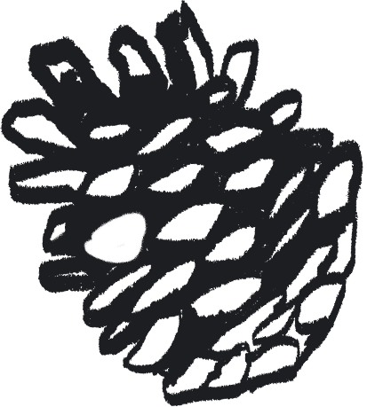
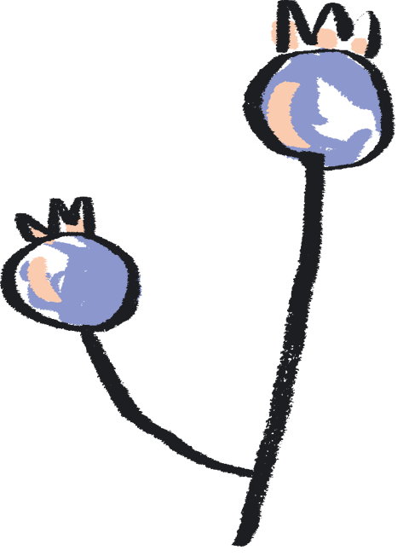
How to use this resource
You can use this resource in two ways:
As a live PowerPoint presentation for the whole class to view
As a printed pdf
Each year group has a dedicated set of slides.
The main content of each slide is directed at the pupils.
This content is animated to ensure that the teacher is in control of the pace of the lesson.
Each slide also has a corresponding set of ‘notes’, which are directed at the teacher.
To use the resource in PowerPoint Slide Show mode:
Go to the slide you wish to begin from
Click ‘Slide Show’ tab in the top navigation bar
Click ‘From Current Slide’ in the menu bar
To see the notes in this mode, click on the ‘…’ in the lefthand corner and select Presenter View
To view the notes:
Click on the View tab in the top navigation bar
Select ‘Notes’ to see these at the bottom of each slide

Slide 5
About this Resource…
Our Teacher Lab resource pack supports both creative practice and scientific enquiry in the classroom. We aim to offer teachers access to a variety of art experiences, aligned to each year group’s science curriculum. Through these activities, we hope to introduce exciting ways to combine the deepening of scientific knowledge and skills with the development of creative practice. Each activity also aims to embed scientific understanding and help children to ‘know more and remember more’ about the chosen topic.
We chose the working scientifically skills of ‘identifying and classifying’, as these are skills which run throughout the primary curriculum. We have chosen ‘Nature’ as a theme across all of the activities, offering ways to broaden children’s experience and understanding of nature and their place within it. Each nature-based topic has been selected from the National Curriculum and for reception the Early Learning Goals, to ensure each is as relevant as possible.
With reference to this knowledge base, we demonstrate how arts practice can be used to reinforce the skills and processes of identifying and classifying. For each year group, we have chosen a different art-based skill to provide teachers with a wide repertoire of creative ideas. We hope that these might be a starting point to enable teachers to use these creative practices to reinforce learning in other curriculum areas.

Slide 6
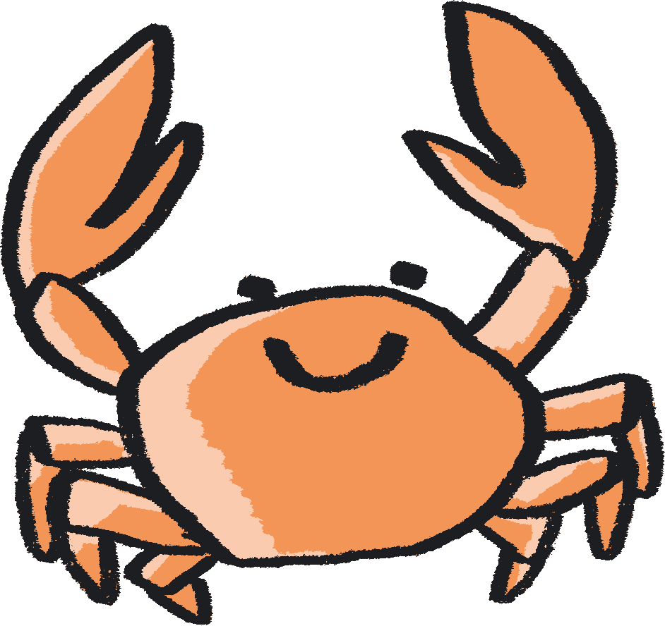
Each activity is designed as a mini project brief for your class, they are jumping off points to take in whichever direction best suits you. We encourage you to follow the natural curiosity of the children you’re working with and adapt the activity how best you see fit.
In terms of work with SEND children - each child is of course different, so when working with this resource, feel free to pick and choose activities which feel most suitable for them, depending on how they feel that day. Feel free to get creative with the activities and adapt them to your child's needs to create the best experience possible.

Slide 7

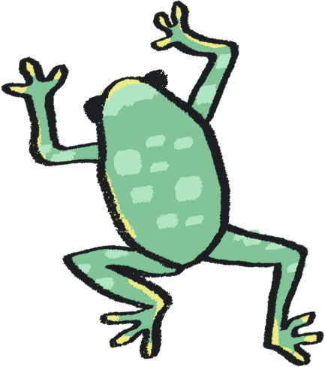
Author Statements
Gill Sekatawa, Art and Design Lead, Nelson Academy:
My aim for the resource was to provide a range of activities and experiences which will not only allow students to soak up the knowledge but also that allowed all involved to acquire transferable skills in art and problem solving to use in their future learning.
Prior to this Teacher Lab project, we had recently explored art and poetry with Kaitlin as part of Barbican Box in West Norfolk, which was an amazing experience. When the Barbican and Creative Arts East approached us about working together again, but this time in the suggested area of Science, it became immediately clear that we should involve Sarah, my teaching team colleague. As Science lead for our school, she is tasked with ensuring that, working scientifically, children will know and remember more. From my experience, there is no better way of making knowledge 'stick’ than using art and creativity to make learning engaging.
Sarah Melia, Science Lead, Nelson Academy:
I came at this project as a novice artist, intrigued to learn how art and science could mix and how creative practice could help children to enjoy working scientifically as well as know and remember more about a chosen topic. I wanted to choose a working scientifically thread which would run through all year groups in the hope that we would reach as wide a teacher and pupil audience as possible. By having this common thread link all the year groups’ activities together, the aim is that teachers will be able to adapt art activities from other year groups to use with other knowledge areas in their own year group, thereby creating a bank of resources whose application is potentially much wider than that originally written. As a science lead, I wanted not only to improve my own creative practice, but also to introduce a range of activities that could be adapted and used in different contexts, so that they could support the teaching of schools’ individual science curriculums, no matter what the unit’s knowledge base.

Slide 8
Author Statements continued…
Kaitlin Ferguson, Artist:
It has been really inspiring to work on this collaboration with both Gill and Sarah, and to create a resource which draws upon areas of the curriculum which we each feel very passionate about. It has been a fascinating process, which has allowed us to find inspiration from each other's passions and knowledge.
When we began creating the resource, we agreed it was really important that each set of activities felt truly balanced between art and science. We saw science as an inspiration for making art, and creativity as a means to explore science on a more meaningful level.
Art is a dynamic subject which has the ability to work in tandem with any subject in the curriculum, to bring greater depth and understanding. During our initial chats, we realised that classifying and sorting was not only a science skill which is relevant to each year group, but it also is a skill found in art. For example, curation is simply the sorting and organising of artworks. Therefore we designed the activities to have identifying and classification at the heart of them.
It’s been really enlightening to learn about the curriculum in greater detail, from those who are actively teaching it. This has allowed me to absorb and learn from the amazing teaching of Gill and Sarah. Like most teachers, Gill and Sarah have to come up with infinite new ideas and activities for their pupils regularly, under pressure of time constraints. Therefore, it has been really rewarding to create a resource which is designed both for ease of use for the teacher but also full of excitement and wonder for the children.
We hope that the resource offers teachers an exciting and ambitious set of ideas, rooted in the curriculum, to help grow the confidence, knowledge, and creativity of children.

Slide 9
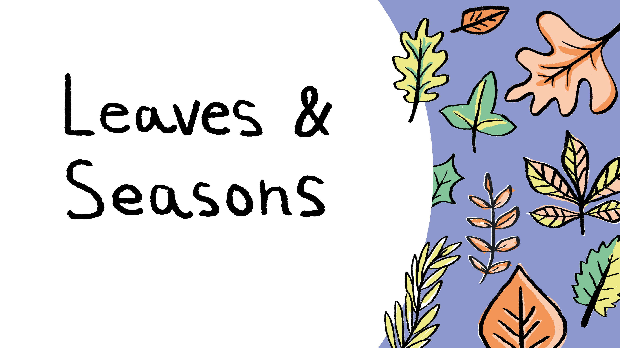
with Year 1
Notes:
Curriculum links: Identify and name a variety of common wild and garden plants, including deciduous and evergreen trees.
Curriculum links: Identify and describe the basic structure of a variety of common flowering plants, including trees.
Curriculum links: Practical scientific methods, processes, and skills: Identifying and classifying.

Slide 10

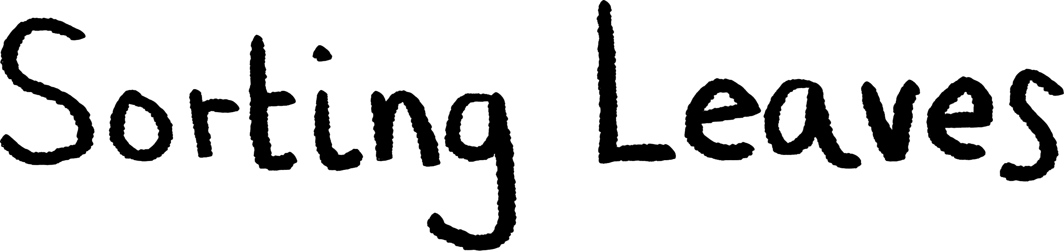






Classification activity
Observe closely, perhaps using magnifying glasses, and compare and contrast familiar plants; describe how they were able to identify and group them.
You will need...
Coloured electrical tape, masking tape or hula hoops to make 'sorting circles' on the floor.
A variety of leaves.
Notes:
Resource note: Leaves could be collected before the lesson or during an outdoor lesson.

Slide 11


Have a careful look at a variety of leaves you've collected.
What words would you use to describe the different leaves?
Look carefully. What similarities and differences can you notice?

Slide 12



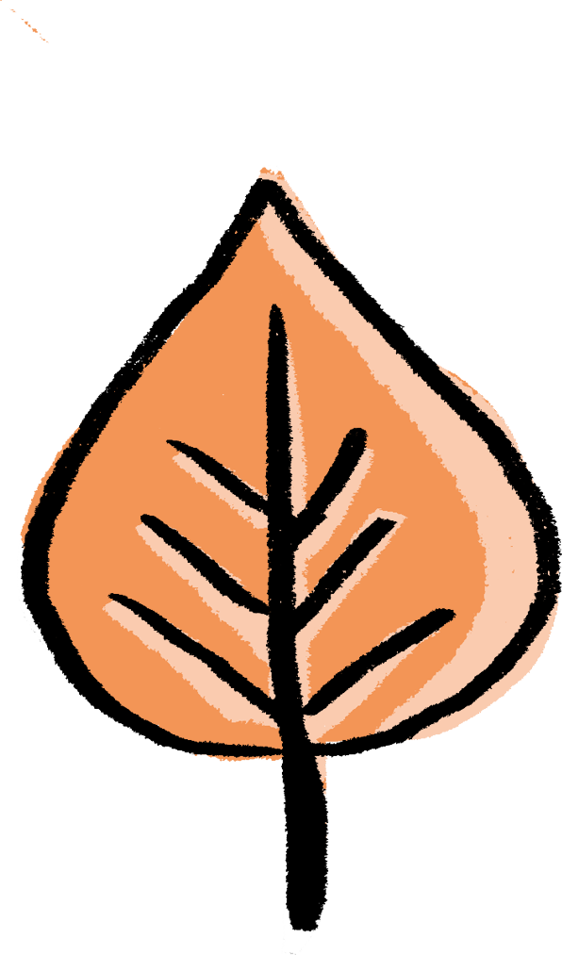
continued…
Draw a set of circles on the floor of the classroom using your tape or hula hoops!
Work together to sort the leaves according to different categories.
  These could be:
  Classify by type: evergreen or deciduous
  Classify by size
  Classify by texture: smooth or rough
  Classify by shape
  Classify by colour
  Or you could even come up with some of your own categories as well!
Notes:
PROMPTS FOR CREATIVE THINKING:
How many different ways and methods can students think of to explore the characteristics of their leaves? What senses can they use?
Possible Extension: If resources permit (or using photographs), classify by seasons.

Slide 13
When looking for different criteria, be sure to come up with reasons for each of your choices.
Some leaves might be able to fit in more than one category so you could put them in overlapping circles (e.g. like a Venn diagram).
Some leaves might not fit into any of your categories and might need to go on the outside of your circles - that’s ok too!
Notes:
PROMPTS FOR CREATIVE THINKING
If there are leaves which can't be classified, what can be done? What further research could be done to help to classify them? Are there any categories not already thought of which could help?
Students can discuss their rationale for classification, and try to agree as a group. How can any disagreement be resolved? Does it need to be resolved? Are there other examples of disagreements or debates in science?

Slide 14
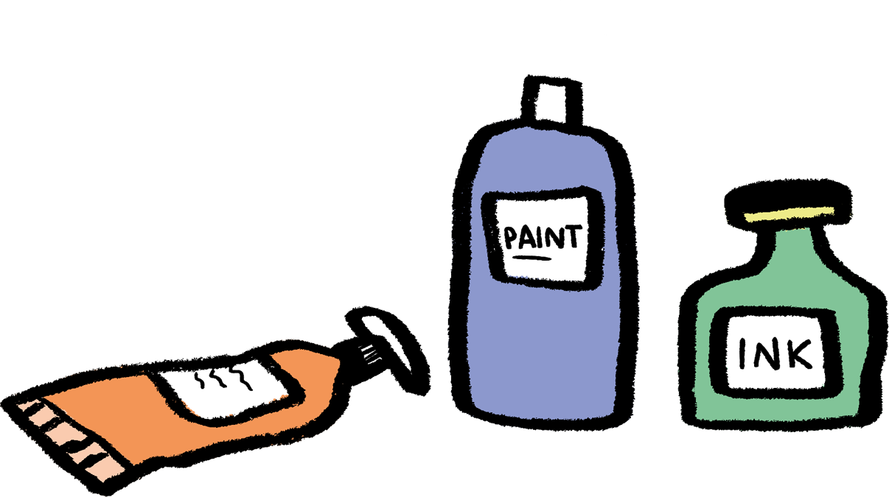
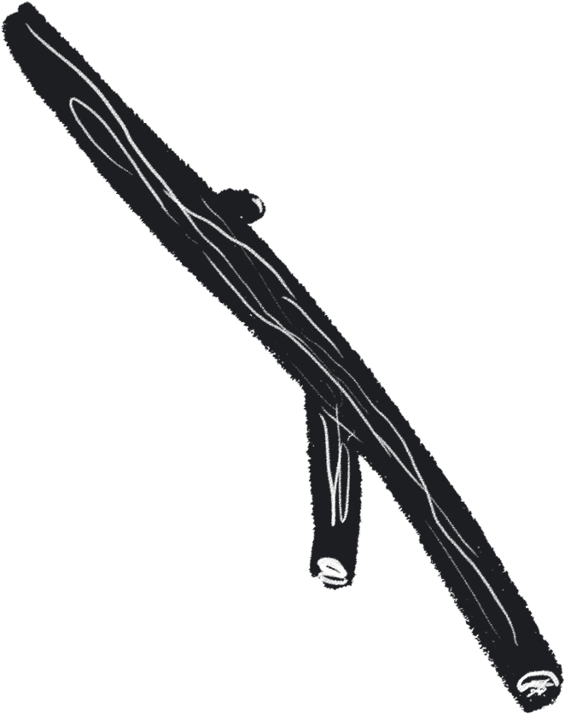
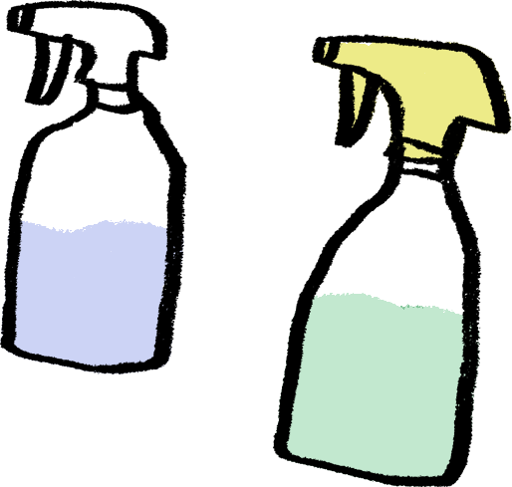
Medium: Printmaking
Art activity
Create prints, sort them and make a science/art display to link back to the classification activity.
You will need:
Natural materials e.g. leaves, flowers, pine cones, twigs etc
Newspaper or table covering
Some paper
Spray bottles and water
Paint or natural inks

Slide 15
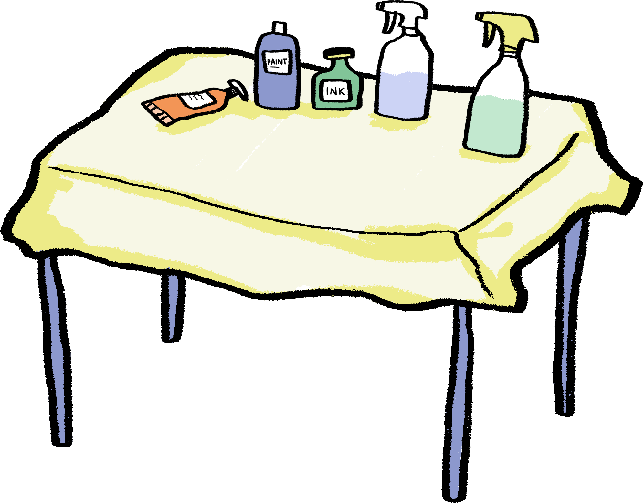
Choose a selection of leaves from the sorting activity.
Set up your work area and cover the table you are working on with either newspaper or a tablecloth.
Fill the spray bottles with a mixture of water and either paint or natural inks.
Notes:
PROMPTS FOR CREATIVE THINKING:
Which leaves do students think will make the best stencils and why? Can they predict which characteristics will have the most visual impact?

Slide 16
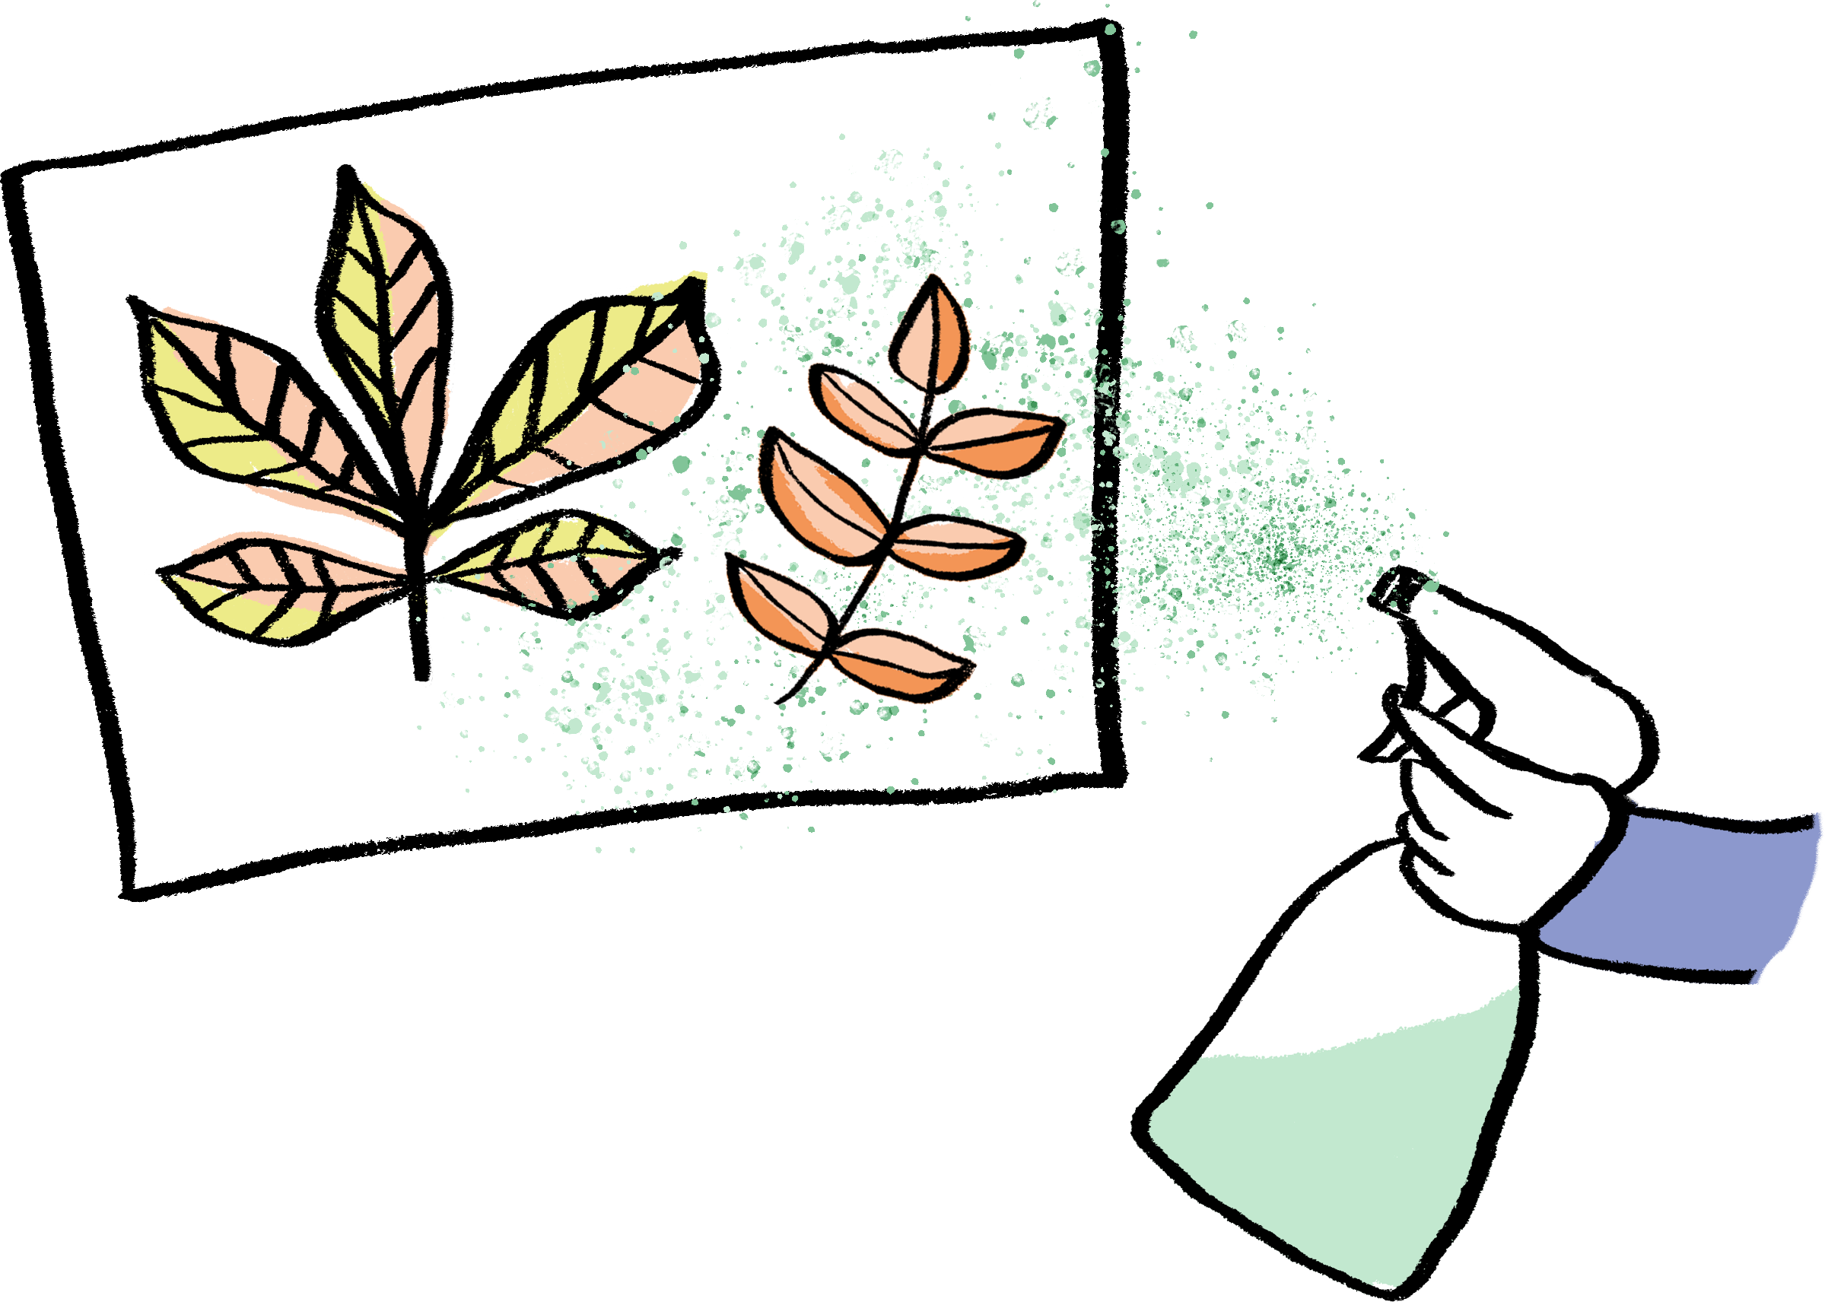

continued…
Arrange the leaves or natural objects in a composition on your paper.
Spray them with your spray bottle.
Try spraying from different directions to capture as much detail as possible.
  You could also experiment with using different colours or layering different objects.
When you are finished, lift up your leaves to reveal your Natural Stencil Print!
Notes:
PROMPTS FOR CREATIVE THINKING
Students can reflect on the outcome of their stencil print - is there anything they would do differently next time? More / less paint, spraying from a different angle, etc? Students can try these out in further attempts.
Discussion - were there things that students found difficult when making their prints? How did they overcome this? How can they use this learning in the future?
Possible Extension:
After the art activity has been completed, re-create the sorting circles, this time showcasing the artwork you have produced.
Add speech bubbles to say which leaves made the best stencils and why you made the classification decisions you did.
Create your very own exhibition wall display!

Slide 17
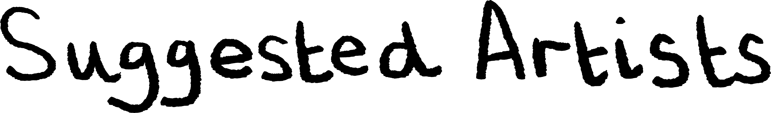
Kaitlin says: “Lorenzo Duran is a Spanish self-taught artist who carves beautifully detailed artworks into leaves. He was inspired by watching how a caterpillar made holes in a leaf by eating it!”
Andy Goldsworthy is a British artist, who uses natural materials to create site-specific artworks which explore the relationship between humans and their natural surroundings.
James Brunt lives and works in Yorkshire and creates artworks using leaves to make patterns and shapes. What patterns can you create using the leaves you have collected?
Lorenzo Duran
Andy Goldsworthy
James Brunt

Slide 18

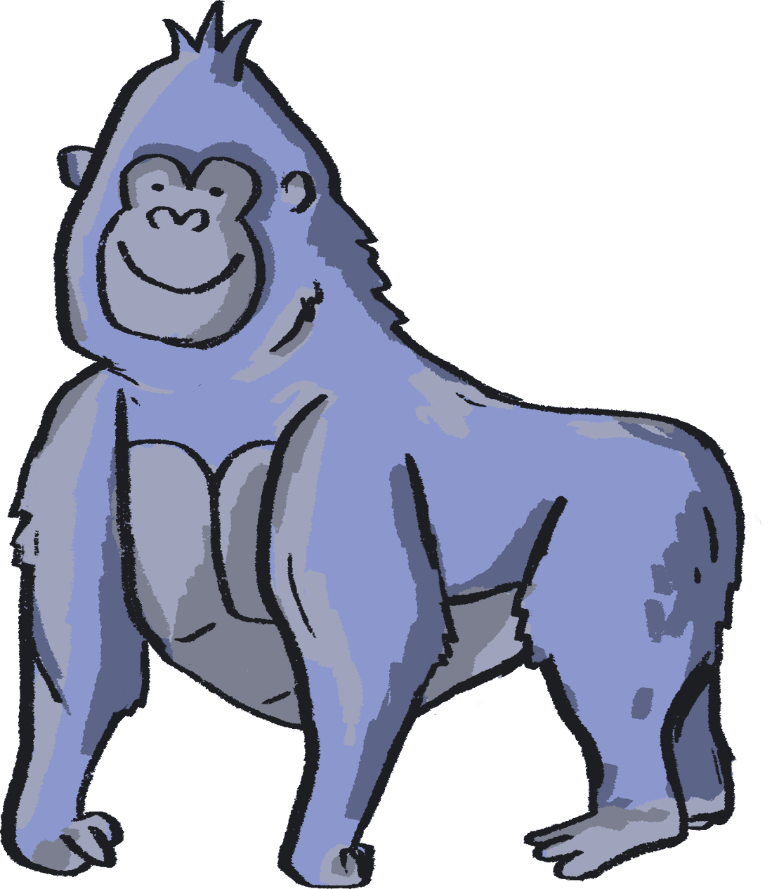

Authors:
Kaitlin Ferguson, Artist
Gill Sekatawa, Art and Design Lead, Nelson Academy
Sarah Melia, Science Lead, Nelson Academy
Illustrator:
Sophie Clouston, Creative Arts East
Commissioned and produced in 2021 by:
Barbican Creative Learning
Creative Arts East for PEACH West Norfolk
With thanks to:
Staff and students at Nelson Academy, Downham Market
Norfolk and Norwich Festival Bridge
Attribution:
You are welcome to share this resource with colleagues and adapt it as you see fit. Please note that if you do so, the following credit line must be used:
Taken from Teacher Lab: Teaching Primary Science through Creativity, written by Kaitlin Ferguson, Gill Sekatawa and Sarah Melia. Illustrations by Sophie Clouston. Commissioned by Barbican Creative Learning and Creative Arts East. With support from the Esmée Fairbairn Foundation and Nelson Academy, Downham Market. Teacher Lab is a Barbican Creative Learning programme

Slide 19

Below are some links to more resources for supporting creativity in learners:
https://www.researchgate.net/publication/305218451_A_Five_Dimensional_Model_of_Creativity_and_its_Assessment_in_Schools
https://www.thomastallisschool.com/tallis-habits.html
https://nnfestival.org.uk/festival-bridge/schools-education/resource-bank/
https://www.groundworkgallery.com/exhibitions-about-environment/virtual-tour/

