Slide 1

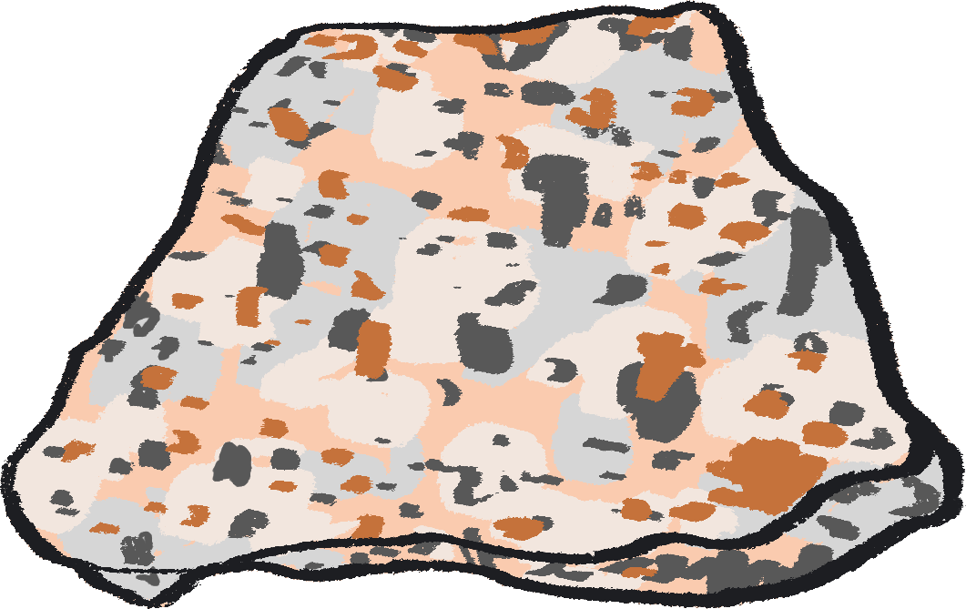



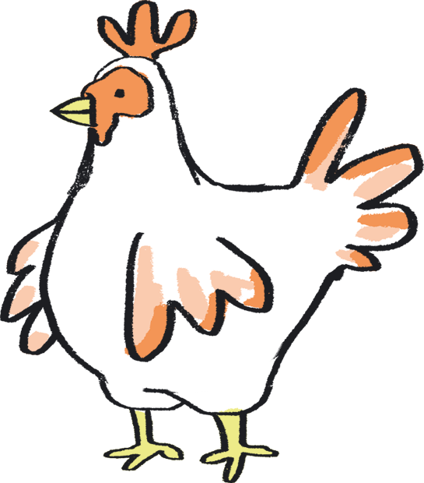
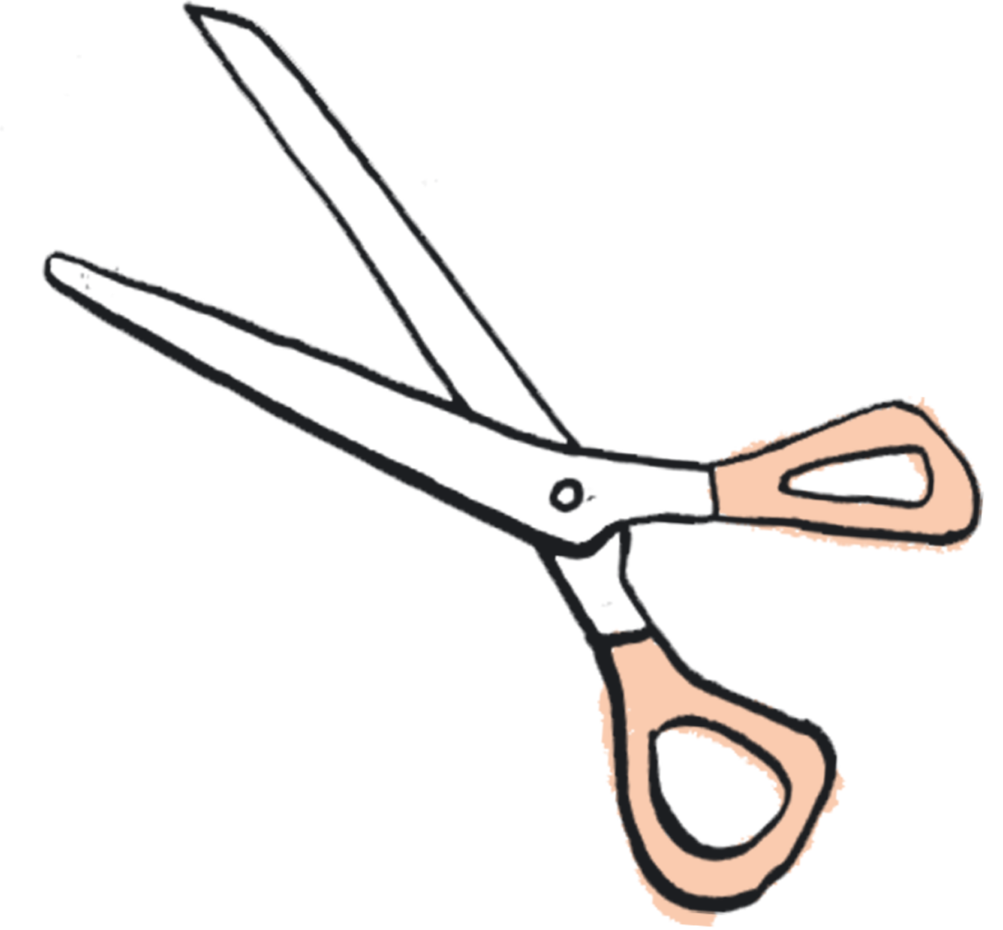

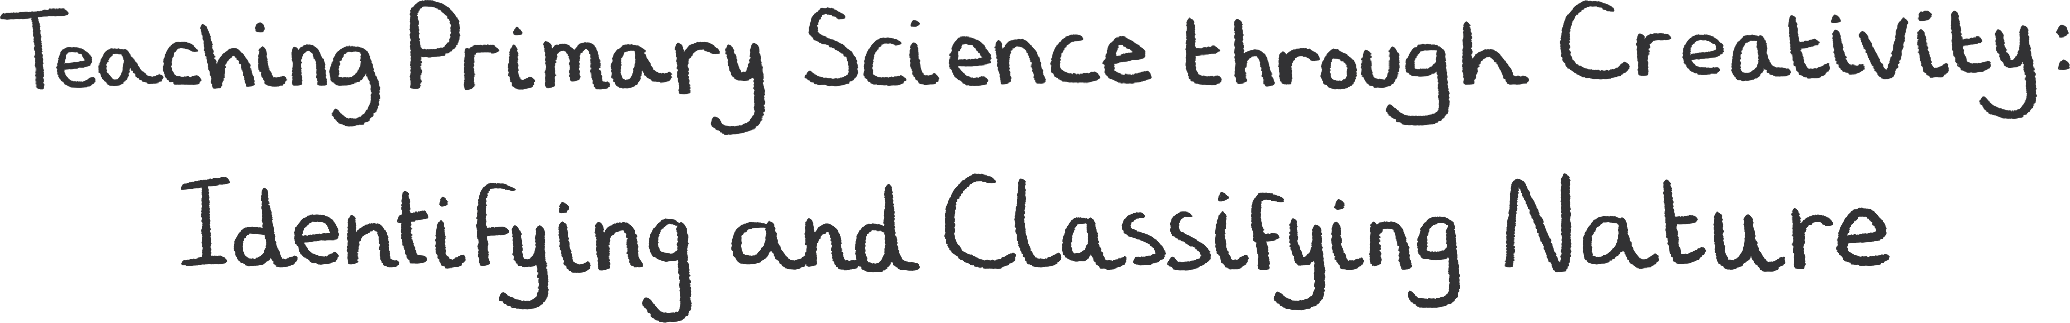
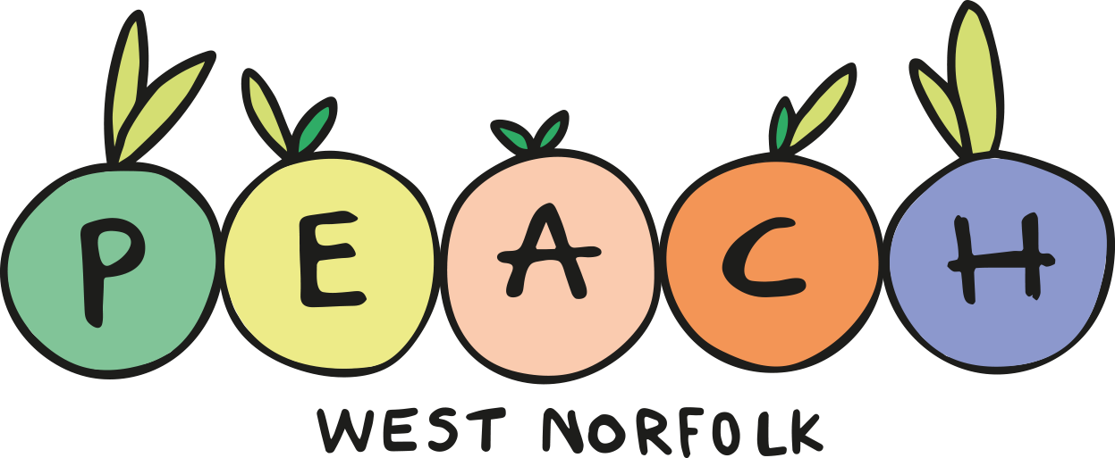



Teacher Lab
YEAR THREE Teaching Resource – Slides and Notes

Slide 2
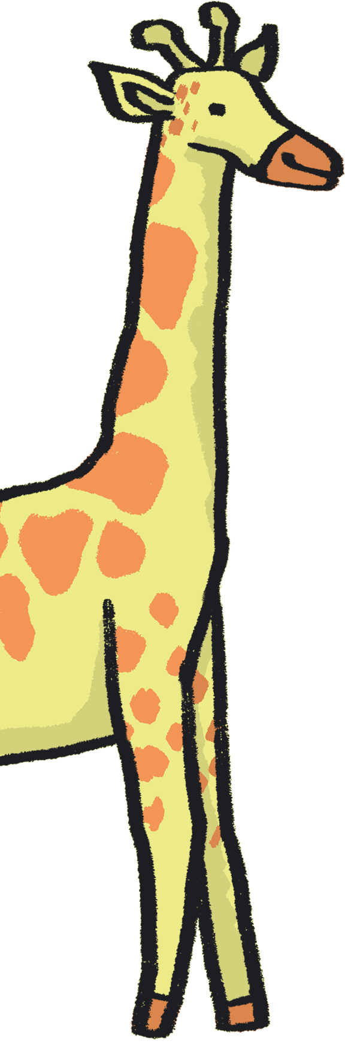
Contents
About Teacher Lab
How to use this resource
About this resource
Author statements
Lesson plans:
  Year 3 – Rocks
Credits
References

Slide 3
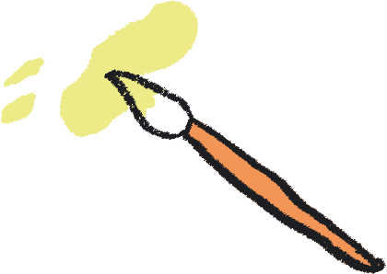
About Teacher Lab
The Teacher Lab project promotes creative practice in the classroom by supporting cross-curricular teacher and artist exchanges in the UK. It offers teachers direct access to a variety of artists, in order to re-imagine the curriculum and develop practical tools for learning through the arts.
You can access the previous Teacher Lab resource (exploring Push and Pull forces) created by teacher Christina Paul and actor and mathematician Victoria Gould, here: https://sites.barbican.org.uk/teacherslab/
……………………………………………………………………………………………………………………………………………………………………………..
This Teacher Lab was a collaboration between Barbican Creative Learning, Creative Arts East for PEACH West Norfolk, and involved teachers Gill Sekatawa and Sarah Melia from Nelson Academy in Downham Market, Norfolk, and Norwich based artist Kaitlin Ferguson.
Through a series of planning, testing and reflection sessions, Gill, Sarah and Kaitlin co-designed a range of creative activities to support the delivery of the primary science curriculum. These were then developed into a resource pack, in the form of a set of PowerPoint Slides which can be used directly in a lesson, with supportive guidance notes to assist your teaching.

Slide 4
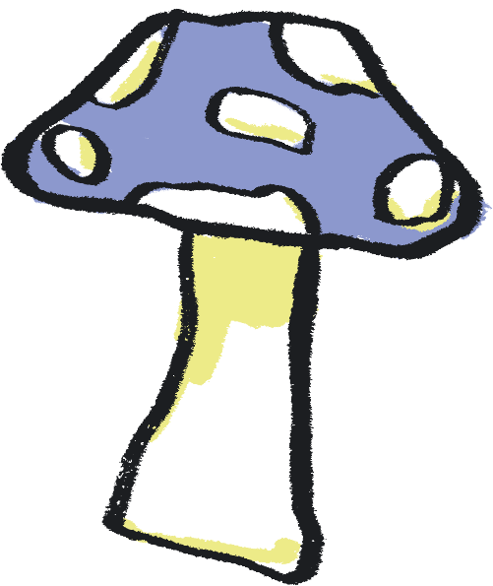
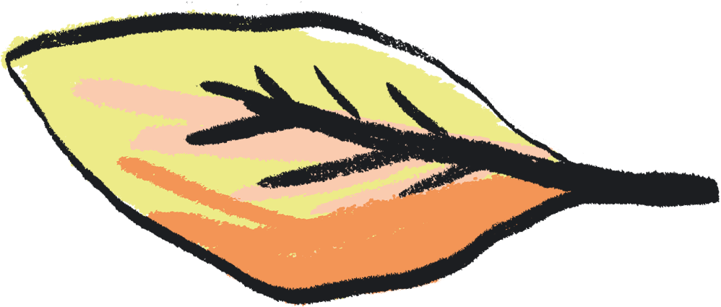
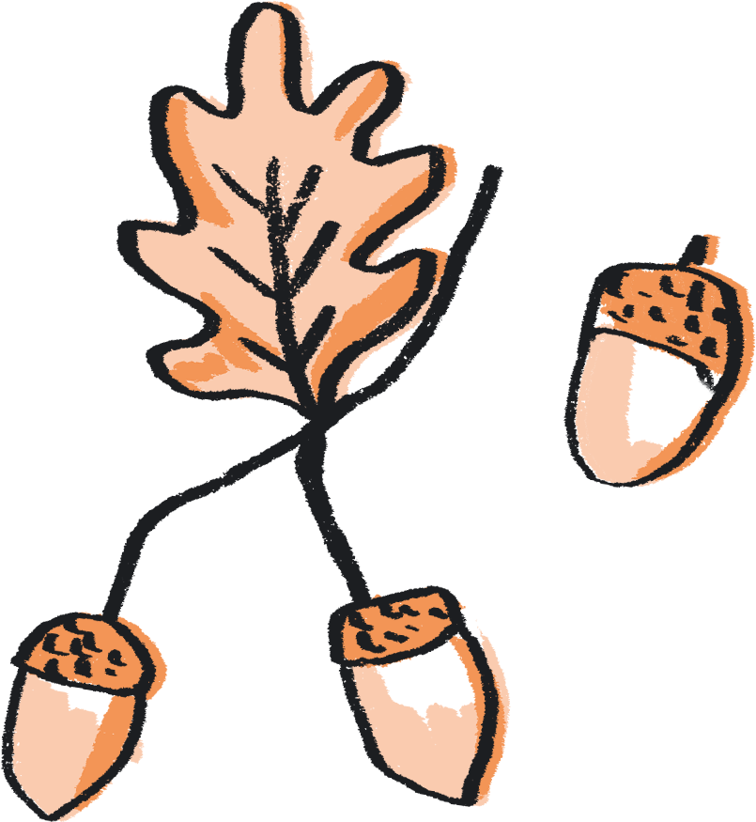
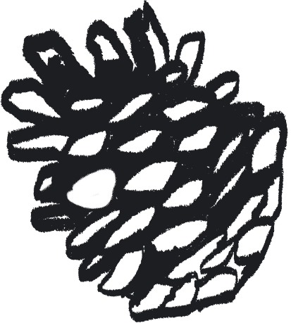
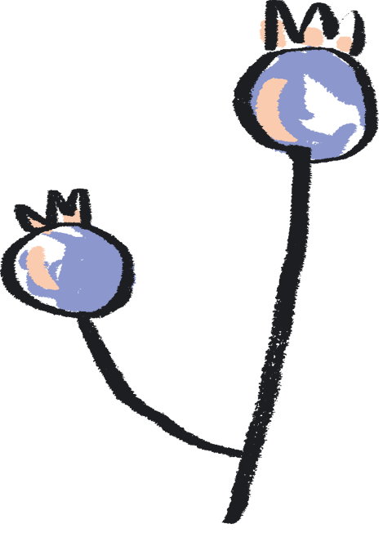
How to use this resource
You can use this resource in two ways:
As a live PowerPoint presentation for the whole class to view
As a printed pdf
Each year group has a dedicated set of slides.
The main content of each slide is directed at the pupils.
This content is animated to ensure that the teacher is in control of the pace of the lesson.
Each slide also has a corresponding set of ‘notes’, which are directed at the teacher.
To use the resource in PowerPoint Slide Show mode:
Go to the slide you wish to begin from
Click ‘Slide Show’ tab in the top navigation bar
Click ‘From Current Slide’ in the menu bar
To see the notes in this mode, click on the ‘…’ in the lefthand corner and select Presenter View
To view the notes:
Click on the View tab in the top navigation bar
Select ‘Notes’ to see these at the bottom of each slide

Slide 5
About this Resource…
Our Teacher Lab resource pack supports both creative practice and scientific enquiry in the classroom. We aim to offer teachers access to a variety of art experiences, aligned to each year group’s science curriculum. Through these activities, we hope to introduce exciting ways to combine the deepening of scientific knowledge and skills with the development of creative practice. Each activity also aims to embed scientific understanding and help children to ‘know more and remember more’ about the chosen topic.
We chose the working scientifically skills of ‘identifying and classifying’, as these are skills which run throughout the primary curriculum. We have chosen ‘Nature’ as a theme across all of the activities, offering ways to broaden children’s experience and understanding of nature and their place within it. Each nature-based topic has been selected from the National Curriculum and for reception the Early Learning Goals, to ensure each is as relevant as possible.
With reference to this knowledge base, we demonstrate how arts practice can be used to reinforce the skills and processes of identifying and classifying. For each year group, we have chosen a different art-based skill to provide teachers with a wide repertoire of creative ideas. We hope that these might be a starting point to enable teachers to use these creative practices to reinforce learning in other curriculum areas.

Slide 6
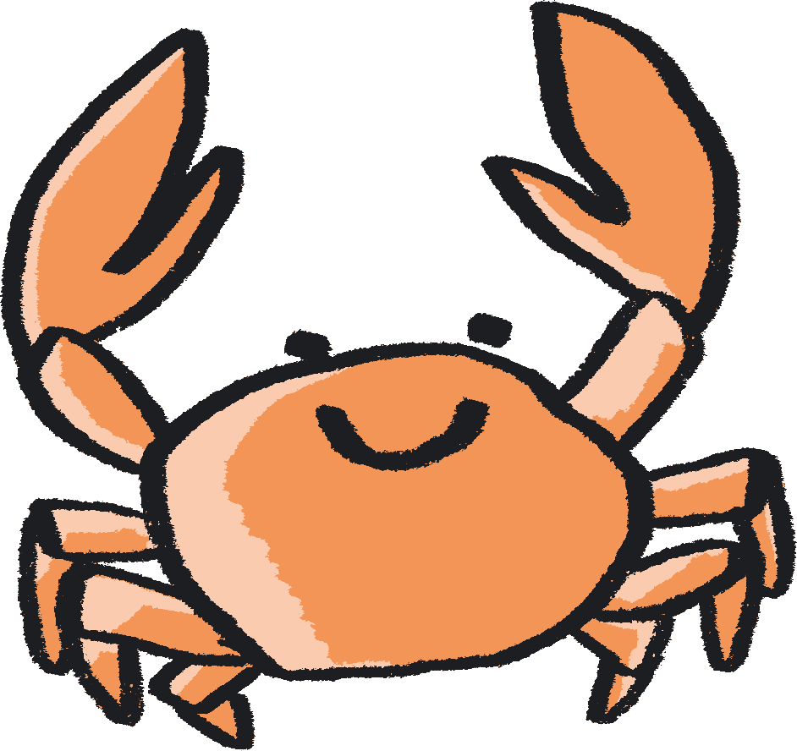
Each activity is designed as a mini project brief for your class, they are jumping off points to take in whichever direction best suits you. We encourage you to follow the natural curiosity of the children you’re working with and adapt the activity how best you see fit.
In terms of work with SEND children - each child is of course different, so when working with this resource, feel free to pick and choose activities which feel most suitable for them, depending on how they feel that day. Feel free to get creative with the activities and adapt them to your child's needs to create the best experience possible.

Slide 7
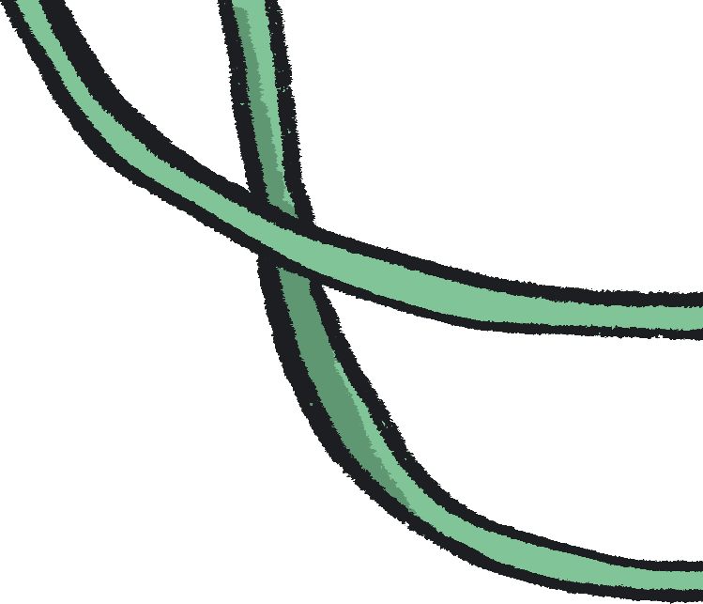
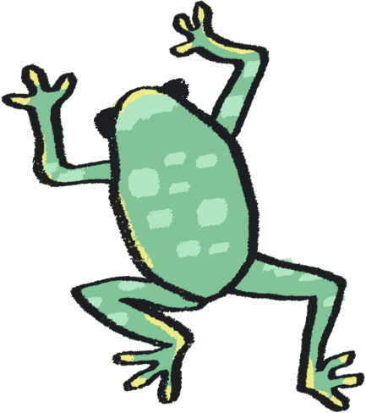
Author Statements
Gill Sekatawa, Art and Design Lead, Nelson Academy:
My aim for the resource was to provide a range of activities and experiences which will not only allow students to soak up the knowledge but also that allowed all involved to acquire transferable skills in art and problem solving to use in their future learning.
Prior to this Teacher Lab project, we had recently explored art and poetry with Kaitlin as part of Barbican Box in West Norfolk, which was an amazing experience. When the Barbican and Creative Arts East approached us about working together again, but this time in the suggested area of Science, it became immediately clear that we should involve Sarah, my teaching team colleague. As Science lead for our school, she is tasked with ensuring that, working scientifically, children will know and remember more. From my experience, there is no better way of making knowledge 'stick’ than using art and creativity to make learning engaging.
Sarah Melia, Science Lead, Nelson Academy:
I came at this project as a novice artist, intrigued to learn how art and science could mix and how creative practice could help children to enjoy working scientifically as well as know and remember more about a chosen topic. I wanted to choose a working scientifically thread which would run through all year groups in the hope that we would reach as wide a teacher and pupil audience as possible. By having this common thread link all the year groups’ activities together, the aim is that teachers will be able to adapt art activities from other year groups to use with other knowledge areas in their own year group, thereby creating a bank of resources whose application is potentially much wider than that originally written. As a science lead, I wanted not only to improve my own creative practice, but also to introduce a range of activities that could be adapted and used in different contexts, so that they could support the teaching of schools’ individual science curriculums, no matter what the unit’s knowledge base.

Slide 8
Author Statements continued…
Kaitlin Ferguson, Artist:
It has been really inspiring to work on this collaboration with both Gill and Sarah, and to create a resource which draws upon areas of the curriculum which we each feel very passionate about. It has been a fascinating process, which has allowed us to find inspiration from each other's passions and knowledge.
When we began creating the resource, we agreed it was really important that each set of activities felt truly balanced between art and science. We saw science as an inspiration for making art, and creativity as a means to explore science on a more meaningful level.
Art is a dynamic subject which has the ability to work in tandem with any subject in the curriculum, to bring greater depth and understanding. During our initial chats, we realised that classifying and sorting was not only a science skill which is relevant to each year group, but it also is a skill found in art. For example, curation is simply the sorting and organising of artworks. Therefore we designed the activities to have identifying and classification at the heart of them.
It’s been really enlightening to learn about the curriculum in greater detail, from those who are actively teaching it. This has allowed me to absorb and learn from the amazing teaching of Gill and Sarah. Like most teachers, Gill and Sarah have to come up with infinite new ideas and activities for their pupils regularly, under pressure of time constraints. Therefore, it has been really rewarding to create a resource which is designed both for ease of use for the teacher but also full of excitement and wonder for the children.
We hope that the resource offers teachers an exciting and ambitious set of ideas, rooted in the curriculum, to help grow the confidence, knowledge, and creativity of children.

Slide 9
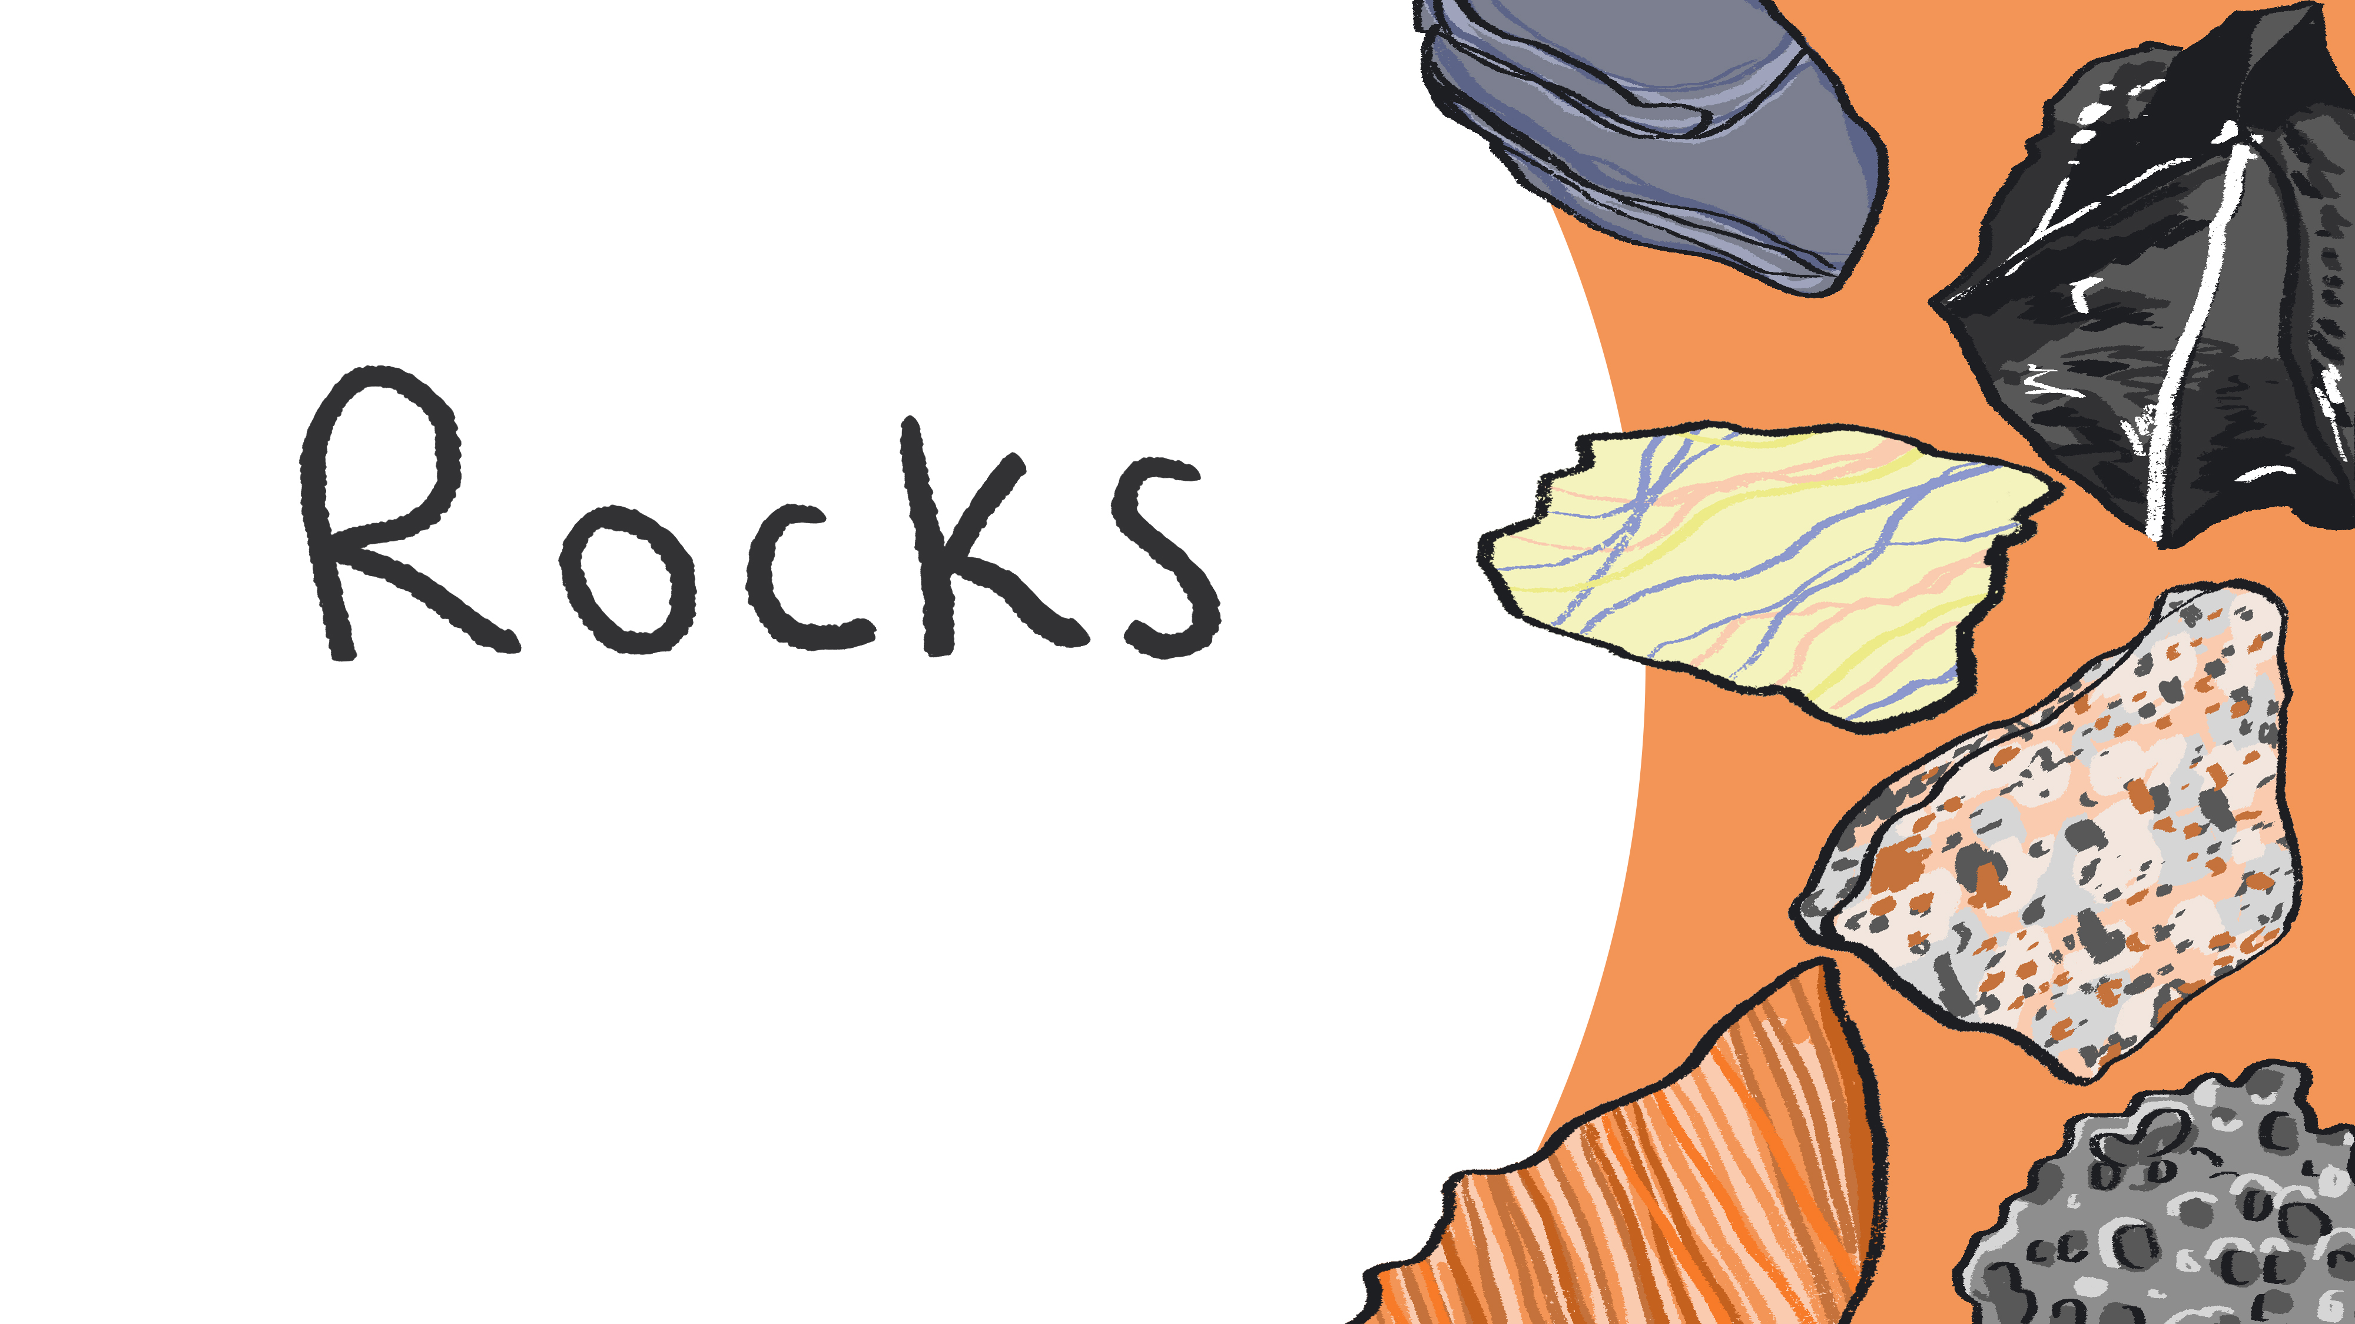
With Year 3
Notes:
Curriculum Links: Compare and group together different kinds of rocks on the basis of their appearance and simple physical properties

Slide 10
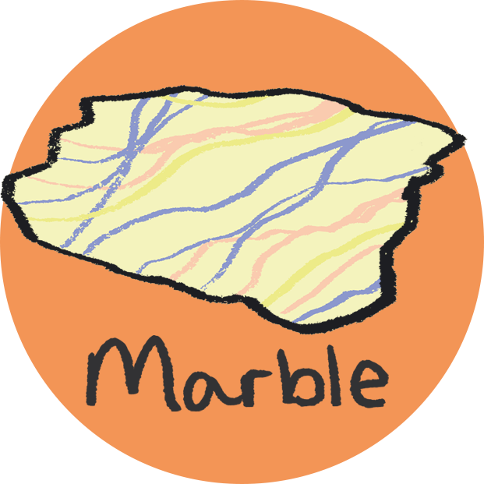
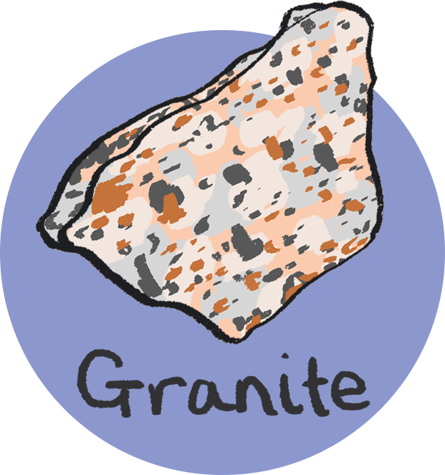

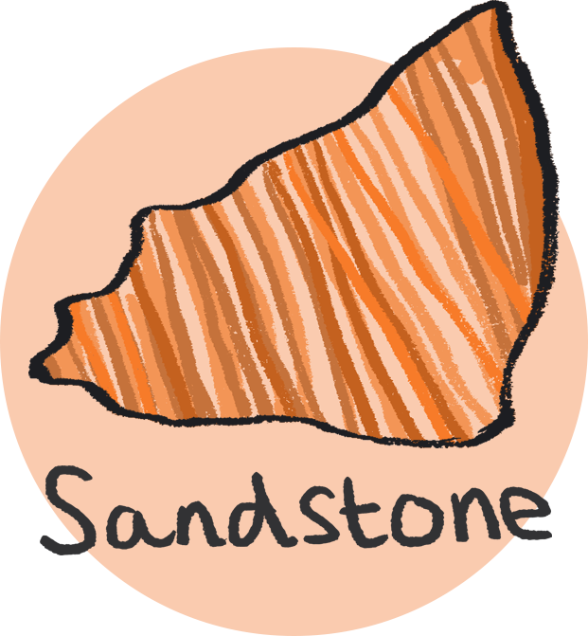
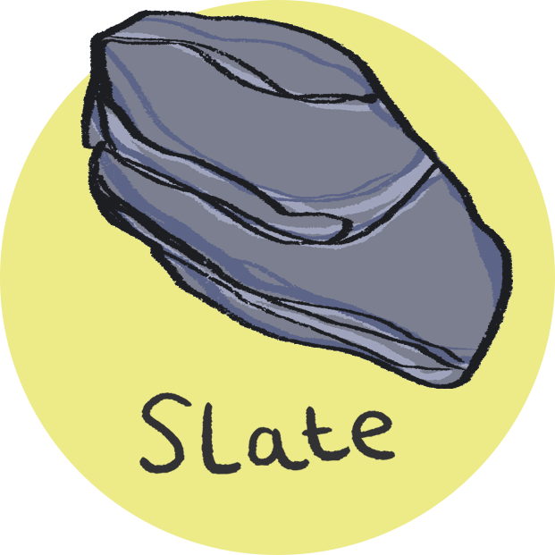
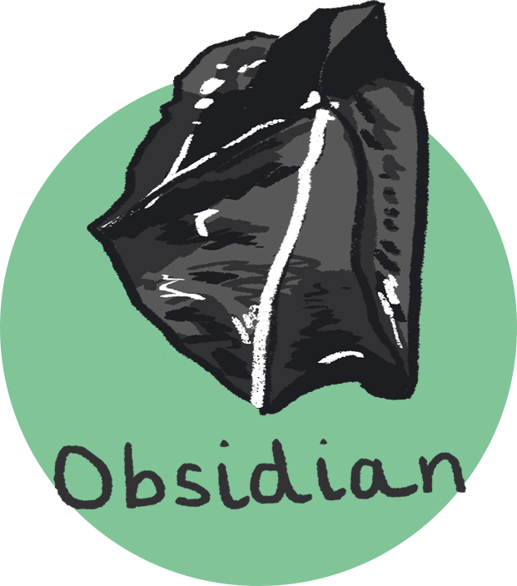
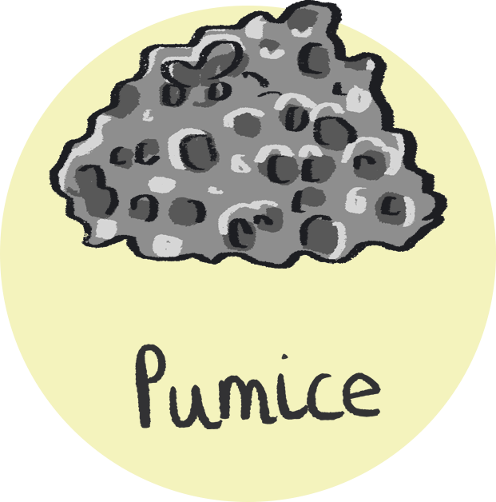
Classification activity
Compare and group together different kinds of rocks on the basis of their appearance and simple physical properties
You will need:
Rock Identification Chart (next)
Variety of rock samples including marble, granite, sandstone, slate, pumice, obsidian.

Slide 11
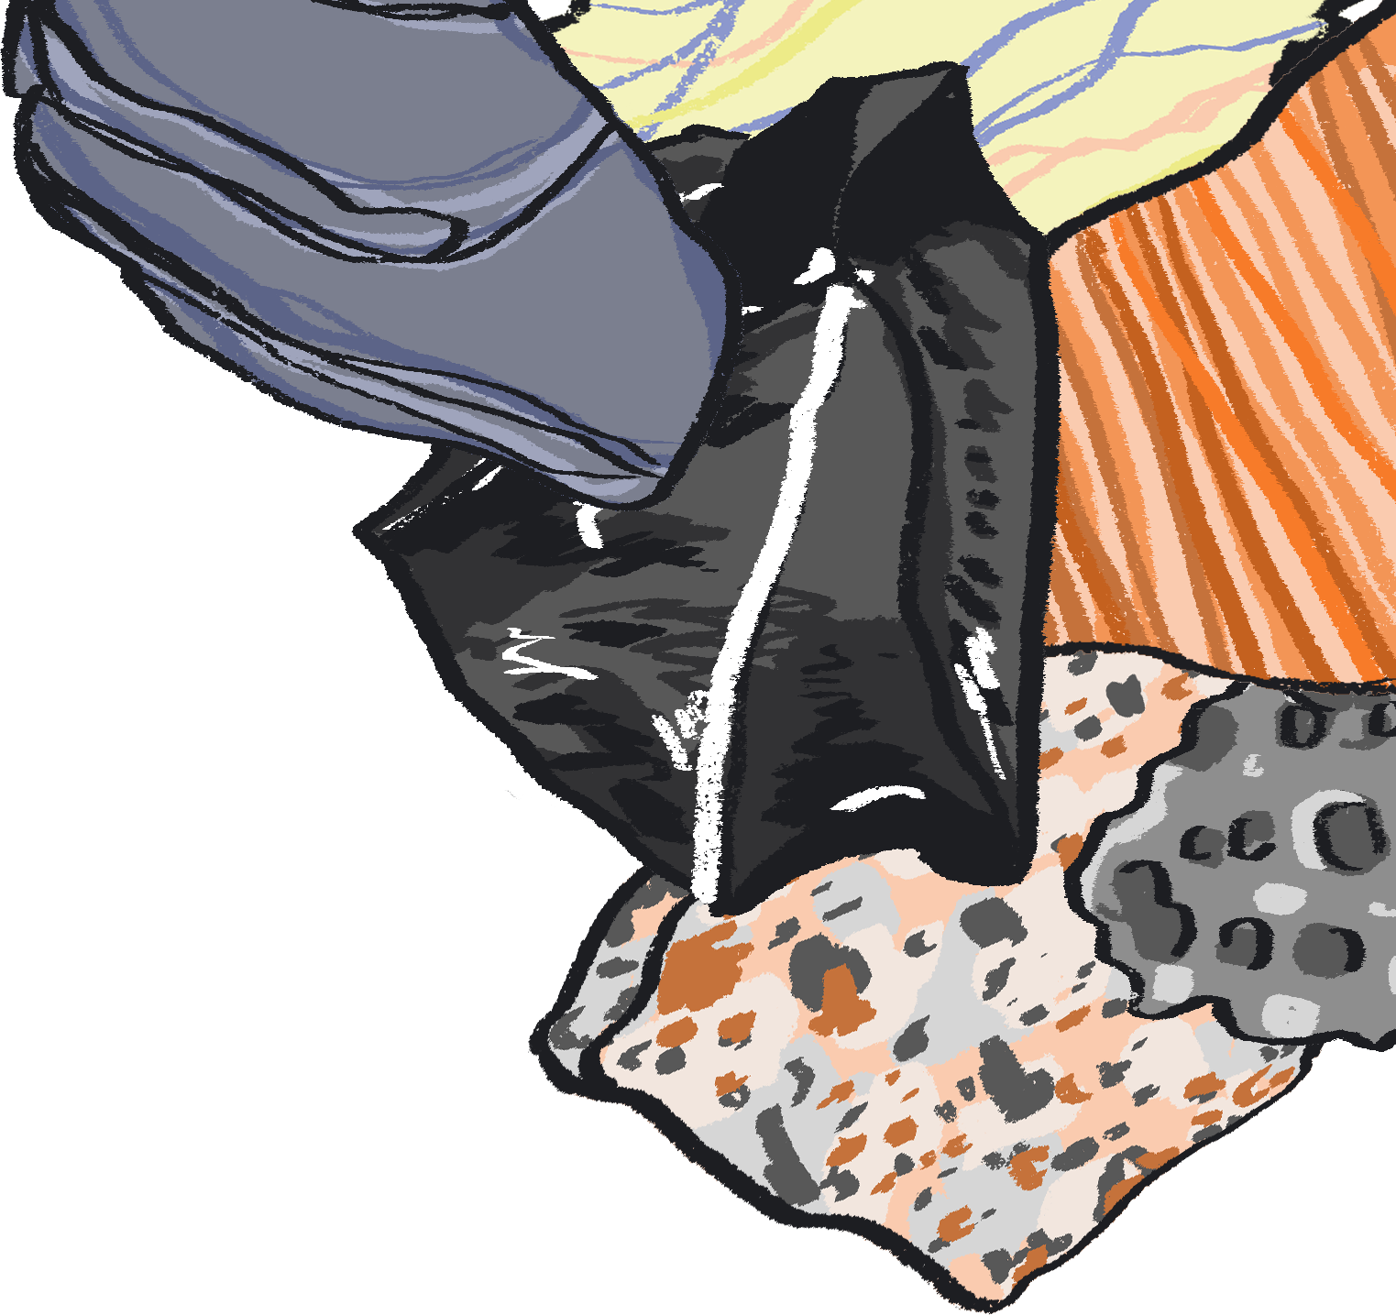








Does the rock have more than one colour?
Yes
No
Does the rock look like it has veins in it?
Does the rock have visible layers?
Yes
No
Yes
No
Marble
Does the rock look like it has crystals in it?
Does the rock have visible grains?
Does the rock look like it is full of holes?
Yes
Yes
No
Yes
No
Granite
Sandstone
Slate
Pumice
Obsidian

Slide 12

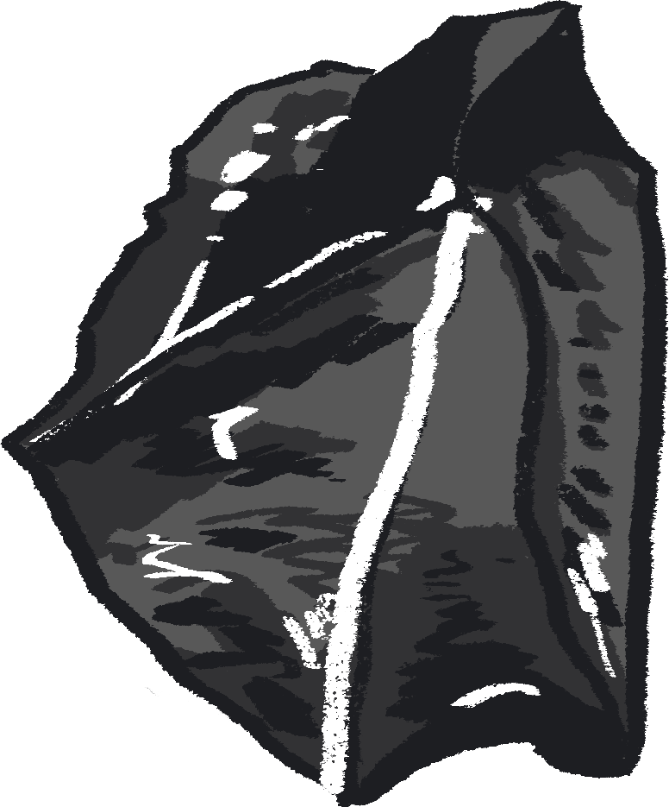
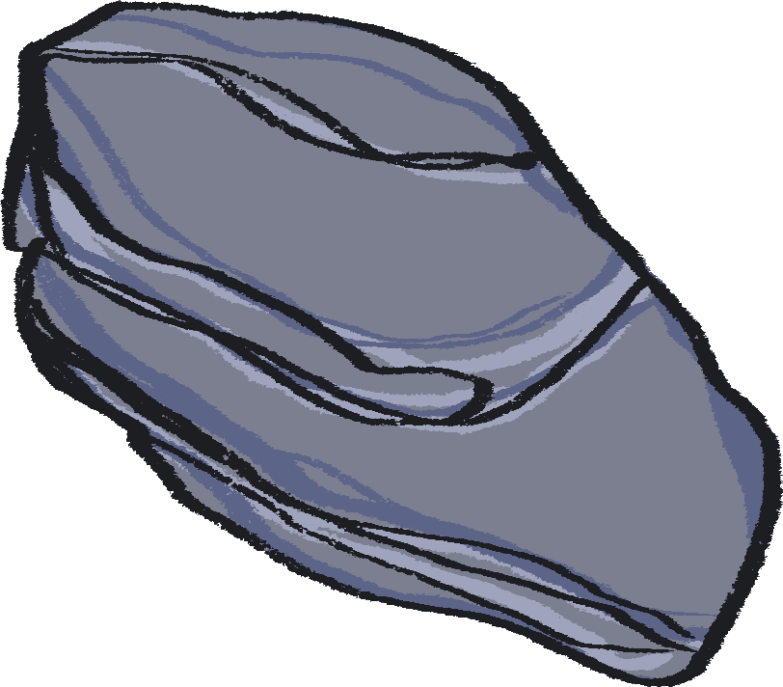
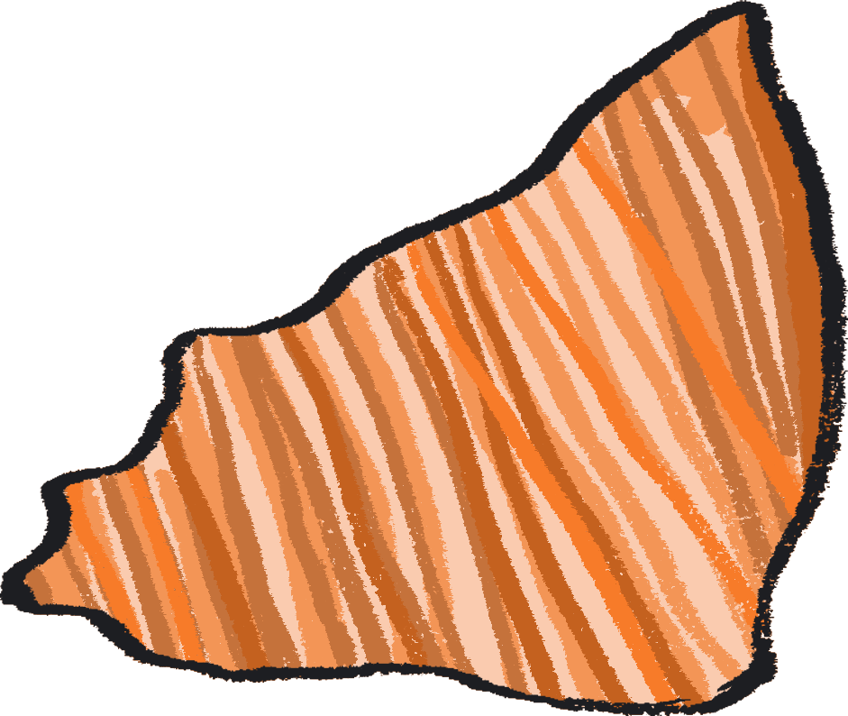
Have a careful look at our rock identification chart, follow the key to see if you can identify different rock samples.
Next:
Start by choosing two rock samples.
What question could you ask to differentiate between them?
What questions could you ask to differentiate three rock samples?
Continuing this thought process, can you make your own key to identify the rock samples?
Notes:
PROMPTS FOR CREATIVE THINKING
To create their categories, students will need to make connections between the different rocks, as well as identify differences. With each new rock that is added, they will need to test out their questions, and see if they still work to identify the rocks, or whether they need to be amended or new questions added.

Slide 13

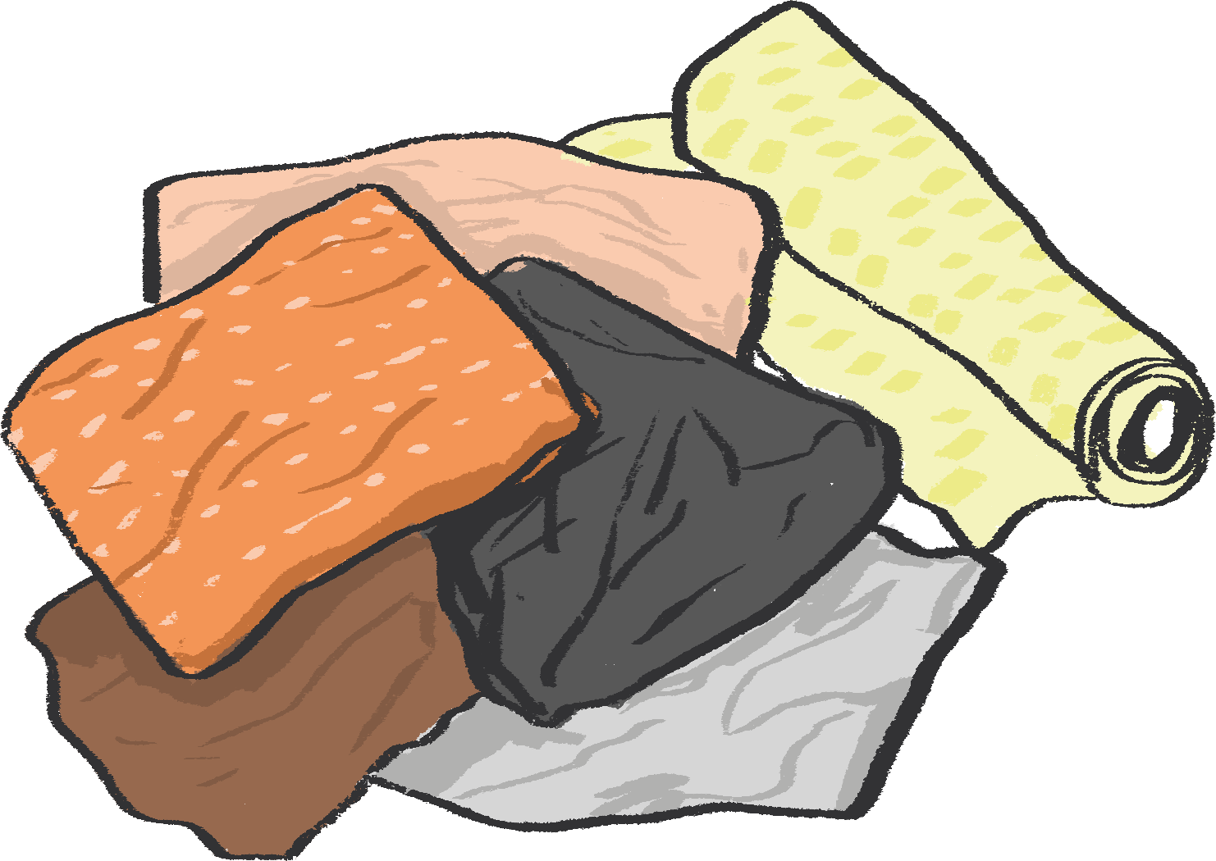
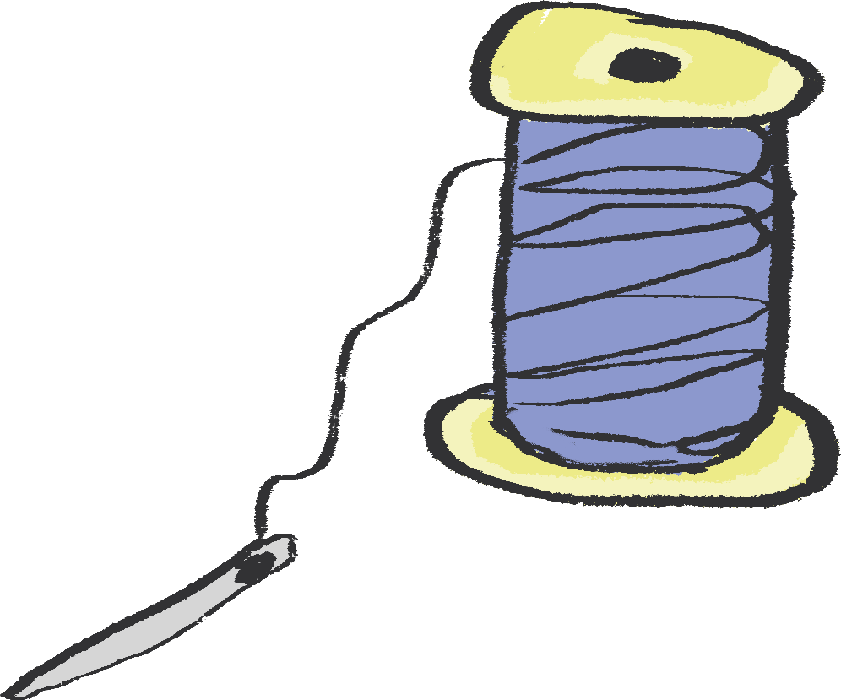
Art activity
Medium: Textiles
Create a geological artwork, which explores the different textures of rock as well as the layers the earth, using recycled materials!
You will need:
Selection of rock samples
Scraps of fabric (recycled if possible)
Magnifying glasses (optional)
A thicker piece of fabric as a backing e.g. canvas
Pencil and piece of paper
Scissors
Option One – Sewing: Pins, needle and thread in a variety of colours.
Option Two – Fabric glue (or if you don't have this PVA will work!)

Slide 14
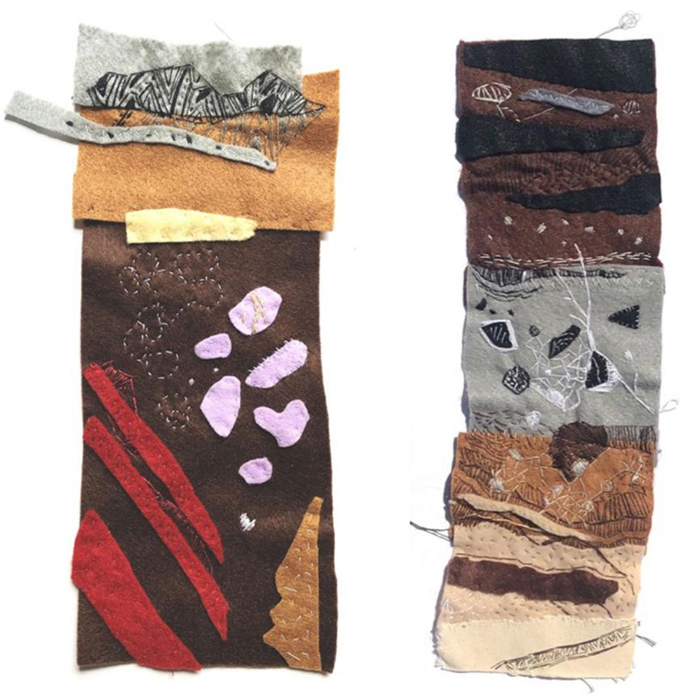
Begin by looking at the rocks you have classified and their different textures, looking carefully with your magnifying glasses.
Try sketching the patterns you see for inspiration.
Imagine digging up and looking at a 'borehole' or tunnel section of earth from 10000 metres below your feet.
Have a go at sketching what you think the layers would look like.
Fun fact: Each layer is called a 'strata'.
Kaitlin Ferguson's Soft Strata Artwork Example
Notes:
Possible Extension:
Children could research what types of rocks are found in your area or even make up their own!
You can find examples of Norfolk rock types and strata here: http://www.northfolk.org.uk/geology/index.html

Slide 15
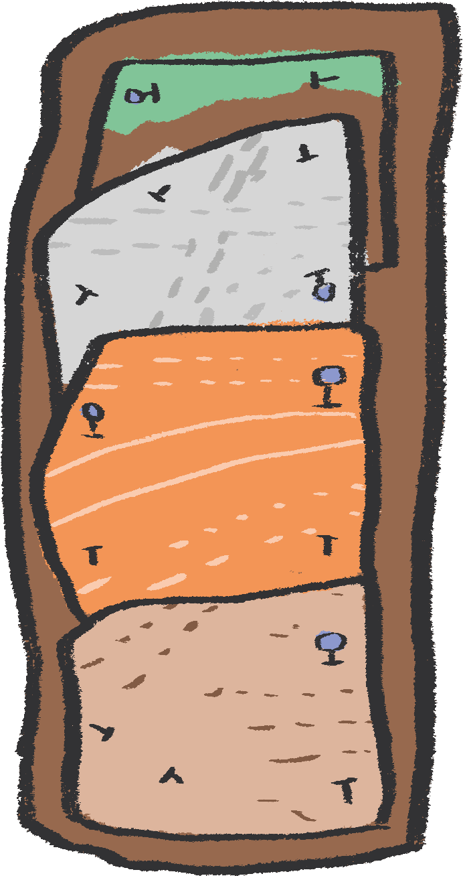
continued…
Once you have sketched your design, sketch it out onto your thicker backing fabric.
Choose some different fabrics to represent the different layers or rock types you have drawn.
Attach each layer to the base fabric by pinning it down with pins or a spare needle, then sew each layer on and remove the pins as you go. If you don't feel confident sewing, you can use fabric glue instead.
Once you have attached each layer of 'strata' you can begin to add detail of the different textures of your rock. You can do this by:
  sewing on patterns
  adding pieces of fabric in contrasting colours
  experimenting with different threads and stitches

Slide 16
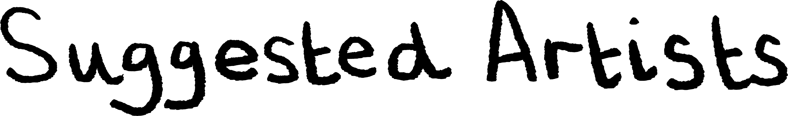
“I really like Julienne Dolphin-Wilding’s artwork 'Matrix Revealed' which is a public sculpture on display in Thetford Forest Park in Norfolk. It is a giant geological core sample showing what is deep underneath our feet.’’ Kaitlin
“What do you get when you combine geology and creativity? Take a look at Kaitlin's website and discuss her varied approaches to making art which draw on geology and science. You could take inspiration from Kaitlin’s prints and create your own series of artworks inspired by rock samples and fossils.” Gill
El Anatsui is a Ghanaian sculptor who works with recycled materials. He often creates installations using pieces of aluminium (aluminium comes from minerals found underground), which are sewn together using copper wire, to make large metal wall sculptures that look like they’re made of cloth. El Anatsui’s work often has lots of different colours, layers, shapes and textures within it.
Julienne Dolphin-Wilding
Kaitlin Ferguson
El Anatsui
Notes:
Possible Extension:
What do you get when you combine geology and creativity?
Take a look at Kaitlin's website and discuss her varied approaches taking inspiration from all things rock!
Use close examination of Kaitlin's screen prints and photography and mash these up with observations of rock samples/ fossils to inspire own prints/ drawings and painted responses.
www.kaitlinferguson.com

Slide 17

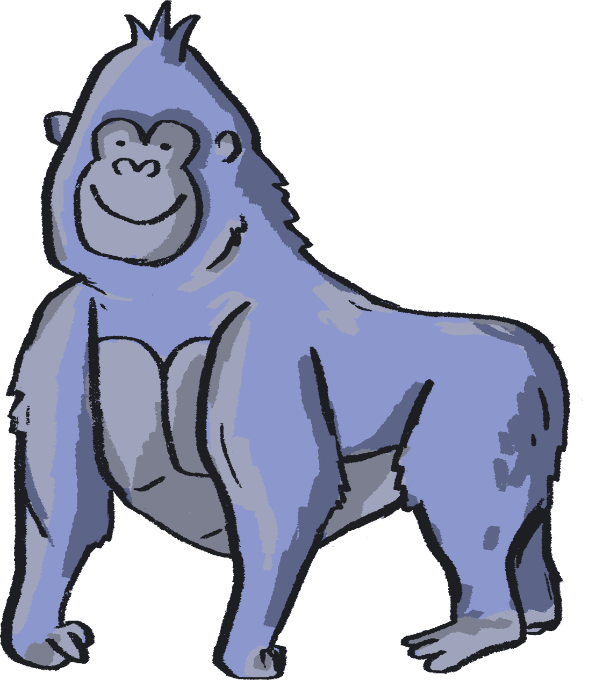

Authors:
Kaitlin Ferguson, Artist
Gill Sekatawa, Art and Design Lead, Nelson Academy
Sarah Melia, Science Lead, Nelson Academy
Illustrator:
Sophie Clouston, Creative Arts East
Commissioned and produced in 2021 by:
Barbican Creative Learning
Creative Arts East for PEACH West Norfolk
With thanks to:
Staff and students at Nelson Academy, Downham Market
Norfolk and Norwich Festival Bridge
Attribution:
You are welcome to share this resource with colleagues and adapt it as you see fit. Please note that if you do so, the following credit line must be used:
Taken from Teacher Lab: Teaching Primary Science through Creativity, written by Kaitlin Ferguson, Gill Sekatawa and Sarah Melia. Illustrations by Sophie Clouston. Commissioned by Barbican Creative Learning and Creative Arts East. With support from the Esmée Fairbairn Foundation and Nelson Academy, Downham Market. Teacher Lab is a Barbican Creative Learning programme

Slide 18

Below are some links to more resources for supporting creativity in learners:
https://www.researchgate.net/publication/305218451_A_Five_Dimensional_Model_of_Creativity_and_its_Assessment_in_Schools
https://www.thomastallisschool.com/tallis-habits.html
https://nnfestival.org.uk/festival-bridge/schools-education/resource-bank/
https://www.groundworkgallery.com/exhibitions-about-environment/virtual-tour/

